Slide 1
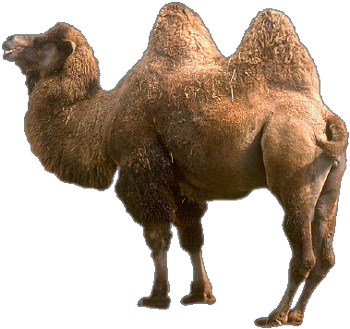
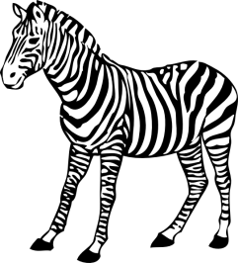
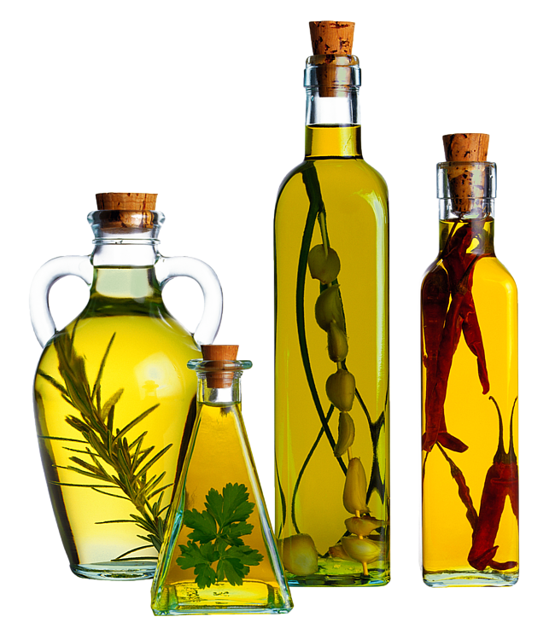
National cuisine.
Manakova Svetlana
11-А

Slide 2
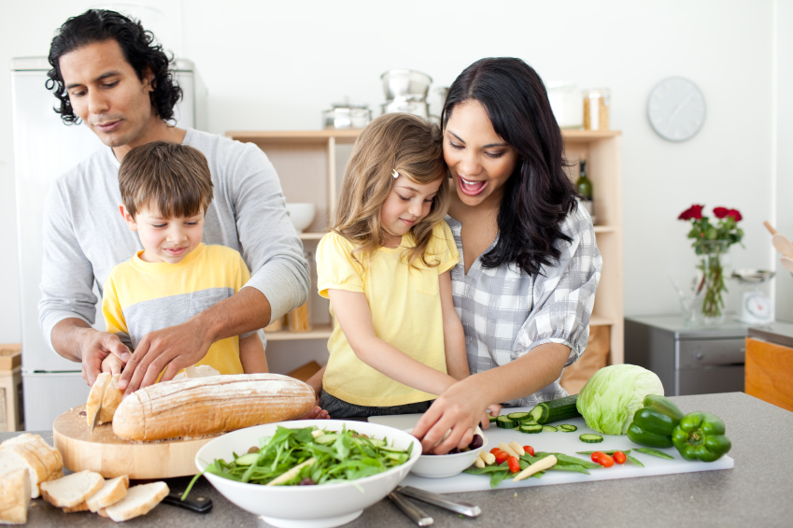
From generation to generation handed people cooking experience. They kept all the traditions associated with food, knowing that the food - the basis of life, health and well-being.

Slide 3
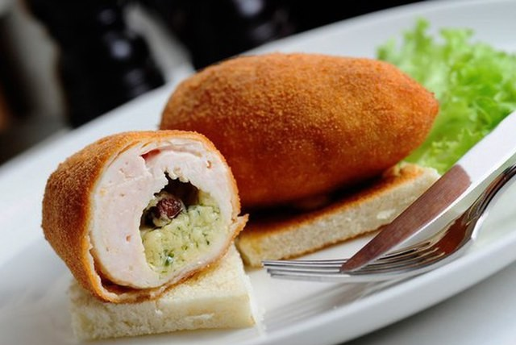
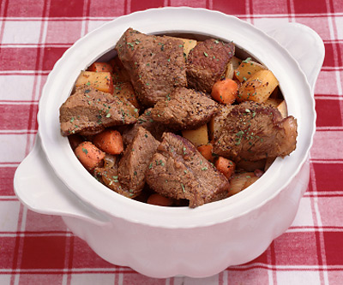
Ukrainian cuisine
Ukrainian cuisine is widely known among the Slavic cuisines.
She long has spread far beyond the borders of Ukraine, and some Ukrainian dishes such as borscht and dumplings, included in the menu of international cuisine.

Slide 4
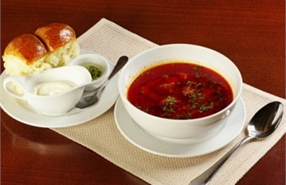
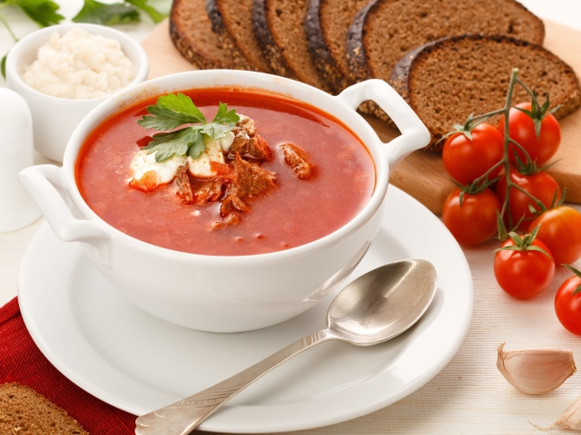
One of the most characteristic of the Ukrainian national cuisine dishes, a symbol of national cuisine was and remains borscht. The most widely used of beet borscht and cabbage, as well as with sorrel, nettles and other herbs.

Slide 5
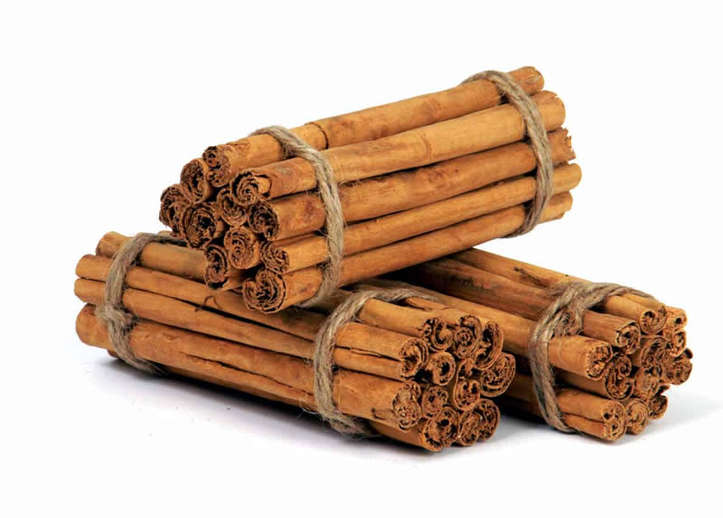
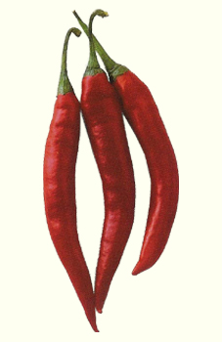
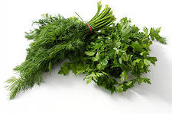
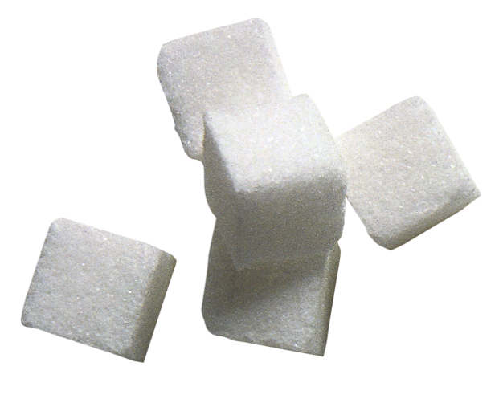
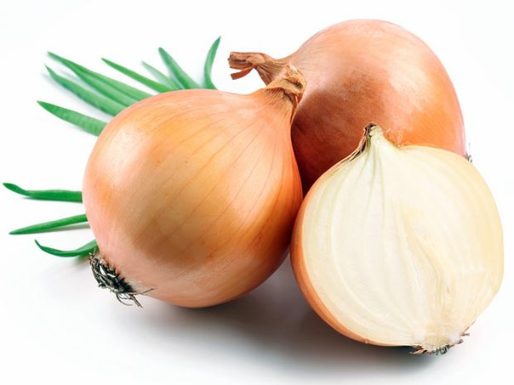
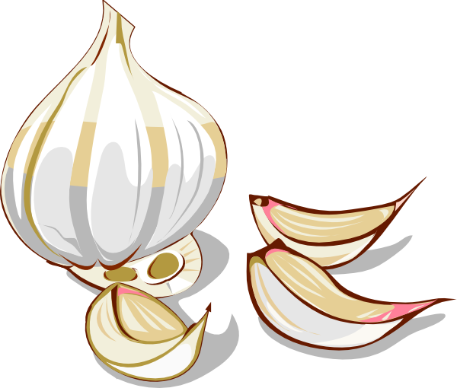
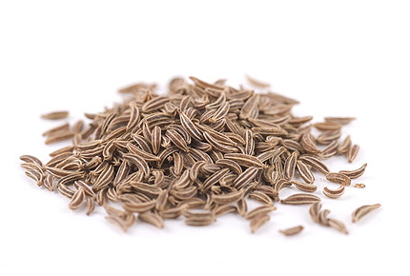
In the Ukrainian national cuisine spicy seasonings are very common, most of which have used pepper, horseradish, garlic, onion, cumin, red pepper.

Slide 6
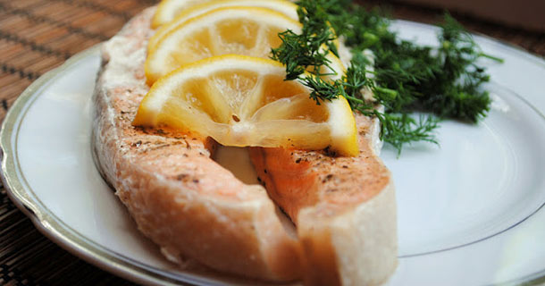
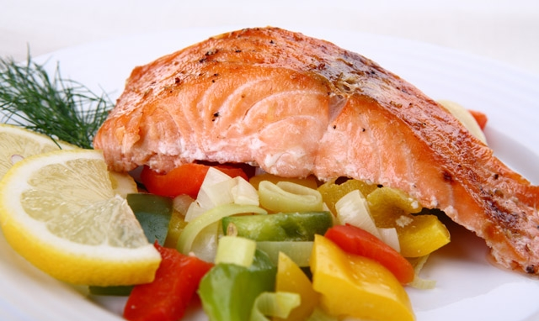
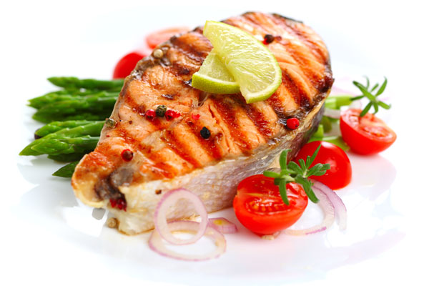
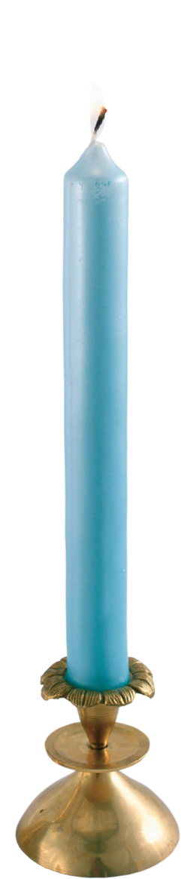
Significant place in the Ukrainian national cuisine take meals of fish: carp, baked in sour cream; carp stuffed with mushrooms and buckwheat, carp stewed with onions or sour cream.

Slide 7
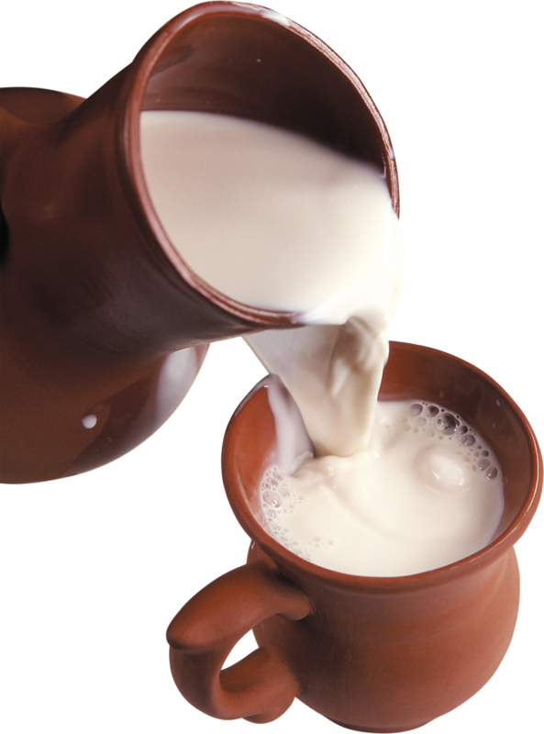
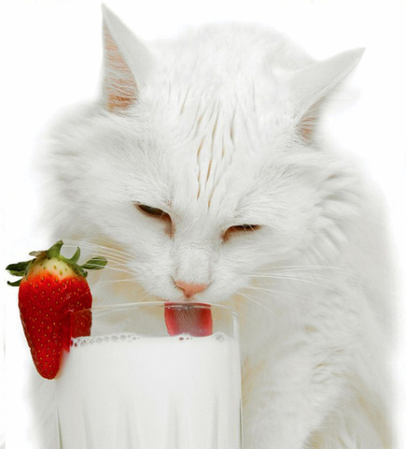
Particularly prevalent in the Ukrainian national cuisine got dairy dishes: fresh, tart, baked milk, cheese.

Slide 8
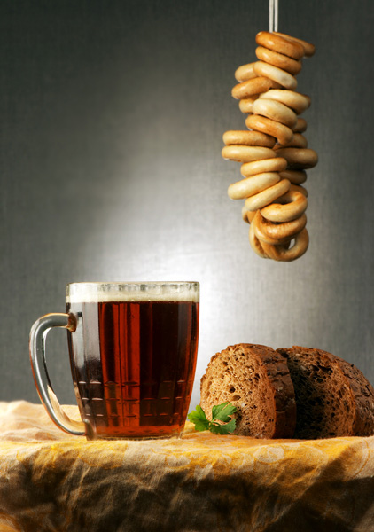
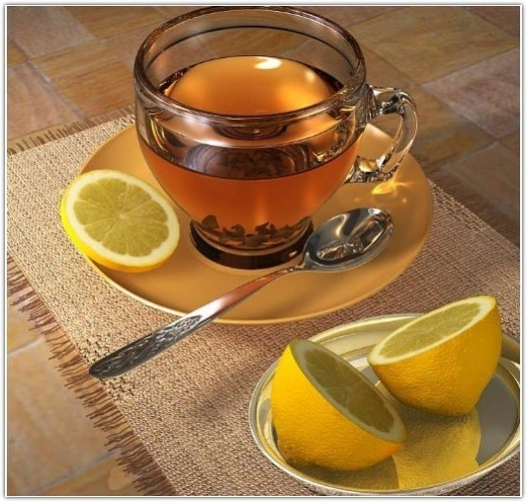
Drinks.
Among the ancient Ukrainian drinks - produced by the process of natural fermentation mead, beer, kvass, Uzvar.

Slide 9
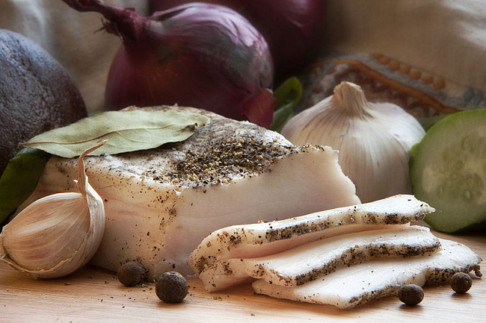
Typical dishes.
• Salo

Slide 10
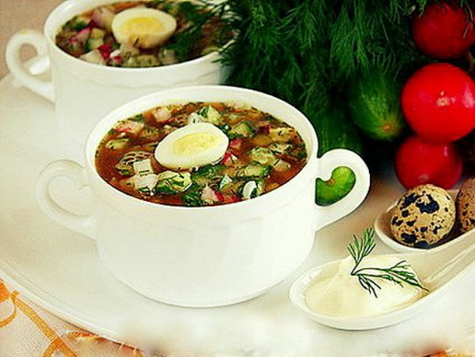
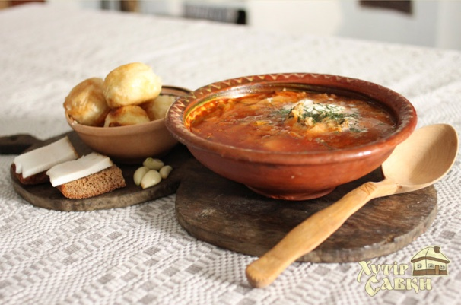
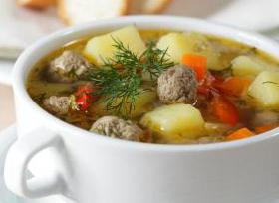
Soups:
• Borscht
• Green borsch
• hot soup
• Friedge

Slide 11
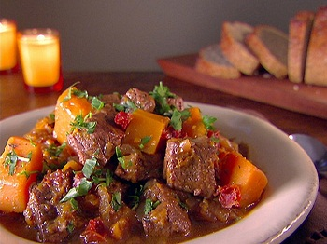
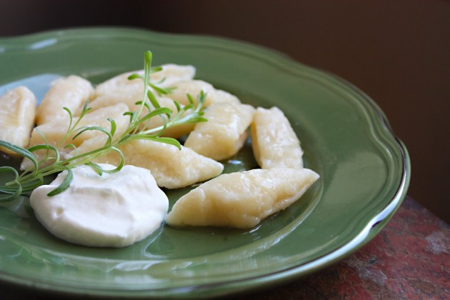
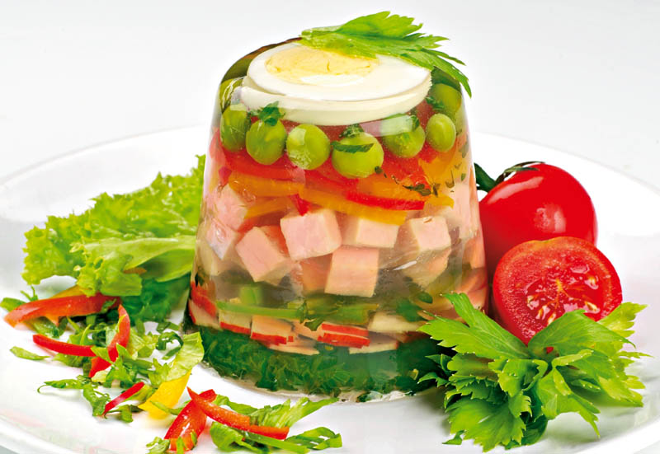
Second course:
• Dumplings
• Galushki
• Roast
• Jellied

Slide 12
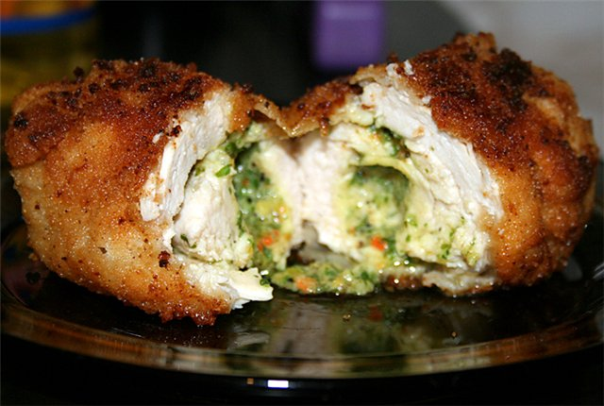
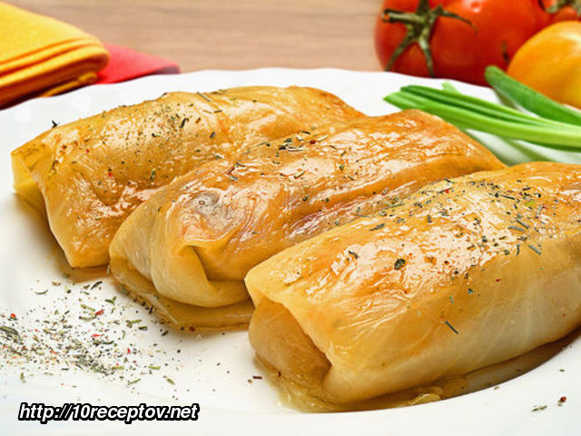
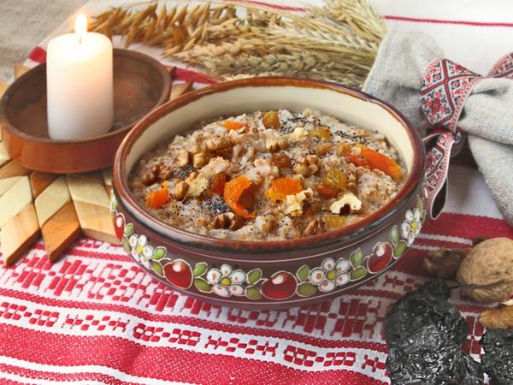
• Cabbage Rolls
• Kiev Cutlet
• Kutia

Slide 13
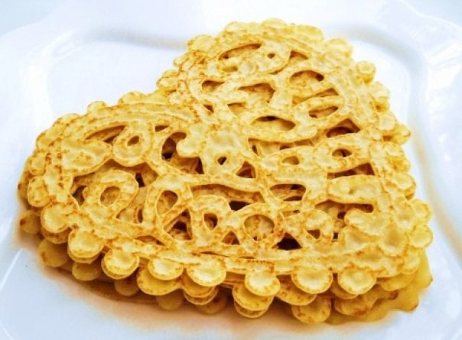
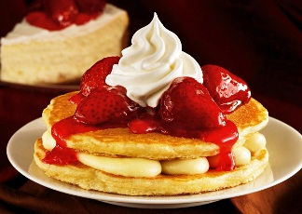
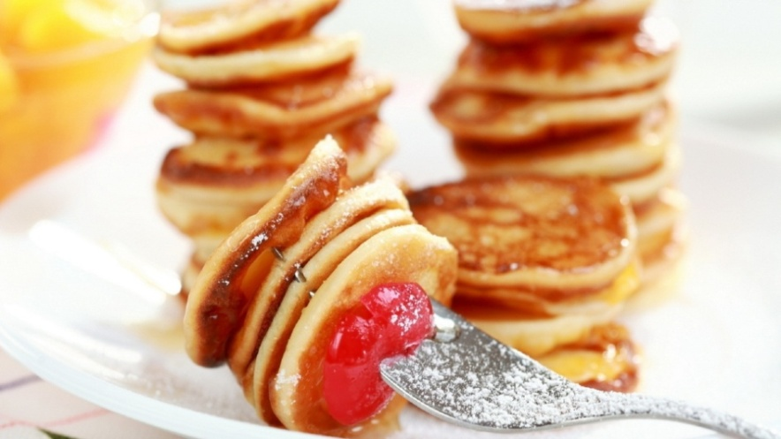
Different kinds of pancakes and fritters:
• Grechanik
• Mlyntsi
• Pancakes
• Oladiki

Slide 14
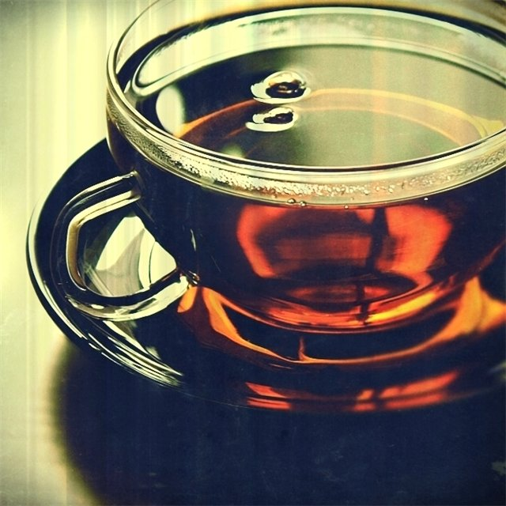
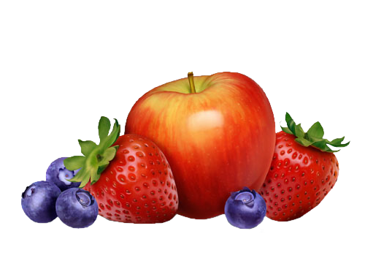
Ukrainian cuisine is varied, tasty and extremely unusual. Ukrainians as true lovers of delicious food, made ​​a huge contribution to world cuisine.

Slide 15
Game

Slide 16
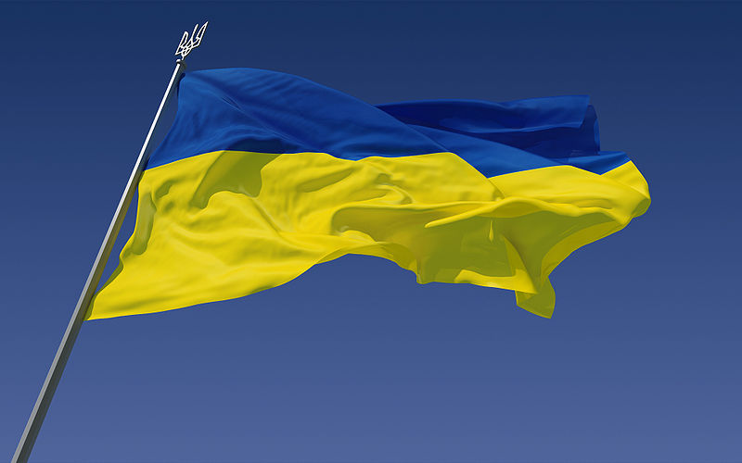
You need to choose a picture which belongs to Ukraine.

Slide 17
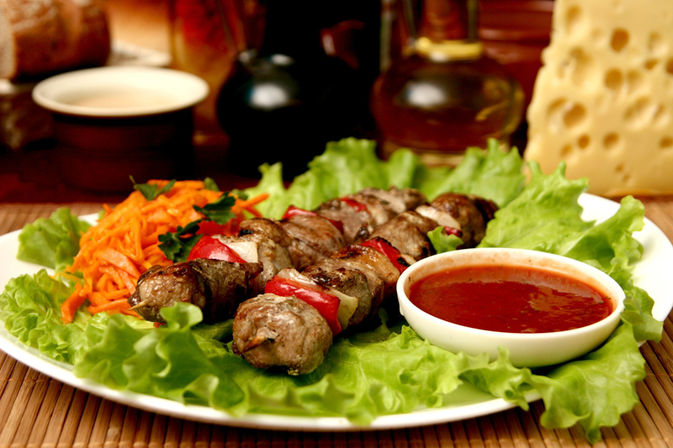
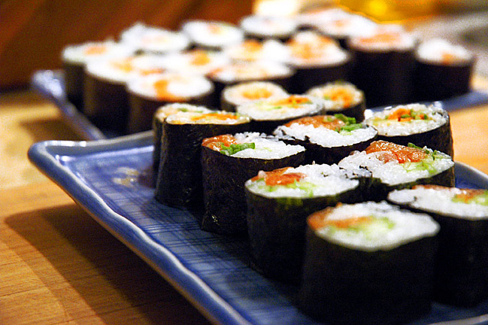
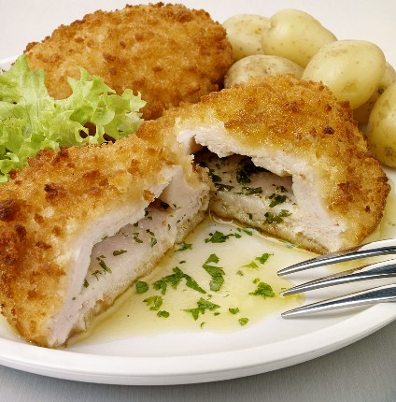
1
1 - kebab. 2 - sushi. 3 - Kiev Cutlet.
2
3

Slide 18
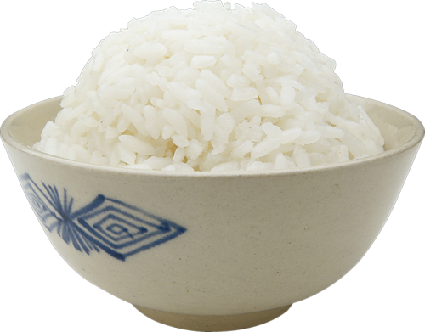
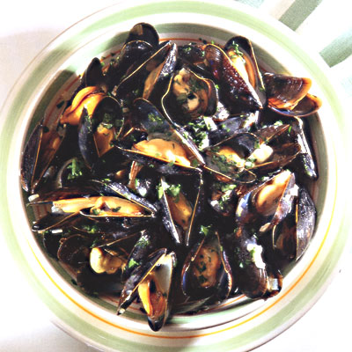
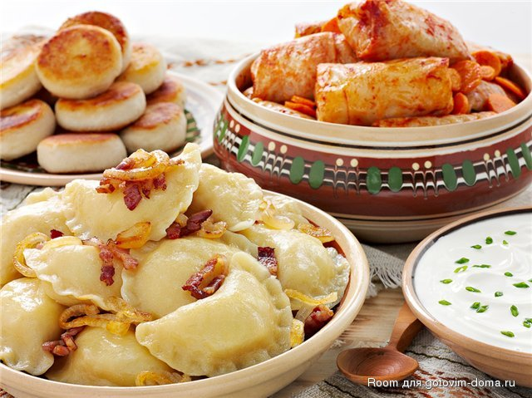
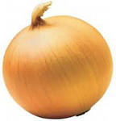
1
3
1 – rice. 2 - Cabbage Rolls . 3 - mussels.
2

Slide 19
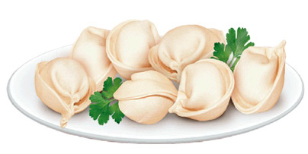
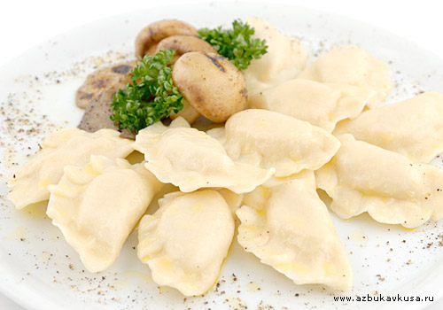
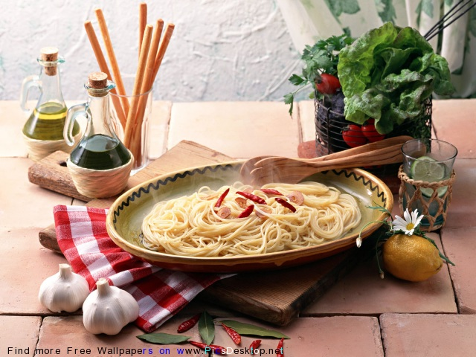
2
1 - vareniki. 2 - dumplings. 3 - pasta.
1
3

Slide 20
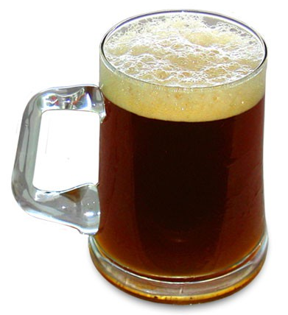
1 – kvass.
2 – pepsi.
3 – whiskey.

Slide 21
Thank you.

