Slide 1
Baroque in the world and in Ukraine
By Taras Shevchenko
m. II-25

Slide 2
What is Baroque?
The word baroque is derived from the Portuguese word "barroco", Spanish "barroco", or French "baroque", all of which refer to a “pearl of irregular shape”
The founder of the Baroque in Italy was Michelangelo Buonarroti

Slide 3
General characteristics
Excellency
Splendor
Brightness of color
Contrast
Asymmetry of structures

Slide 4
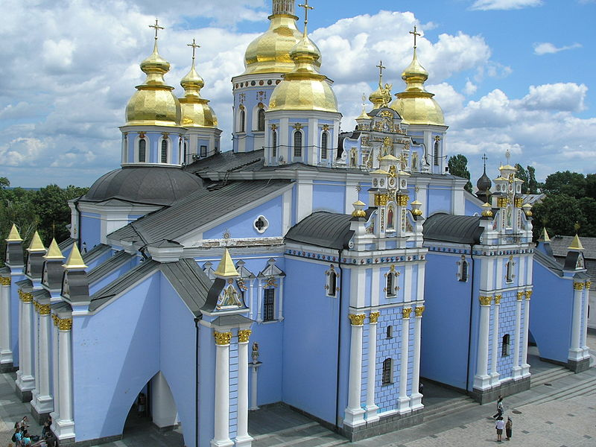
St. Michael's Cathedral

Slide 5
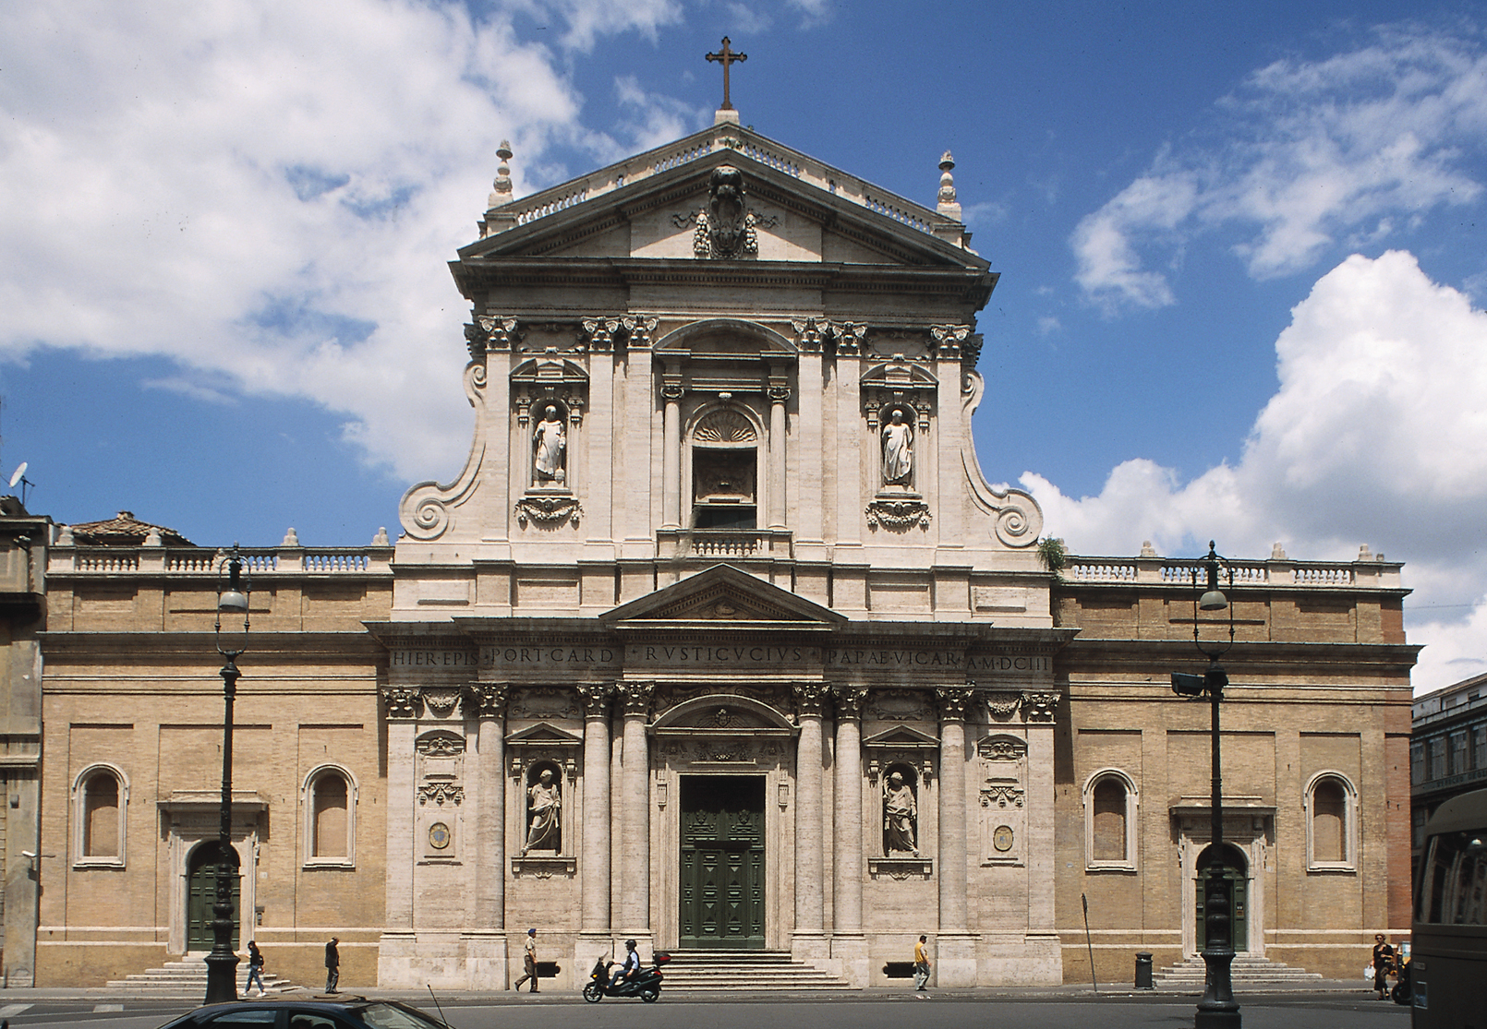
Santa Susanna (Rome)

Slide 6
Baroque in the literature
Writers and poets in the Baroque era perceive the real world as an illusion and a dream. Realistic descriptions often combined with their allegorical image. It is widely used in this age symbols, metaphors, theater techniques, graphics, antithesis, parallelism, graduation oxymoron.

Slide 7
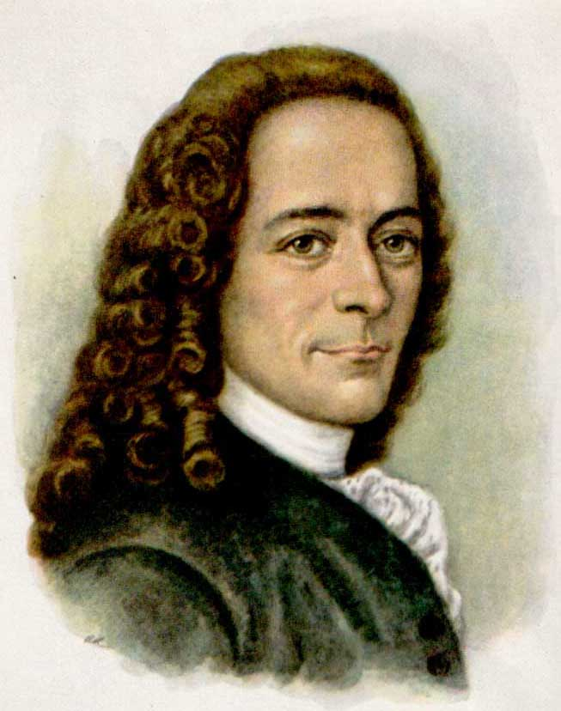
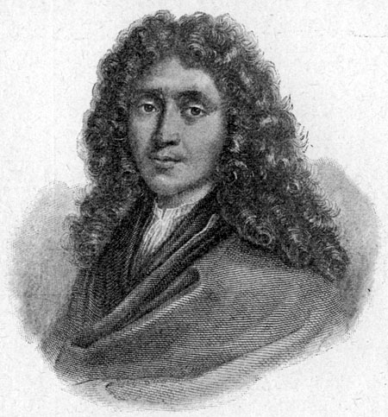
Representatives of the literary Baroque
Voltaire
Moliere

Slide 8
Baroque in Ukraine
Ukrainian baroque architectural style as in Ukraine began to emerge in the 17th century. Baroque in Ukrainian lands represented in most church architecture, much less in the engraving and painting. Architecture played a dominant role and left the largest number of specific examples of the style in different regions.

Slide 9
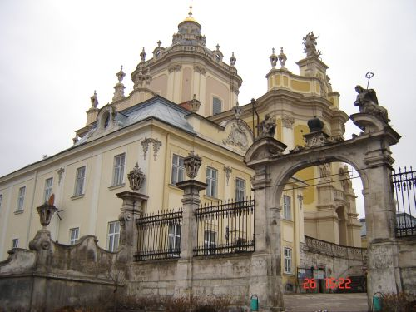
St. Yurii cathedral in Lviv

Slide 10
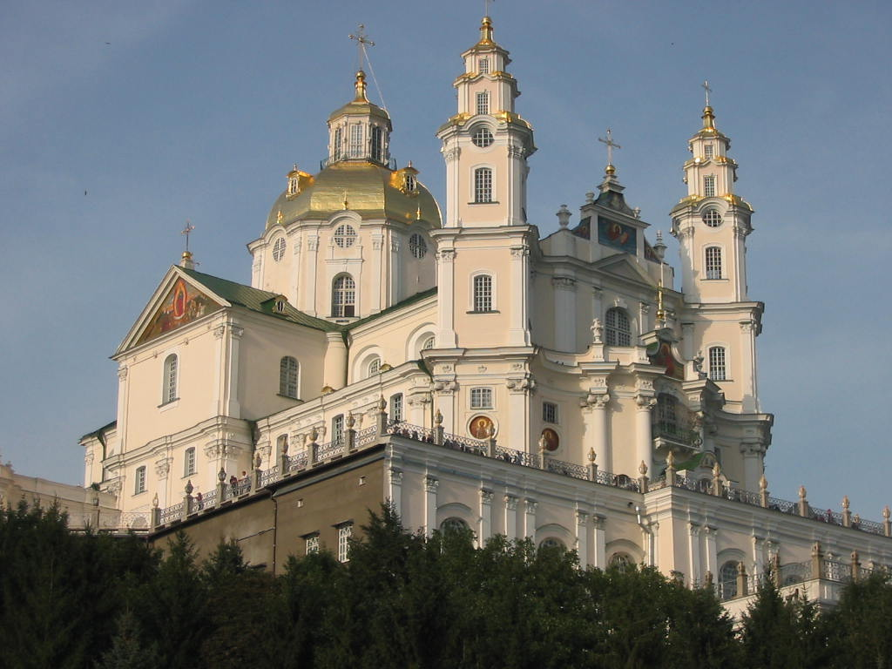
Pochaevskaya lavra

Slide 11
Conclusions
Baroque in Ukraine is inspired the typical elements and local color that distinguishes it from the Baroque world. You should also understand the "Baroque in Ukraine" and "Ukrainian Baroque."
Baroque in Ukraine - is made sights to order foreigners.
Ukrainian Baroque or Cossack Baroque - emerged as a result of a combination of local architectural traditions and European baroque.

Slide 12
Thanks for your attention!

