Slide 1
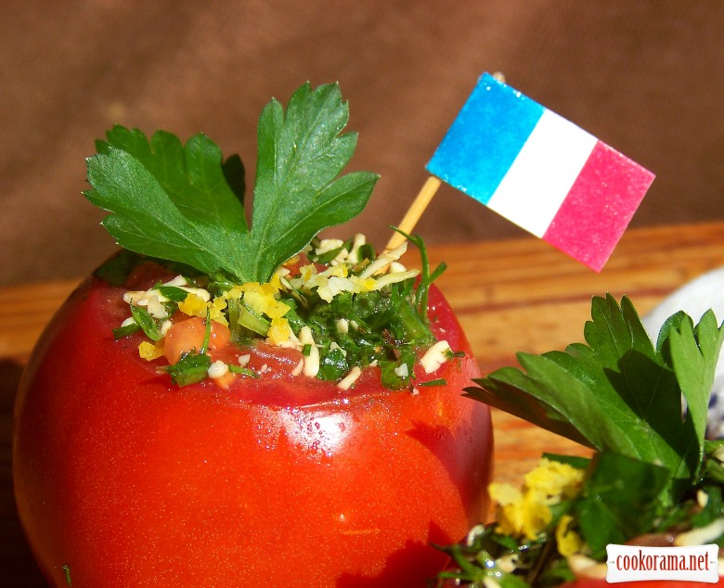
French cuisine
Menu

Slide 2
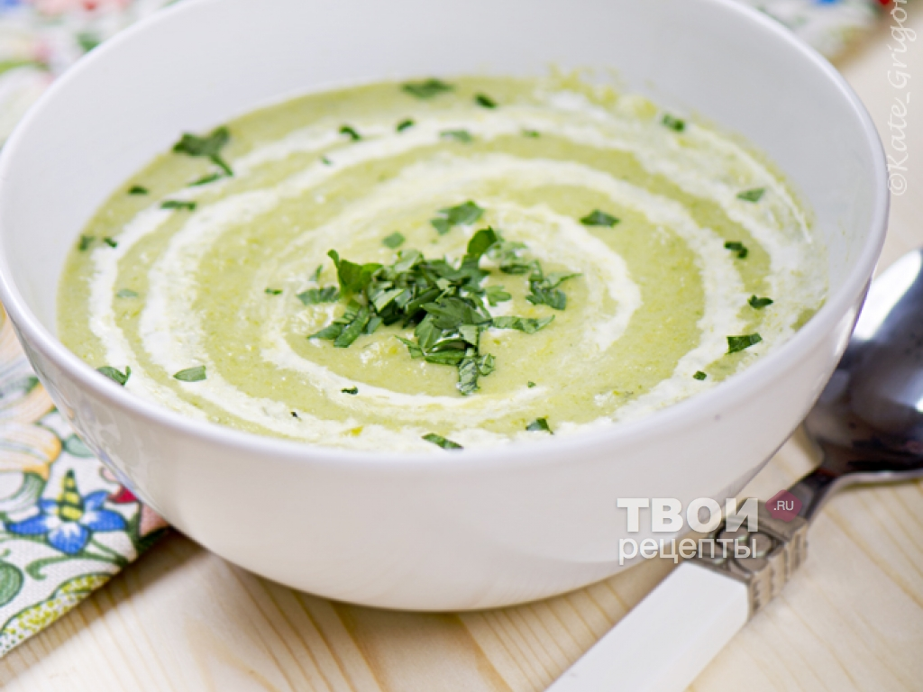
Soups
Soup with leeks
(leek, potatoes, carrots)

Slide 3
Soups
Onion soup filled with cheese
(onions, potatoes, beef or chicken broth, grated cheese)

Slide 4
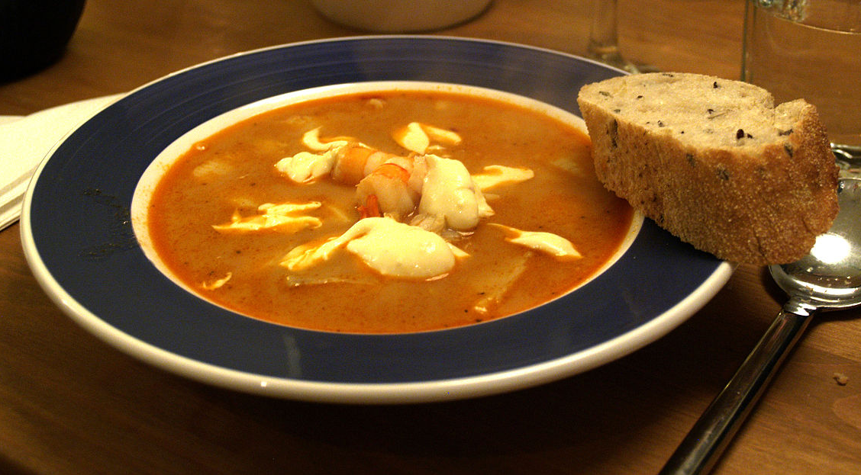
Soups
Fish soup bouillabaisse
(Fish, seafood, tomato, dry white wine, orange zest, spices)

Slide 5
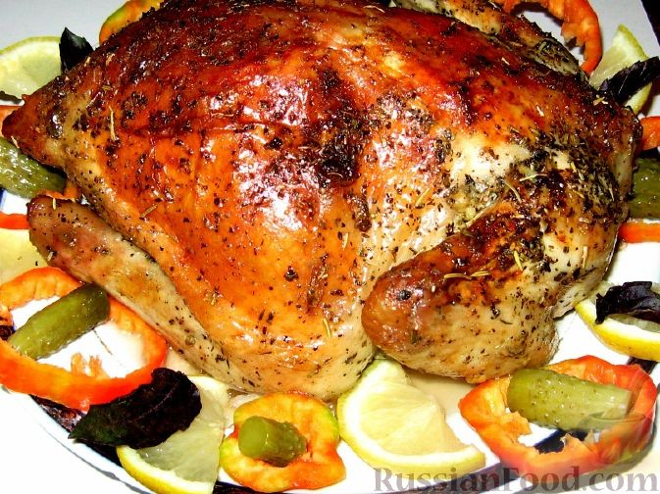
Meal and fish
Chicken baked with provencal herbs and garlic
(chicken, sour cream, garlic, herbs, salt, pepper)

Slide 6
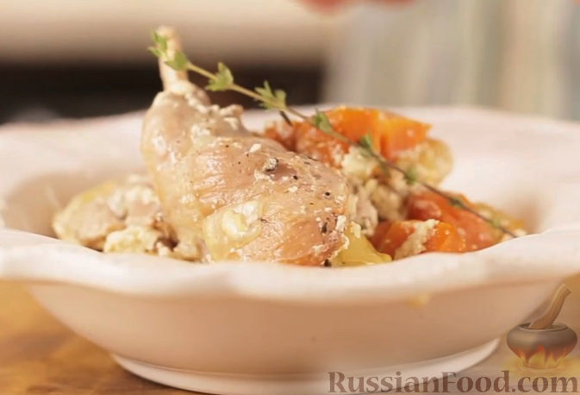
Meal and fish
Rabbit, baked in cream with vegetables
(rabbit, celery, carrots, leeks, cream, dry white wine, thyme)

Slide 7
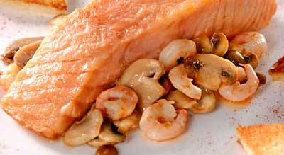
Meal and fish
Trout with shrimp
(trout, shrimp, peeled, mushrooms, juice, loaf)

Slide 8
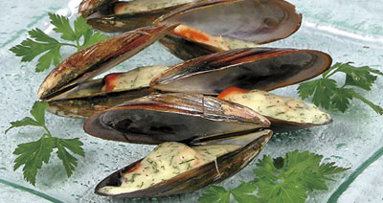
Meal and fish
Mussels with Bechamel
(mussels dry white wine garlic lime juice milk)

Slide 9
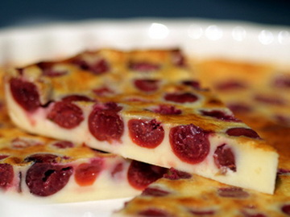
Deserts
Cherry Pie Clafoutis
(sugar, pinch of salt, eggs, milk, cherries, powdered sugar for decoration)

Slide 10
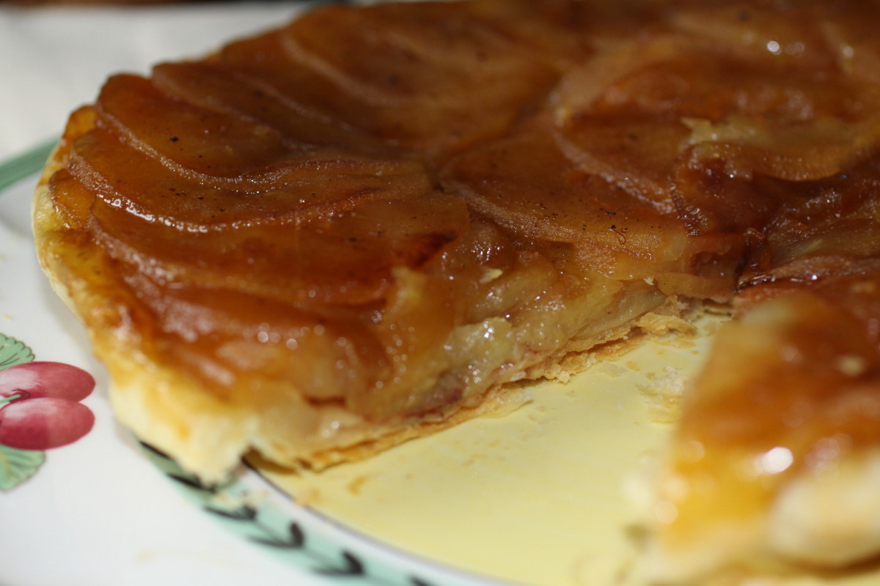
Deserts
Tarte Tatin
(apples, butter, ground cinnamon, sugar, lemon juice, Calvados, cold butter, egg yolk)

Slide 11
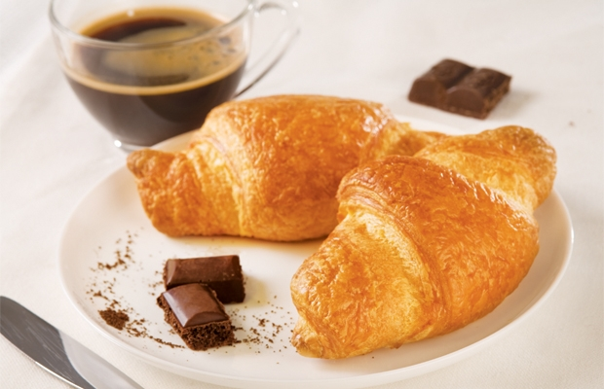
Recept of a week
Croissant

Slide 12
Recept of a week
You will need: 225 g of finished puff pastry 170g of cheese, 4 slices of ham.
Preheat oven to 220 degrees. Roll out the dough into the formation of 0.5-0.8 cm thick, powdered with flour a work surface, cut the layer into 4 triangles. Incise the base of the triangle in the middle, 1-2 cm and put on him the stripes of cheese and ham, roll in the direction from the base to the acute angle, corner tucked down, as the product can be developed. Edge croissants slightly stretch and bend to form crescents rolls purchased. Bake 15 minutes in preheated oven.

Slide 13
Recept of a week
In the same manner may be prepared croissants with any filling. But there is another option - the croissants are baked without filling, then finished products cut in half lengthwise, spread the filling on the bottom of croissants in the oven for 2-5 minutes warm up and serve, covering the upper halves of buns.

