Slide 1
Spanish cuisine
Spanish cuisine consists of a variety of dishes, which stem from differences in geography, culture and climate. It is heavily influenced by seafood available from the waters that surround the country, and reflects the country's maritime roots. It is a Mediterranean diet.

Slide 2
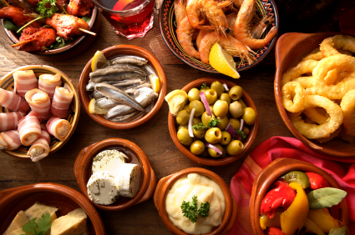
Typical dishes

Slide 3
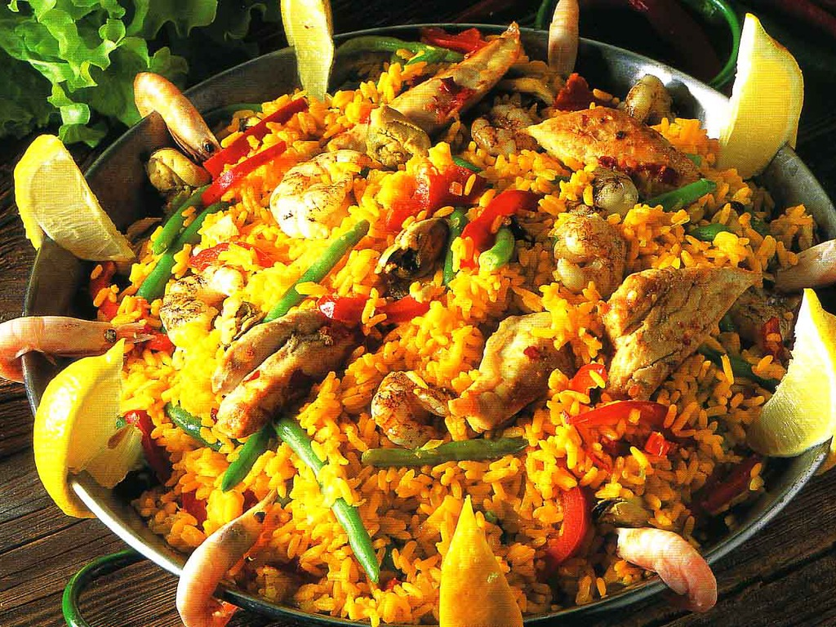
Paella
Paella is a traditional Spanish dish from Valencia. It is a rice dish that can have meat, fish, seafood, and vegetables and is characterized by its use of saffron to give it a yellow color and unique flavor. There are three main types of paella:
Valencian paella/paella valenciana: rice, green vegetables, rabbit, chicken, or duck, snails, beans, and seasoning.
Seafood paella/paella de marisco: rice, seafood, and seasoning.
Mixed paella/paella mixta: combination of seafood, meat, vegetables, beans, and seasoning.

Slide 4
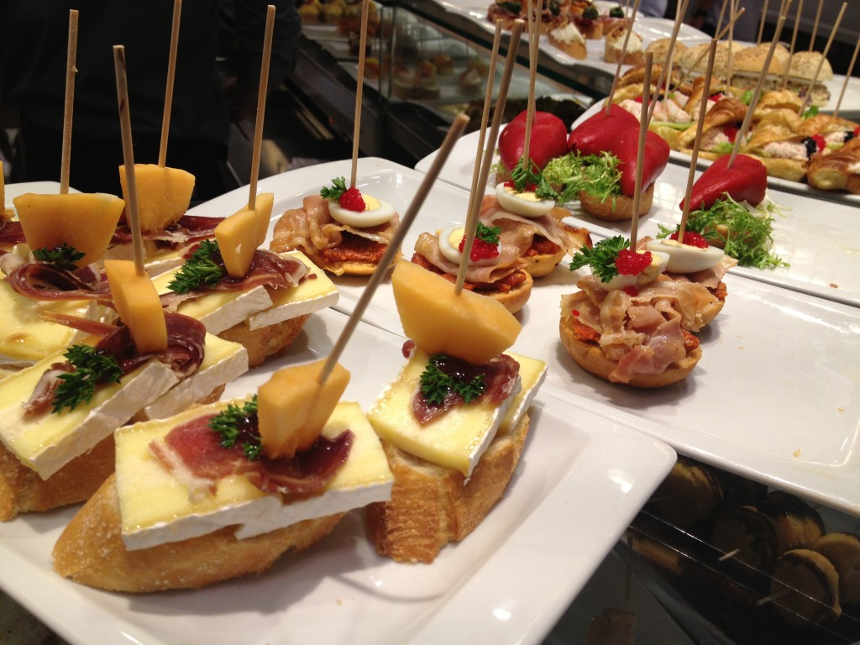
Tapas
Tapas is a great Spanish food tradition composed of small dishes of different types of food, like appetizers or snacks. The dishes may be cold (jamón serrano, queso manchego, olives, etc.) or warm (tortilla española, meatballs, etc.) and can be served as bar food or as complete meals. It’s a great opportunity to taste a whole variety of flavors and dishes, so if you are ever in Spain make sure to order tapas and experience what the country has to offer!

Slide 5
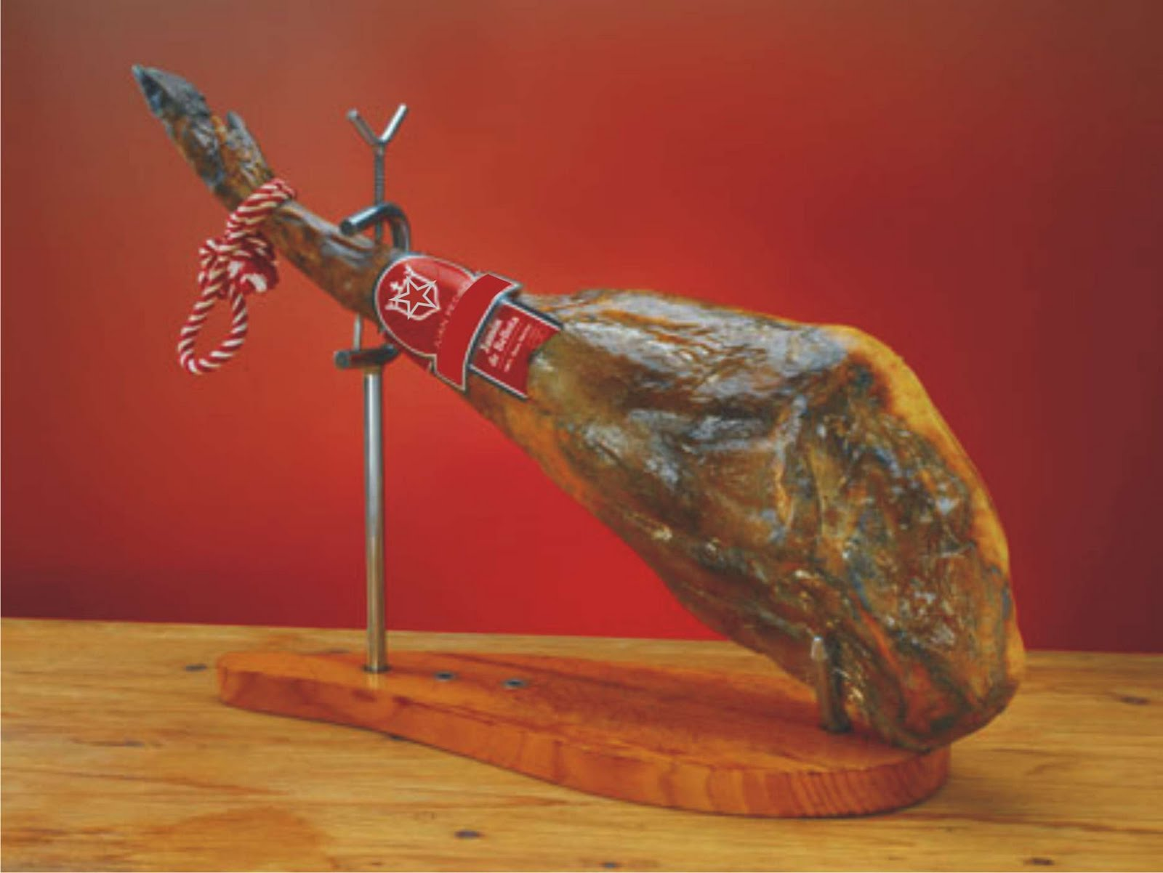
Jamon Serrano/Iberico
Jamón serrano and jamón ibérico are dry-cured Spanish hams that are served in thin slices and are a typical Spanish food. Jamón serrano is named after the custom of drying the salted and cured ham in a shed high on the mountain (sierra in Spanish, or serrano when used to classify the ham). While jamón serrano is typically made from the Landrace white pig, jamón ibérico, which is much more expensive, is made from black Iberian pigs, and often called jamón de pata negra (black hoof). Despite their differences, both jamones are deliciously salty and savory examples of Spanish cuisine!

Slide 6
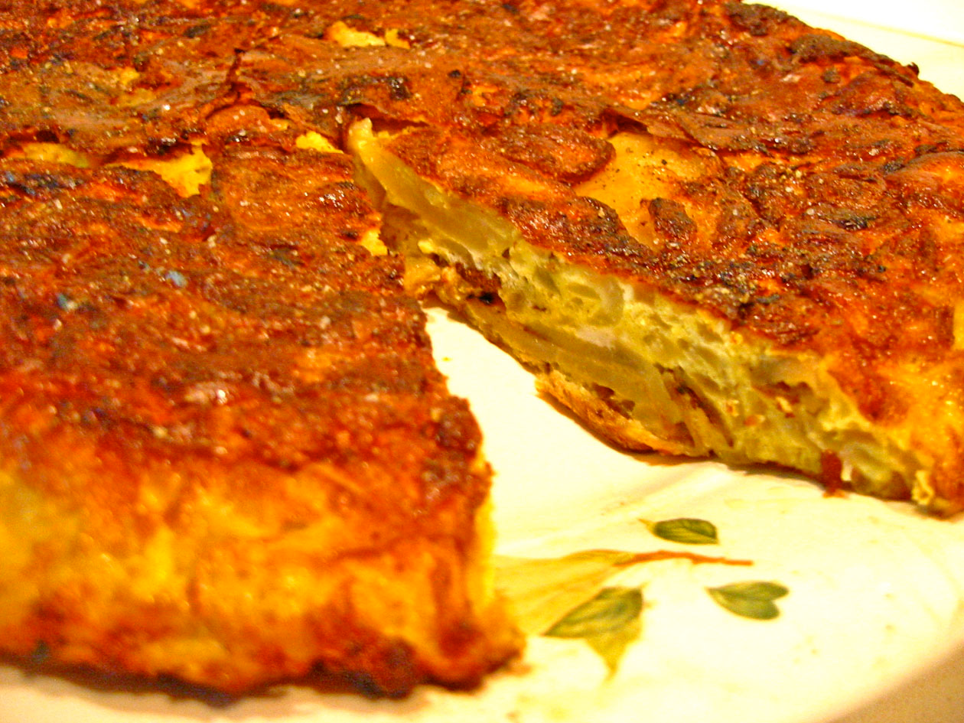
Tortilla Española
Another great typical Spanish food is the tortilla española. The tortilla is an omelette-like potato dish, fried in olive oil, and served as a tapa. It is a filling and flavorful dish (with the addition of chopped onions) and can be served in slices, warm or cold.

