Slide 1
Business etiquette in Finland
Attitudes and values form the basis of any culture reflecting the ways people think and behave. Knowledge of these can therefore be of significant importance in communicating effectively with your counterparts. Ignorance of these issues can result in a cultural barrier that may inhibit the communication process, and have a negative effect on the success of your activities.

Slide 2
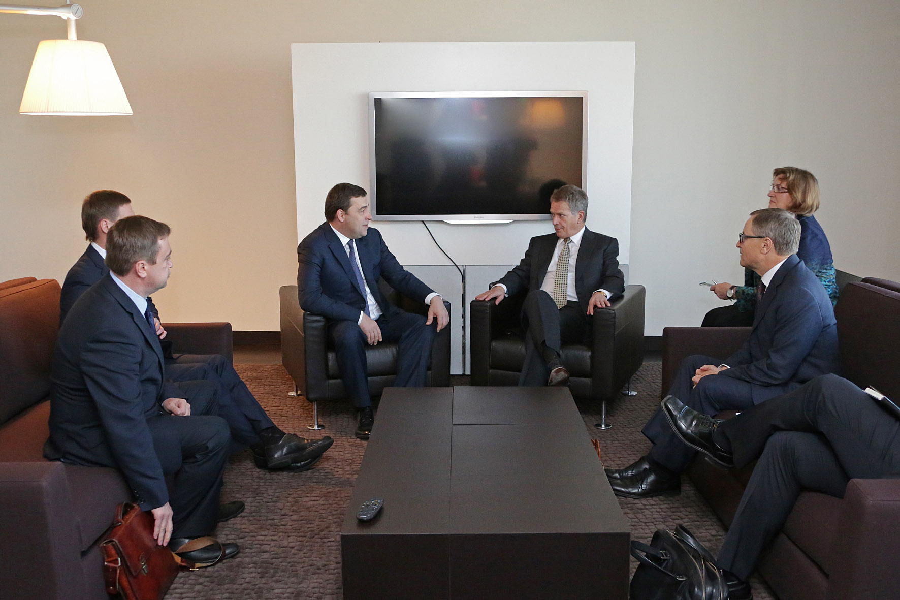
Finns are considered modest, honest and reliable. They place great value on words and mean what they say. “Take a bull by its horns and a man by his word” is an old Finnish saying. A Finn’s ‘yes’ is a ‘yes’ and a ‘no’ is never a ‘perhaps’. Finnish frankness may seem a bit daunting but their way of communicating is upfront and uncomplicated, which is rather refreshing.

Slide 3
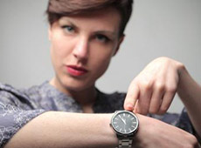
In business meetings Finns take punctuality very seriously and expect you to do likewise; call to explain if you will be more than five minutes late.
The main values of Finns are as follows: modesty, working at a measured pace, honesty, reliability, a respect for traditions and customs, strength, silence, democracy, independence, resourcefulness, bravery, diligence, sensitivity and cleanliness.

Slide 4
Finns endavour to make productive use of their time. They follow timetables and other plans faithfully and expect the same of others. Being late is considered very rude. This pertains both to business and social occasions. If you are running more than five minutes late for a meeting or a dinner, you should call ahead and apologize.
Meetings are expected to start and end at the agreed. Finns are also well prepared for meetings so much of the work is done in advance. Although Finns are careful with the groundwork, they still often make decisions quickly. They are known for not asking many questions should be prepared to give such an extensive presentation that and so you there will be no need for complementary questions. This also makes time management easier.

Slide 5
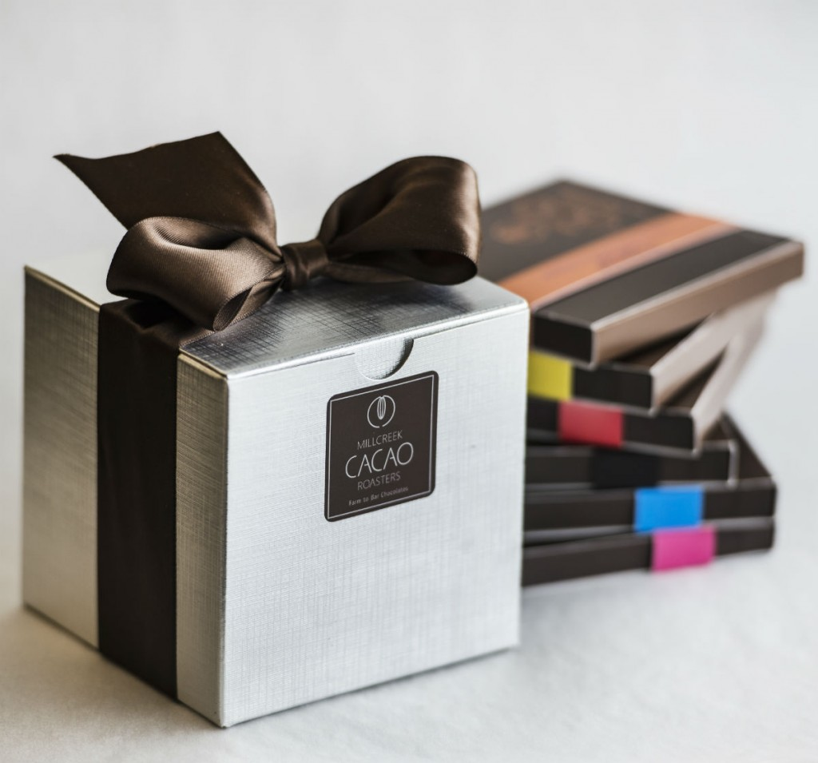
When invited to a private home, it’s polite to bring a small gift with you. Some safe options for gifts are chocolates, wine and flowers but avoid giving white and yellow flowers as they are common at funerals and as potted plants.
In business meetings it is uncommon to exchange gifts. However after successful negotiations it is acceptable to give small gifts, such as glass, books, local gifts or liquor. When giving gifts you should be careful to make sure that these are not too valuable so that they cannot be interpreted as bribes.

Slide 6
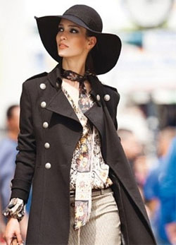
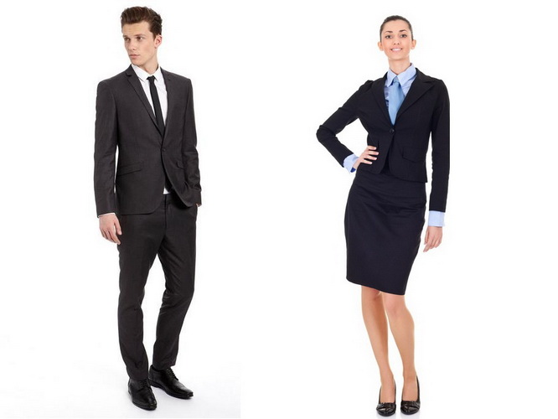
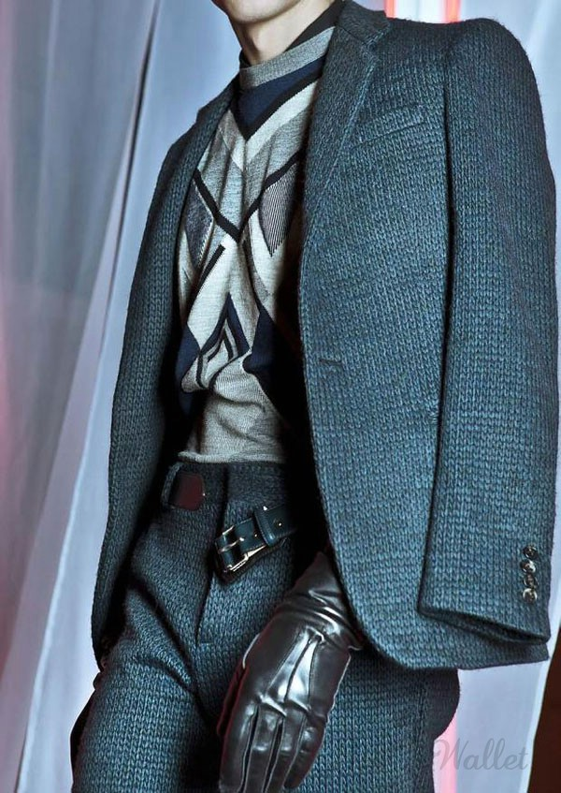
Business attire is stylish and conservative in Finland. Men should wear business suits and women should choose skirt suits, trouser suits, or dresses. For dinner, dress formally if no other dress code is given.
The temperatures also vary considerably between the north and south. For example a 20-30 degree variation in the temperature between southern and northern Finland at the same point in time is not unusual. It is advisable to take some waterproof clothing with you throughout the year. In order to keep your feet dry, you should take additional outdoor footwear with you. It is quite common for women to change their outdoor shoes to something more elegant once inside.

