Slide 1
National Portrait Gallery

Slide 2
The National Portrait Gallery is an art gallery in London, England, housing a collection of portraits of historically important and famous British people. It was the first portrait gallery in the world when it opened in 1856.
The gallery moved in 1896 to its current site at St Martin's Place, off Trafalgar Square, and adjoining the National Gallery. It has been expanded twice since then.
The National Portrait Gallery (NPG) also has three regional outposts at Beningbrough Hall, Bodelwyddan Castle and Montacute House. It is unconnected to the Scottish National Portrait Gallery in Edinburgh, with which its remit overlaps.
The gallery is a non-departmental public body sponsored by the Department for Culture, Media and Sport.

Slide 3
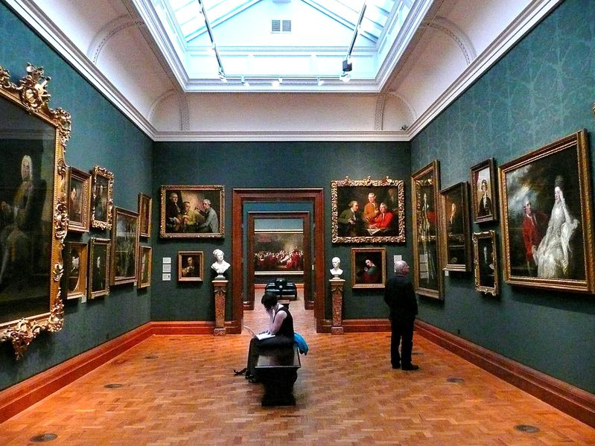
The collection
The gallery houses portraits of historically important and famous British people, selected on the basis of the significance of the sitter, not that of the artist. The collection includes photographs and caricatures as well as paintings, drawings and sculpture. One of its best-known images is the Chandos portrait, the most famous portrait of William Shakespeare although there is some uncertainty about whether the painting actually is of the playwright.
Not all of the portraits are exceptional artistically, although there are self-portraits by William Hogarth, Sir Joshua Reynolds and other British artists of note. Some, such as the group portrait of the participants in the Somerset House Conference of 1604, are important historical documents in their own right. Often, the curiosity value is greater than the artistic worth of a work, as in the case of the anamorphic portrait of Edward VI by William Scrots, Patrick Branwell Bront’s painting of his sisters Charlotte, Emily and Anne, or a sculpture of Queen Victoria and Prince Albert in medieval costume. Portraits of living figures were allowed from 1969. In addition to its permanent galleries of historical portraits, the National Portrait Gallery exhibits a rapidly changing collection of contemporary work, stages exhibitions of portrait art by individual artists and hosts the annual BP Portrait Prize competition.
Inside the National Portrait Gallery

Slide 4
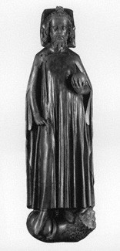
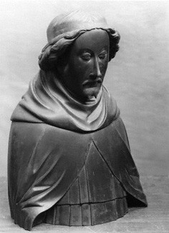
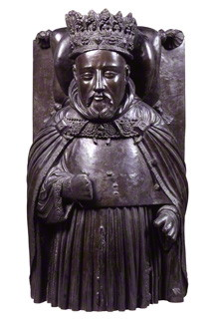
King Edward II
King Richard II
King Henry IV

Slide 5
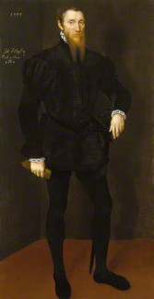
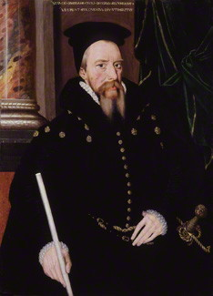
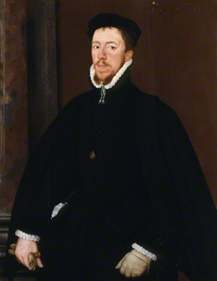
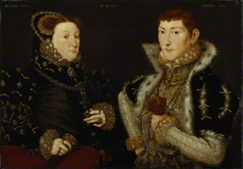
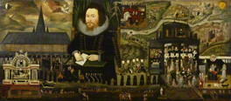
John Astley
William Cecil
Thomas Howard
Mary Nevill, Lady Dacre
Sir Henry Unton

Slide 6
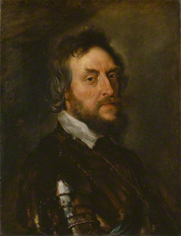
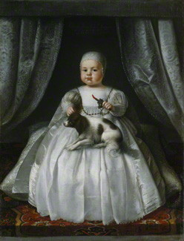
Thomas Howard
King Charles II

Slide 7
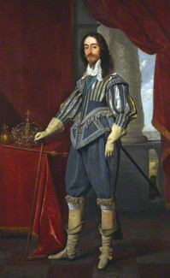
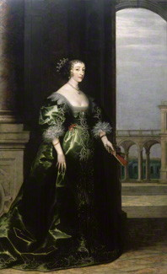
King Charles I
Henrietta Maria

Slide 8
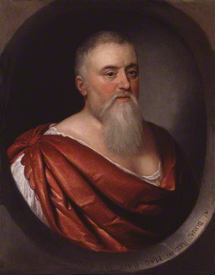
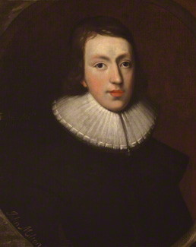
Sir Theodore Turquet de Mayerne
John Milton

Slide 9
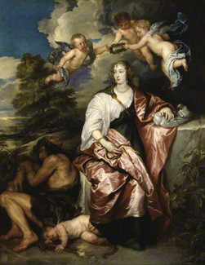
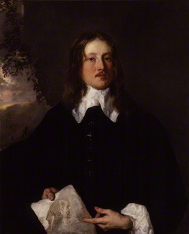
Venetia
Henry Stone

Slide 10
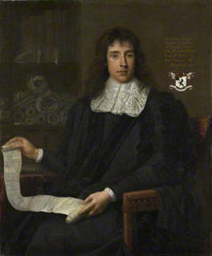
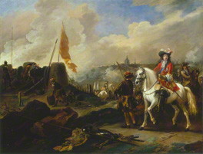
James Scott
George Jeffreys

