Slide 1
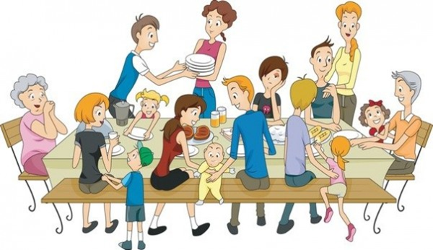
The Ideal Family

Slide 2
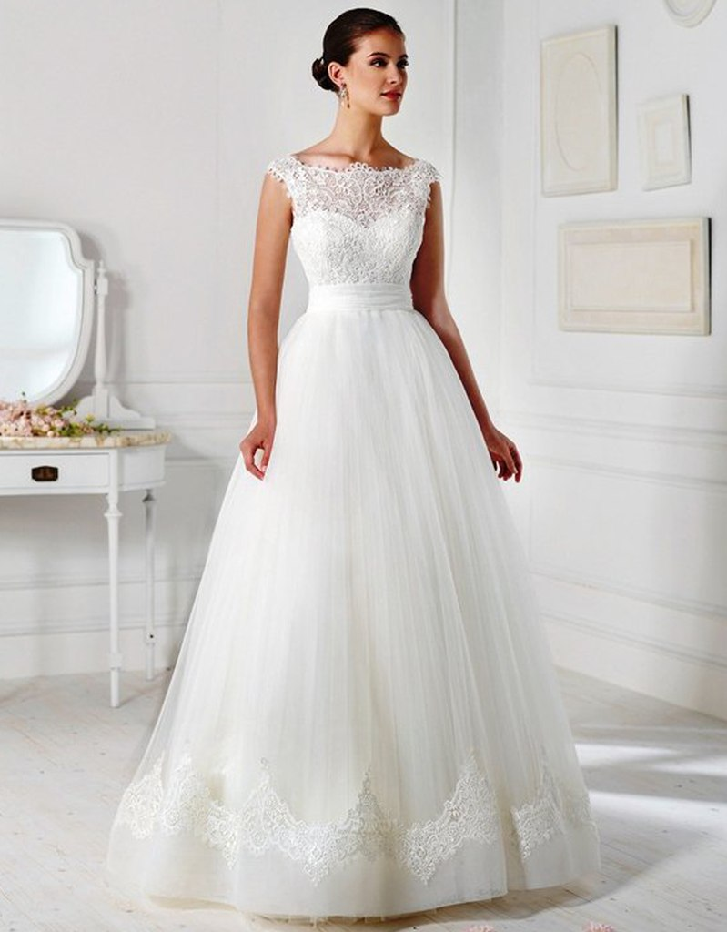
The Ideal Family
The ideal family is the place of the eternal love of parents, the eternal love of husband and wife, and the eternal love of children .

Slide 3
What do you think an ideal family is?
I think an ideal family must have love , health and work. In an ideal family , all the members are happy. They understand, love and help each other. Parents work to earn money for the family. They are responsible for their children. Children are well-educated and study well.

Slide 4
Husband and wife love each other. Husband is a breadwinner of the family. All the members of family share difficulties and responsibilities . I know that some rich family are not always happy. They often have an argument about money.

Slide 5
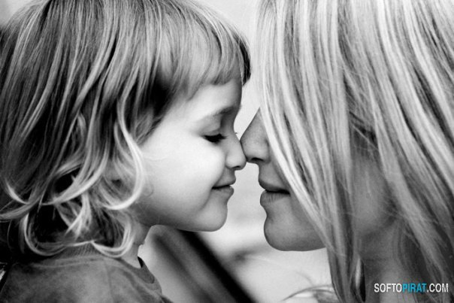
Children are spoilt due to the lack of parent’s care. They may commit crimes like drug addiction. Money is important but it can’t make a family happy. But a poor family is not an ideal one . I hope I will have a happy family in the future.

Slide 6
Thank you for your attention!

