Slide 1
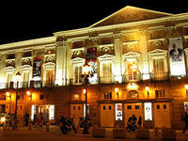
Theaters in Spain

Slide 2
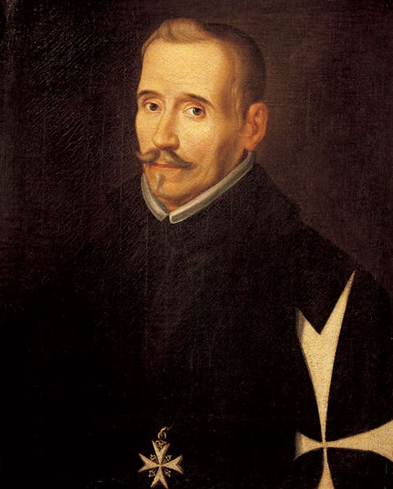
Lope de Rueda

Slide 3
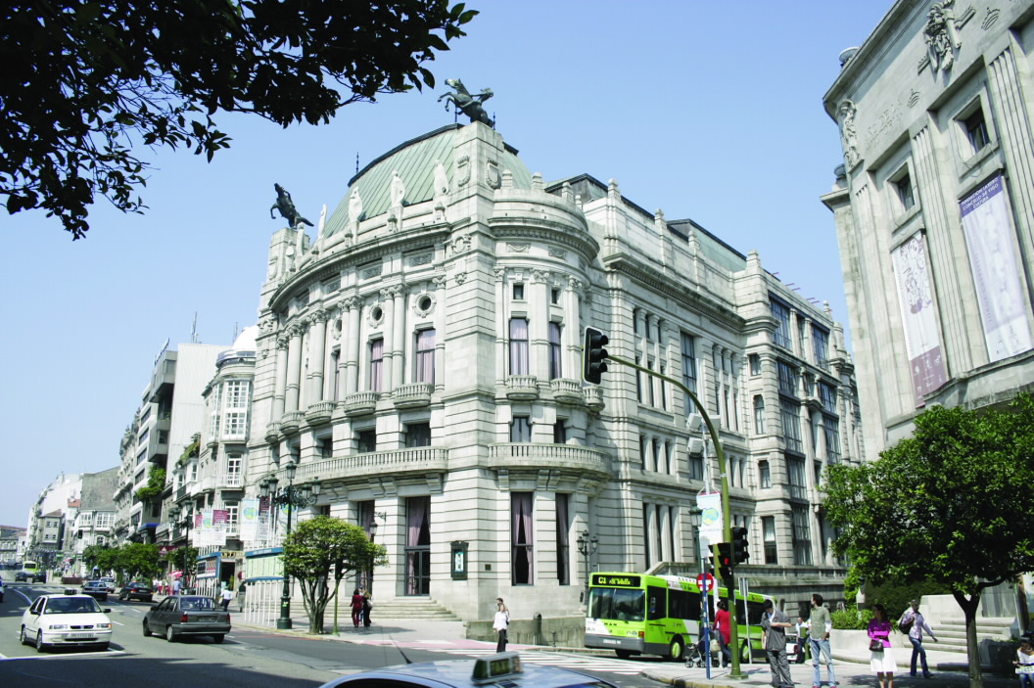
THEATRE GARCIA BARBONE

Slide 4
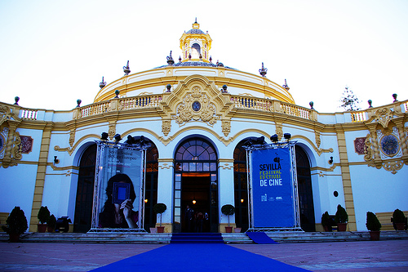
THEATRE LOPE DE VEGA

Slide 5
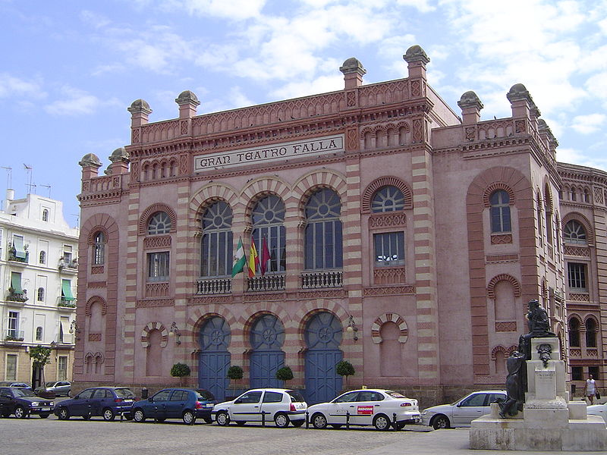
BIG THEATRE FALLA

Slide 6
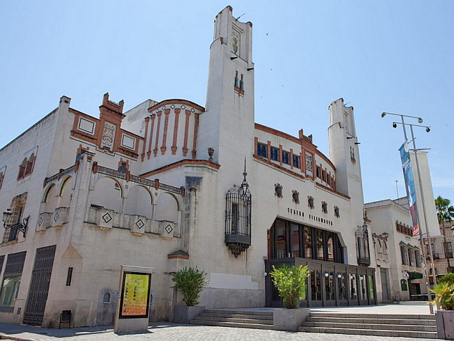
THEATRE VILYAMARTA

Slide 7
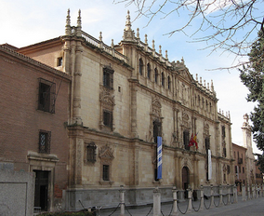
THEATRE COMEDY

Slide 8
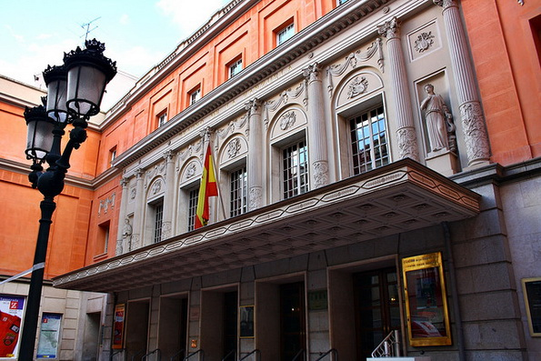
THEATRE "Zarzuela"

Slide 9
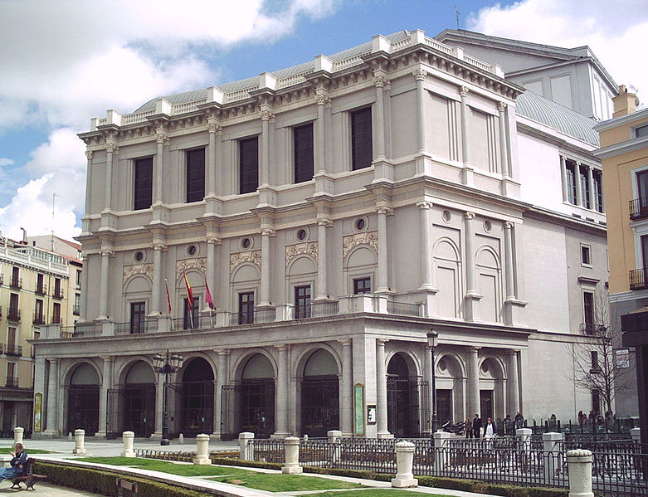
ROYAL THEATRE IN MADRID

Slide 10
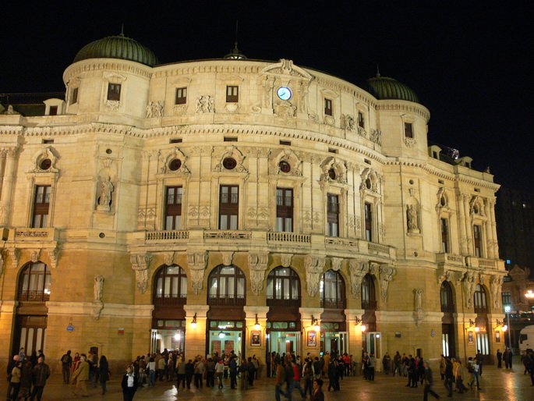
ARRIAGA THEATRE

Slide 11
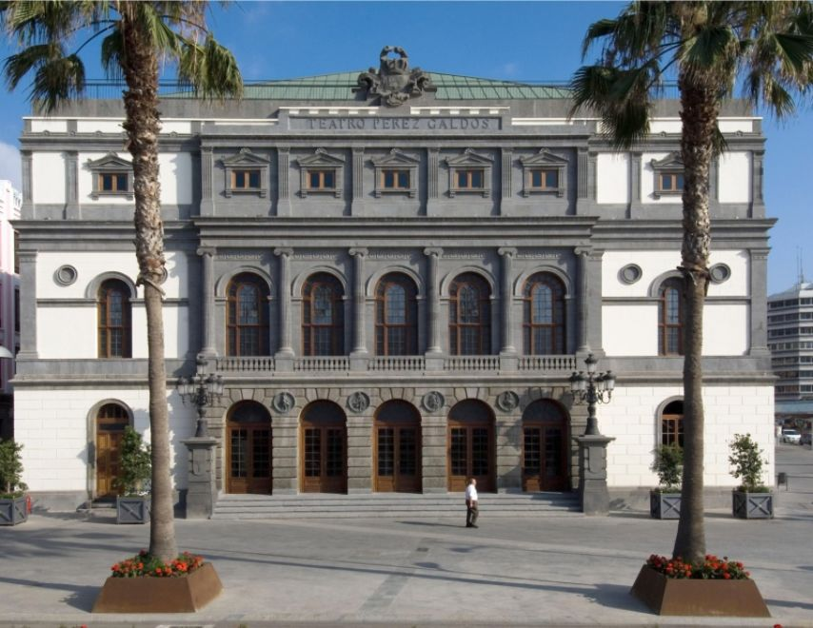
PEREZ GALDOS THEATRE

Slide 12
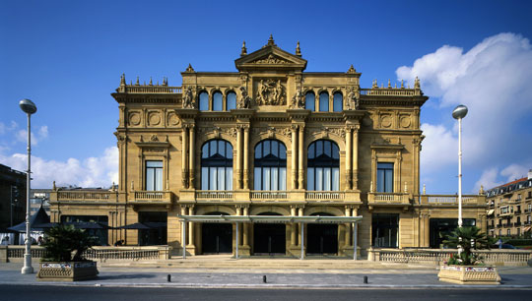
THEATRE VICTORIA EUGENIO

