Slide 1
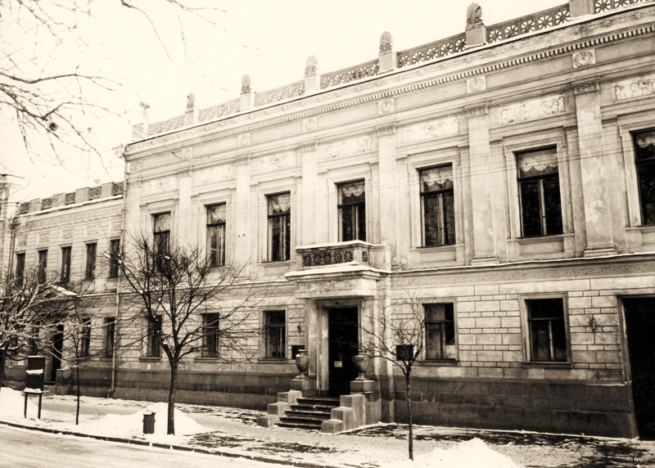
Kyiv museum of russian art
Prepared Alena Rudenko

Slide 2
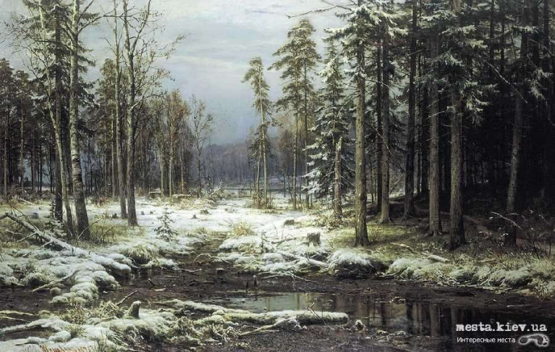
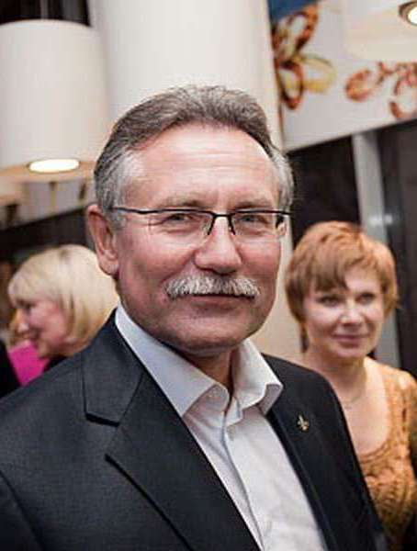
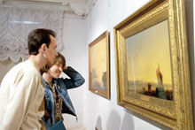
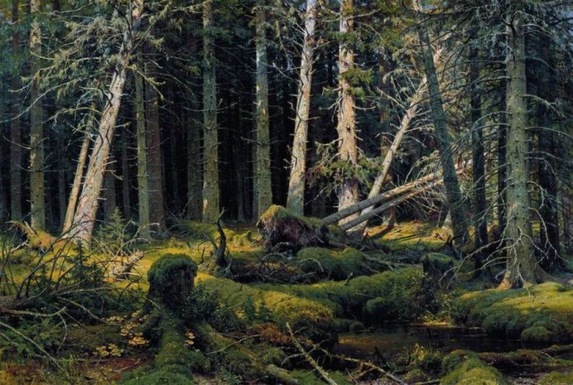
Address: 9, Tereschenkovskaya Street, Kiev Tel: +38 (044) 234-62-18. Opening : 10:00 - 18:00 Closed: Monday and Thursday
Director of Kiev Museum of Russian Art is Yuriy VAKULENKO

Slide 3
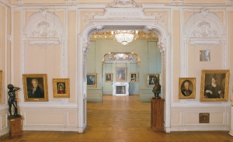
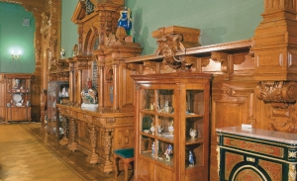
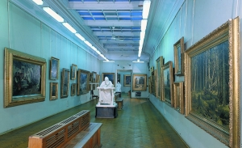
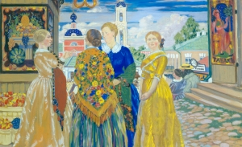
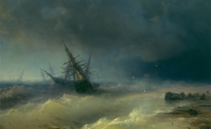
In Kiev Museum of Russian Art there is the largest collection of Russian paintings, drawings and sculptures in Ukraine.
The museum collection is based on the private collections of Kiev patrons of arts. The members of Tereshchenko family (they were well known Ukrainian sugar kings) were the most known patrons of arts in Kiev.

Slide 4
In the courtyard of the museum you can see the monument to Alexander II - the only survived monument to the Russian emperor in the post-Soviet area.
Many paintings by P. Fedotov, I. Shishkin, I. Kramskoy, N. Yaroshenko, I. Repin, V. Vasnetsov, V. Polenov, M. Vrubel, V. Vereshchagin were donated to the museum by Tereschenko family

Slide 5
