Slide 1
The Irish People
culture, traditions etc.

Slide 2
The Irish love traditions
So much so, in fact, that the country is full of them – from eating colcannon (a mixture of cabbage and mashed potatoes) on Halloween to wearing something green on St. Patrick’s Day. Two of the most enduring and internationally famed, however, are traditional music and Irish dancing.

Slide 3
The pub lies at the heart of cultural, social and musical life in Ireland
Not just places to have a drink, in an Irish pub you can philosophize on the meaning of life, ruminate on global politics, listen to a poetry reading, tap your feet to a traditional session, feast on delicious food or just enjoy the quiet settling of a pint of Guinness in front of a crackling fire.

Slide 4
The Irish like to think that Celtic blood flows through the veins of all the great and the good
Among those we are proud to call our own are John F. Kennedy, Davy Crockett, Gene Kelly, Grace Kelly and Ned Kelly, too. On St. Patrick’s Day, though, everyone’s Irish. So don your green and enjoy one of the many St. Patrick’s Day festivals around the world.

Slide 5
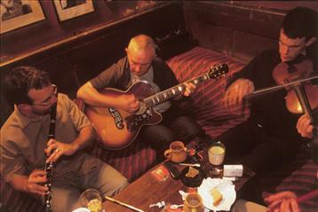
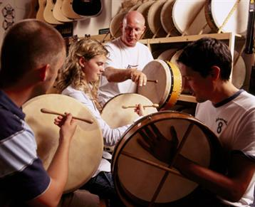
Music in Ireland

Slide 6
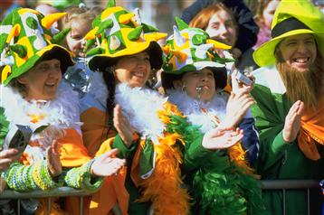
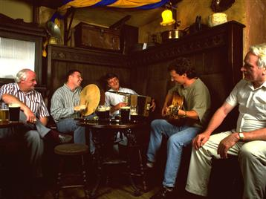
People like to have fun

Slide 7
Thanks for attention!

