Slide 1
The Great Gatsby
F. Scott Fitzgerald

Slide 2
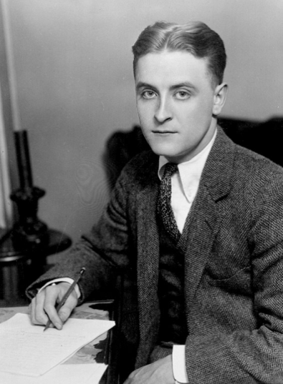
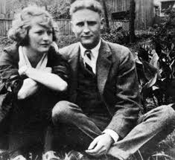
Author Background
Francis Scott Fitzgerald born September 24, 1896
Member of the Princeton Class of 1917
Joined the Army-stationed in Montgomery Alabama where he met Zelda Sayre
Refused to marry him until he could publish This Side of Paradise
Published 3/26/1920, week later the couple married
Part of the literary party scene with Ernest Hemmingway playwright Gertrude Stein

Slide 3
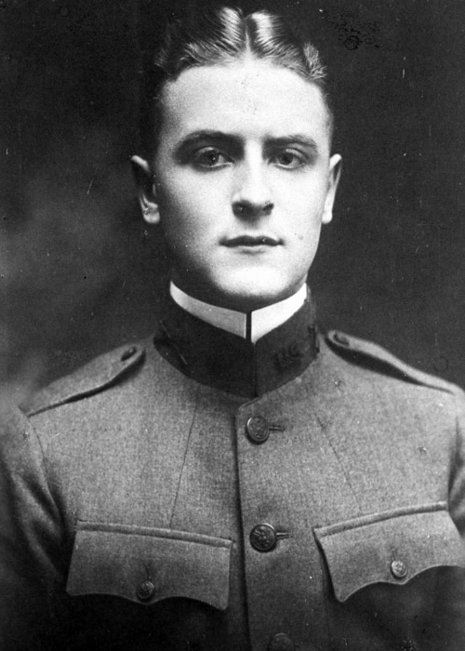
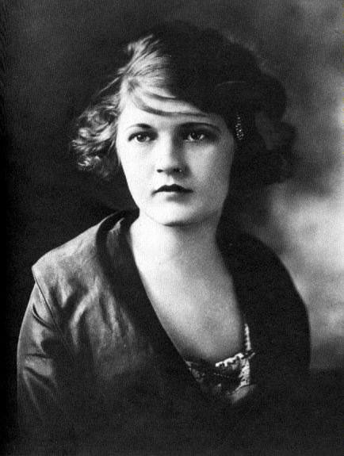

Slide 4
Author Background Cont.
Known as an alcoholic , led to slow writing speed
Critics called him an “irresponsible writer.”
Main themes focused on aspirations and the American Dream and domesticity
Great Gatsby put him on the literary map
Wrote it in France- Zelda had affair
1930-1931-Zelda began dancing led to her mental breakdowns
Save Me The Last Waltz- Tender is the Night is a response to this
Died 12-21-1940-believing himself a failure
Zelda died 1948 in an asylum fire
Revival of his works in 1950-1960’s

Slide 5
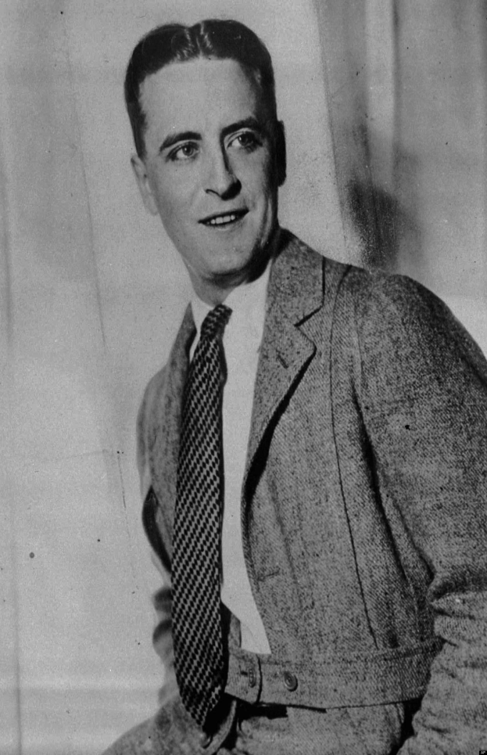
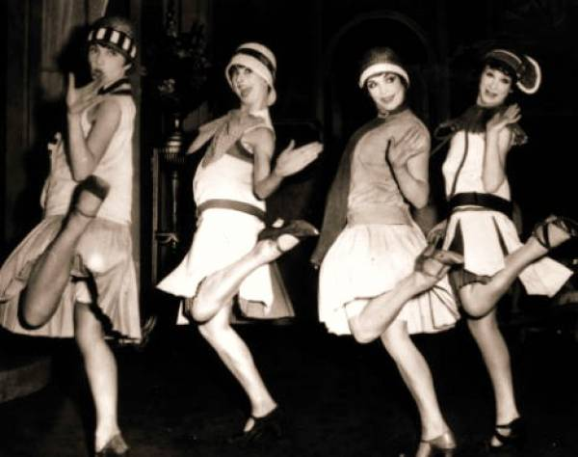
Fitzgerald—inspired by the parties he had attended while visiting Long Island's north shore—began planning the novel in 1923, desiring to produce, in his words, "something new—something extraordinary and beautiful and simple and intricately patterned."

Slide 6
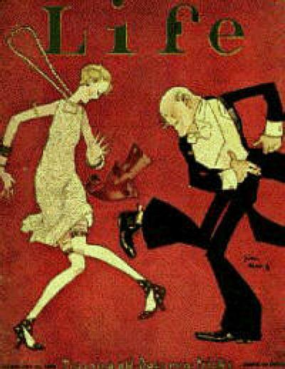
Context
Published in 1925
Prohibition became law in 1920
19th Amendment gave women the right to vote
Modeled Gatsby, and the Buchanan's after his wife’s lover and the relationship between himself and his life.
Triggered ideals of disillusionment after soldiers returned from the war as they dealt with PTSD and brought the party scene of Europe to America
coined the term Jazz Age, which denoted an era of ragtime, jazz, stylish automobiles, and “uninhibited young women with bobbed hair and short skirts”
" Fitzgerald wrote, "It was an age of miracles, it was an age of art, it was an age of excess, and it was an age of satire."

Slide 8
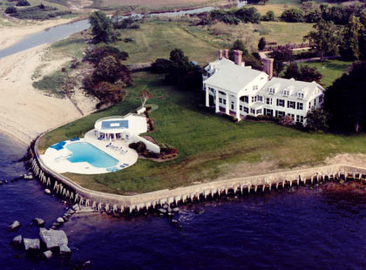
Setting
f
East and West Egg, Long Island New York
West Egg-poorer side (Nick Caraway)
East Egg-Beverly Hills of Long Island (Buchannan's, Gatsby)
Symbolizes the grandeur and dichotomy of the American Dream
Novel also travels to Gatsby’s time in the war and arrival in New York

Slide 9
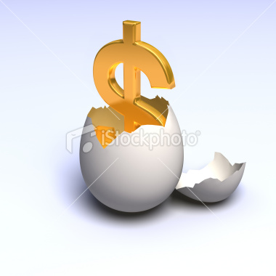
Plot Summary: Eggs Cracked
Nick Carraway, a recent Yale graduate returns home to West Egg to start a career
Neighbors to the mysterious Jay Gatsby
Invited to the home of his cousin Daisy and her husband Tom Buchanan on East Egg.
Meets Jordan Baker, the golf pro who Daisy wants him to date
Nick notices that Daisy is unhappy in her marriage, desperate to escape domesticity
Tom gets a call from a mysterious woman, his mistress Myrtle Wilson

Slide 10
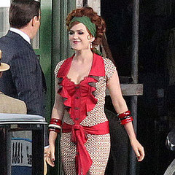
Tom takes Nick to Queens to meet Myrtle
The relationship is permitted by Tom and Myrtle’s friends because both were “vastly unhappy in their marriages.”
Myrtle mocks Daisy and Tom beats her to Nick’s horror
Weeks later, Nick and Jordan attend a Gatsby party, shocked that few of the guests actually know him and gossip that he is an Anti-Semite, and a murderer.
Nick meets Gatsby who asks him to lunch the next day

Slide 11
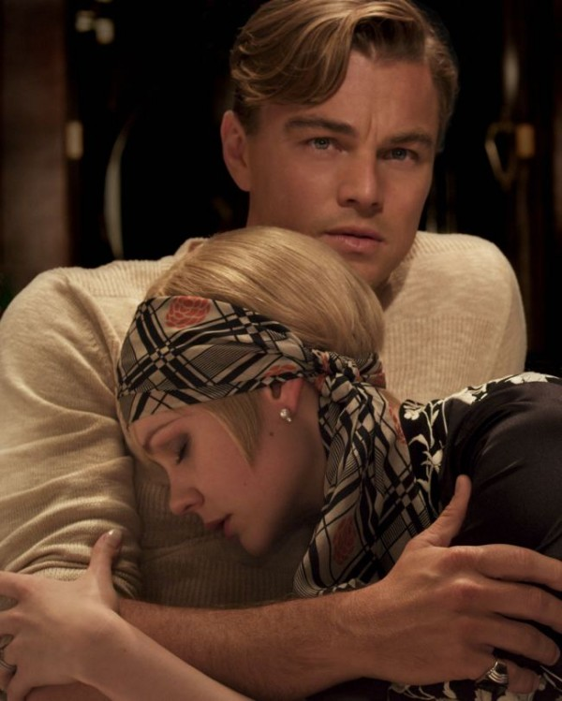
Plot Synopsis: The “Great” Gatsby
At lunch with Gatsby and Jordan the next day, Nick learns that Gatsby attended Oxford University and that his family is “all dead now.”
Meets Meyor Wolfsham, who with Gatsby’s help, fixed the world series in 1919.
On the car ride back to West Egg, Nick notices that Gatsby’s hand is shaking and that his “whole statement had fallen to pieces.”
Gatsby reveals that Daisy Buchannan was the only woman he had ever loved and that they had a relationship five years prior to when he joined the war.

Slide 12
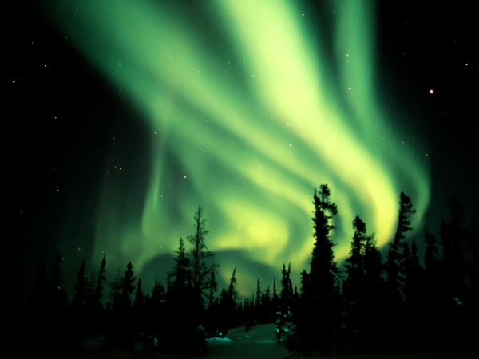
Plot Synopsis: “Red Light, Green Light”
Gatsby built his house to be closer to Daisy and to watch her from afar
The Green light at the end of the dock symbolizes Gatsby’s hopes that they will one day still be able to be together
Daisy and Gatsby reunite and their relationship begins once again
Daisy and Tom attend one of Gatsby’s parties and Daisy becomes overwhelmed with emotion
The party moves to the Buchannan’s house but Daisy declares that they should move to a hotel to escape the heat.
Much to Tom’s dismay, Daisy rides in Gatsby’s yellow car with him, while Tom is forced to drive Nick and Jordan.
On the way into town, Tom meets with Tom Wilson who has locked Myrtle in the house because of her continued affair.

Slide 13
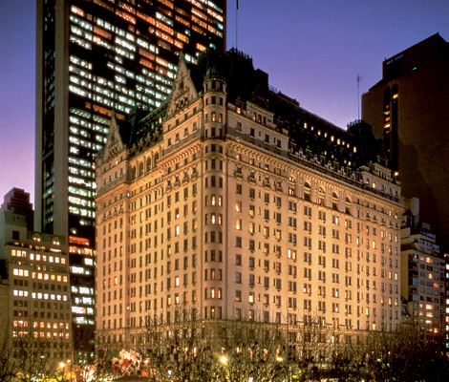
Plot Summary: Summer Heat and Heated Tempers
The party moves to the Plaza Hotel where Tom confronts Daisy about her relationship with Gatsby.
Gatsby brings Daisy to an ultimatum: she must choose to be with Tom or himself.
Daisy is unable to make a decision and runs away with Gatsby.
Furious, on the way home, Daisy seizes control of the car from Gatsby and hits Myrtle Wilson who instantly dies.
Back at the Buchanan’s home, Tom and Daisy flee Long Island unable to face responsibility for their actions

Slide 14
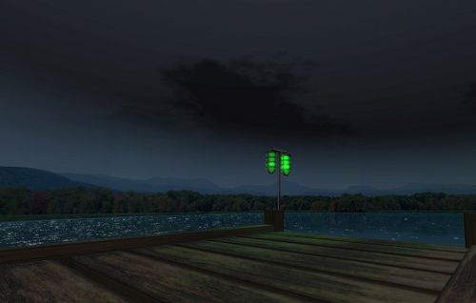
Plot Summary: The Great Gatsby’s Last Illusion
Determined to avenge his wife’s death, George Wilson sneaks into Gatsby’s backyard and murders both himself and Gatsby.
Nick (now separated from Jordan) notifies Gatsby’s father of his son’s death.
Gatsby refused to meet with father because he wanted to get rid of his past.
Few present at the funeral (Owl Eyes)
Nick reflects upon his experiences with Gatsby and realizes albeit loathingly, the truth of his character.

Slide 15
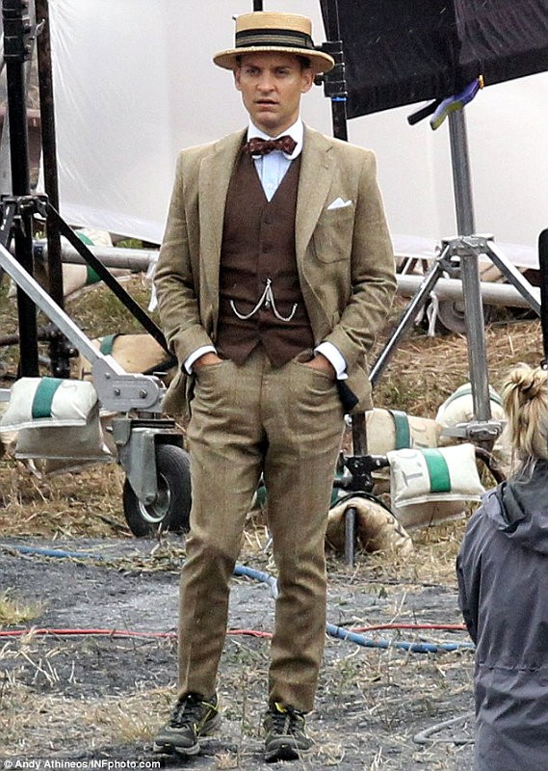
Character Analysis: Nick Carraway
29-30 Yale Grad
Cousins with Daisy and Tom
Narrator of the story
Comes of age (loss of innocence)
Moral compass of the novel
Conflicted both about Daisy and Gatsby and Tom and Myrtle
Unable to decide whether or not Gatsby is to be trusted
Gatsby creates him as a father figure to replace his own.
Relationship with Jordan Baker harmed by her supremely feminist ways.

Slide 16
Character Analysis: Jay Gatsby
Originally known as James Gatz
From North Dakota
Taken in by Dan Cody, a wealthy tycoon from whom Gatsby inherited his wealth
Fell in love with Daisy Buchannan shortly before leaving to fight in WWI
Moved to West Egg in order to see her across the bay
Relentlessly lives in the past and ultimately gives up his life for Daisy hoping that she will love him again.
Don Draper esque

Slide 17
