Slide 1
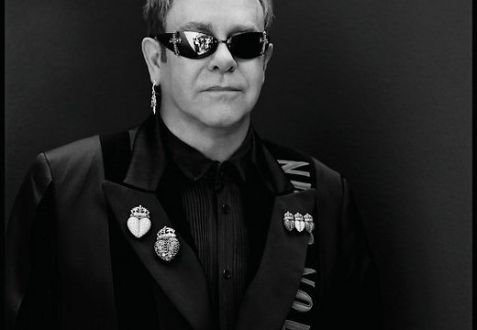
♥Elton John♥

Slide 2
♥Sir Elton John - British rock musician, winner of five Grammy awards, Commander of the Order of the British Empire. In his works, Elton John has evolved from rock and roll through psychedelic rock, later soft rock to pop.♥

Slide 3
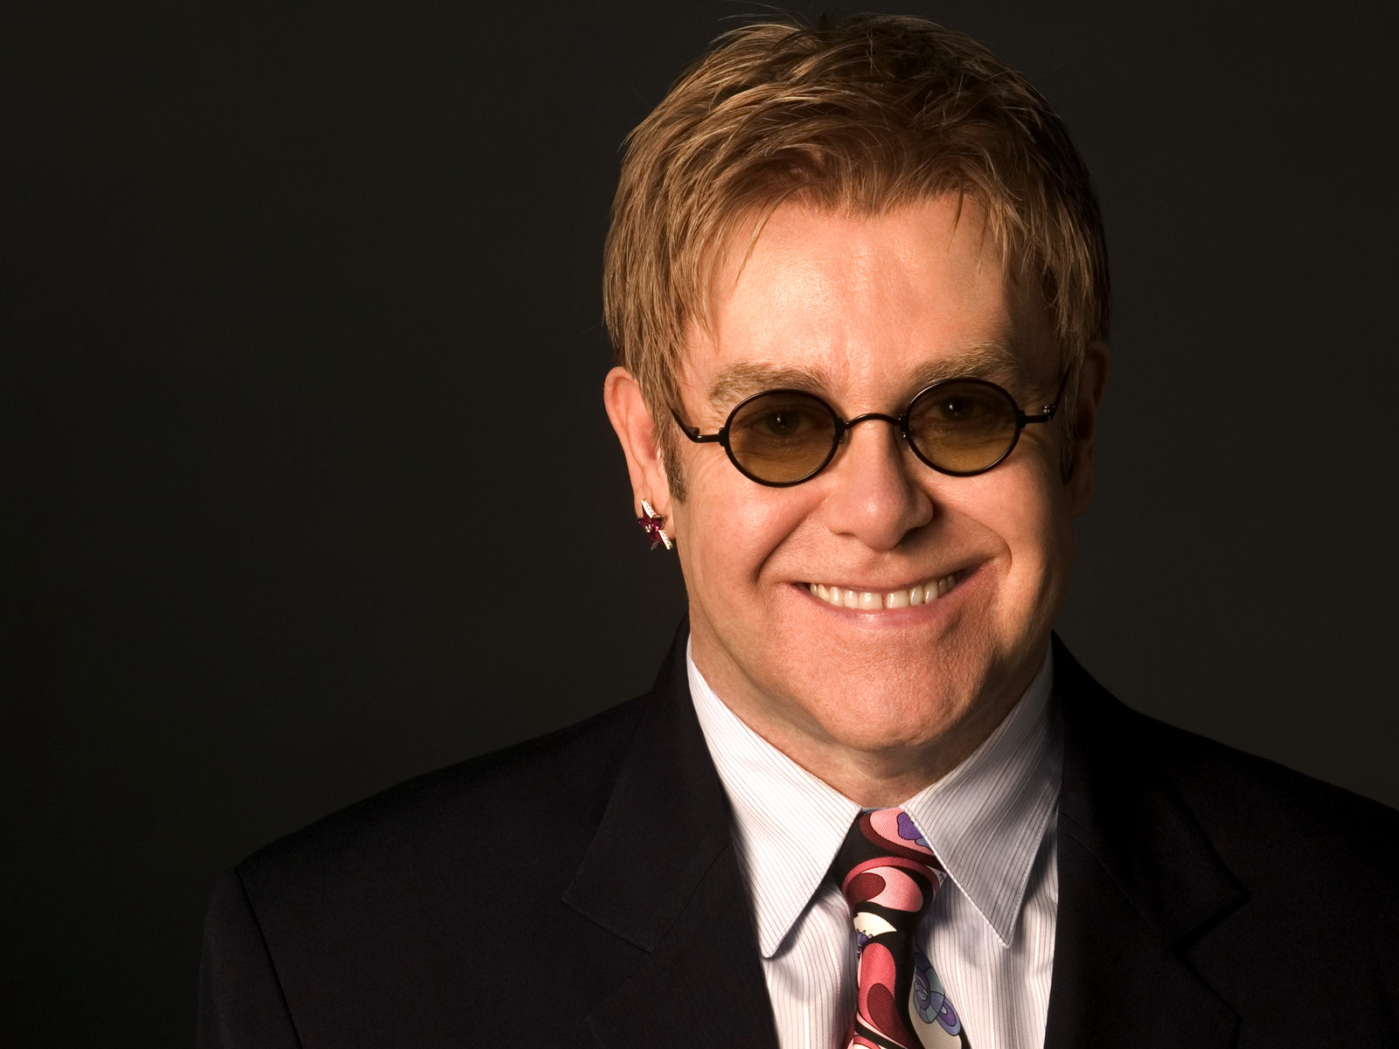

Slide 4
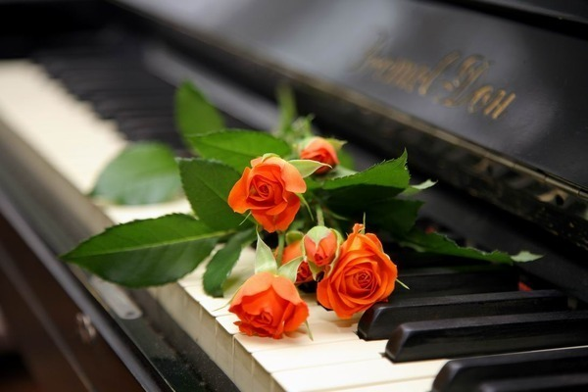
♥Elton John - one of the few artists who managed to keep for a long time on the top of popularity, aided by his abilities as a composer and performer, but also a sense of fashion. We know that Elton John - homosexual. However in 1984 he married Rinat Bauel but divorced three years later, in 1993 constant partner Elton John is a film producer David Furnish♥

Slide 5
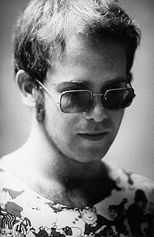

Slide 6
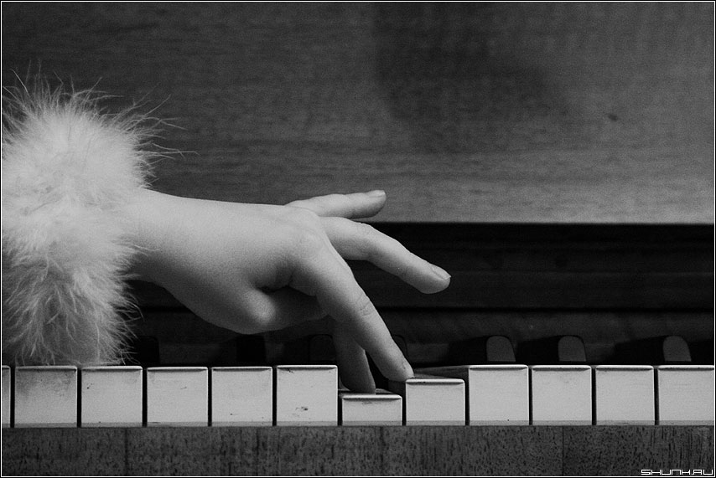
♥Elton John was born in the small town of Pinner, United Kingdom. He began playing the piano even four guy. At age 11 entered the Royal Conservatory, where he studied for 6 years. When the boy was 15 years old, his parents divorced and his mother subsequently married Fred Fayrbrazera. He started his career as a keyboardist in the band Bluesology. In 1967, changed his name, combining the names of saxophonist Elton Dean and Blueology name of the leader of the ensemble. The first single «I've Been Loving You» - released in 1968, and in 1969 released their first album Elton «Empty Sky». The first hit was Elton John «Your Song», written in 1970.♥

Slide 7
♥Pinner, United Kingdom♥

Slide 8
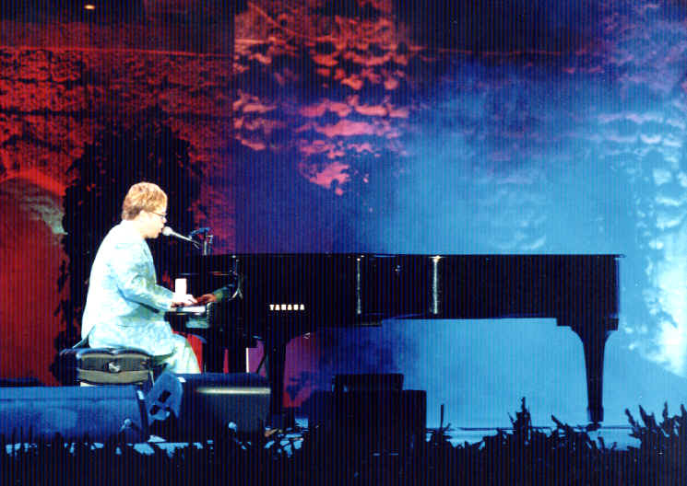

Slide 9
♥Throughout career, Elton John has worked in those areas that have experienced the flowering of popularity. He started his career with the music that was on the border of psychedelic and progressive rock. Together with the band The Who participated in the recording of the rock opera Tommy. An example of this trend is the work of albums Rocket Man and Goodbye Yellow Brick Road.♥

Slide 11
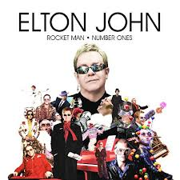

Slide 12
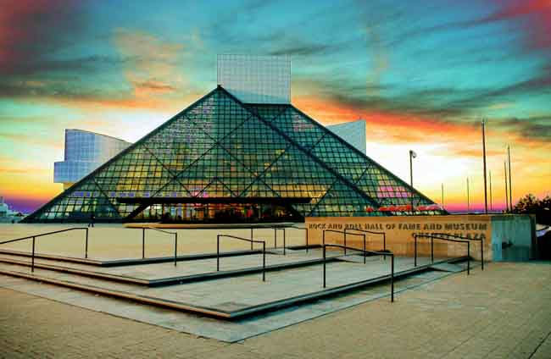
♥In 1994, Elton John's name was entered into the Hall of Fame rock and roll♥

Slide 13
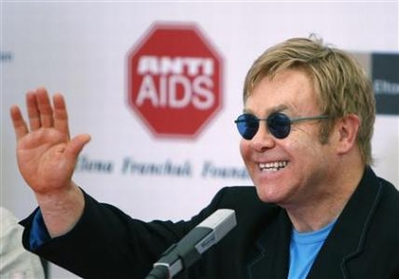
♥June 16, 2007 Elton John performed at the Independence Square in Kiev. This concert was a charity event to support HIV-infected..♥

Slide 14
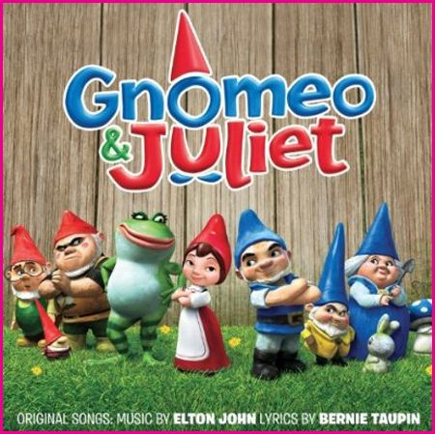
♥Elton John is a producer and composer of the animated film "Gnomeo and Juliet", which was released in 2011.♥

Slide 15
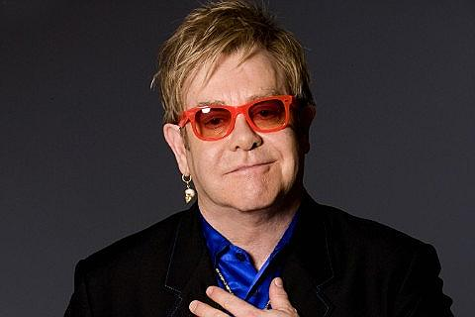
♥Elton John♥

