Slide 1
SSS (Save Severodonetsk Streets)

Slide 2
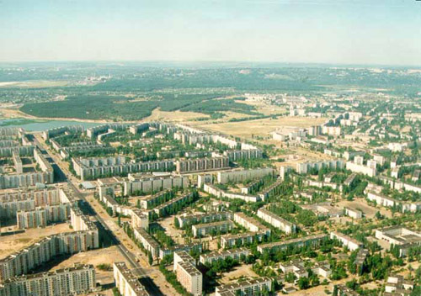
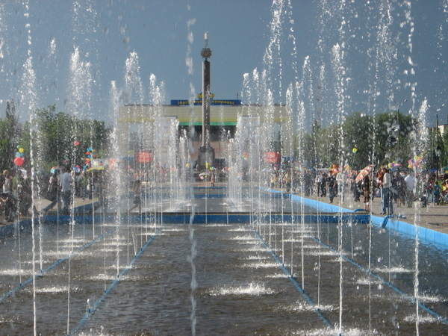
LOGO
My organisation is called Save Severodonetsk Streets
Our town needs protection, so we should help it to develop and to be clean at once.

Slide 3
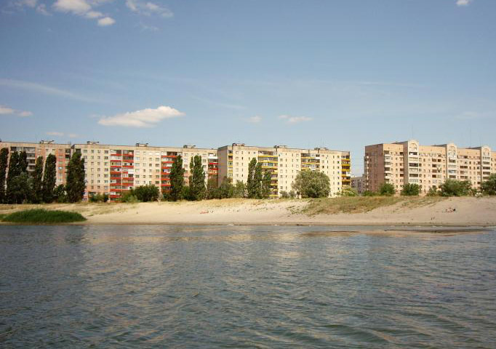
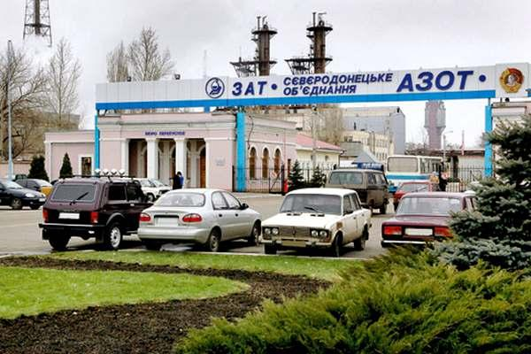
I want to create a big organization which will pay people’s attention to or problems.
LOGO
I know that simple people such me or my classmates can’t help our polluted air or rivers.
Unfortunately our plant Azot pollutes all components of our environment.

Slide 4
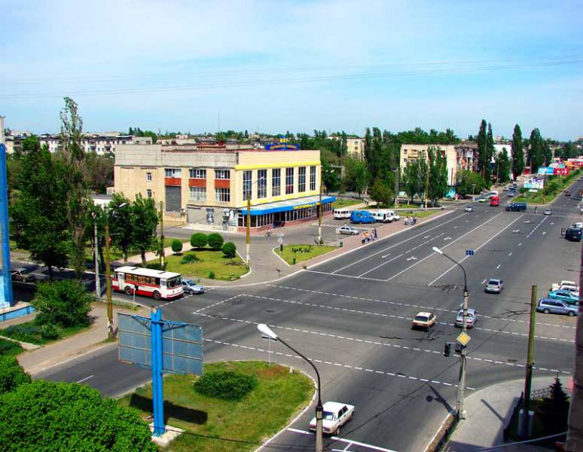
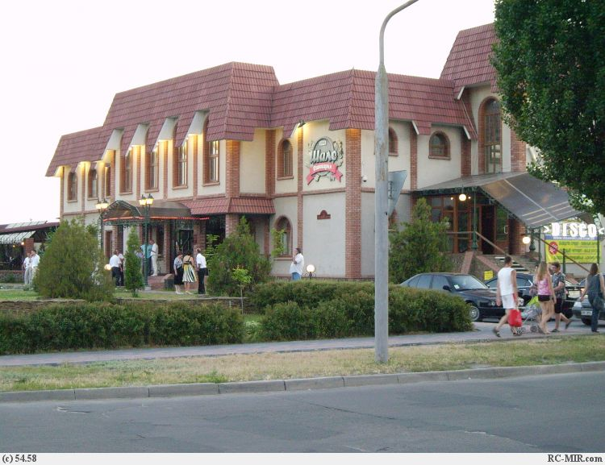
But we can do some simple things.
At least we can through our rubbish in special places, but not in streets.
Many of us are not content about the condition of our streets.Why don’t we help them to become cleaner?
LOGO

Slide 5
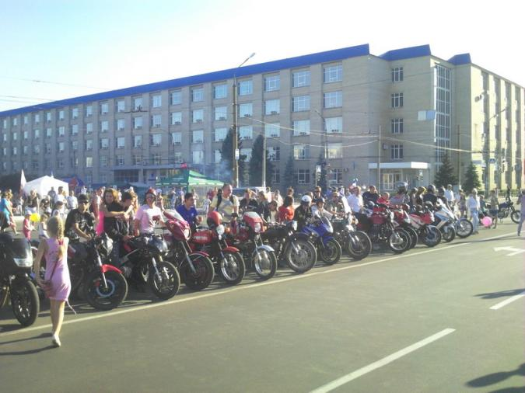
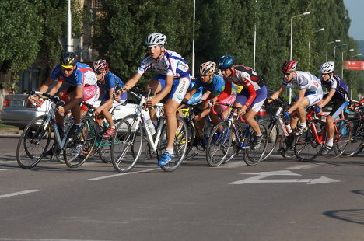
Also it’s good to participate in some actions, for example, the day without cars. It’s good not only for our nature but also for our health.
LOGO

Slide 6
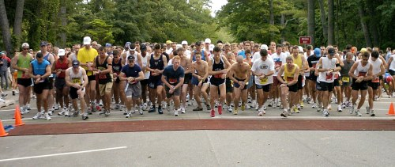
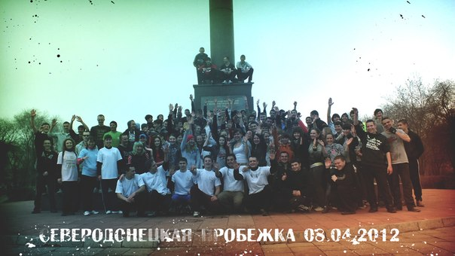
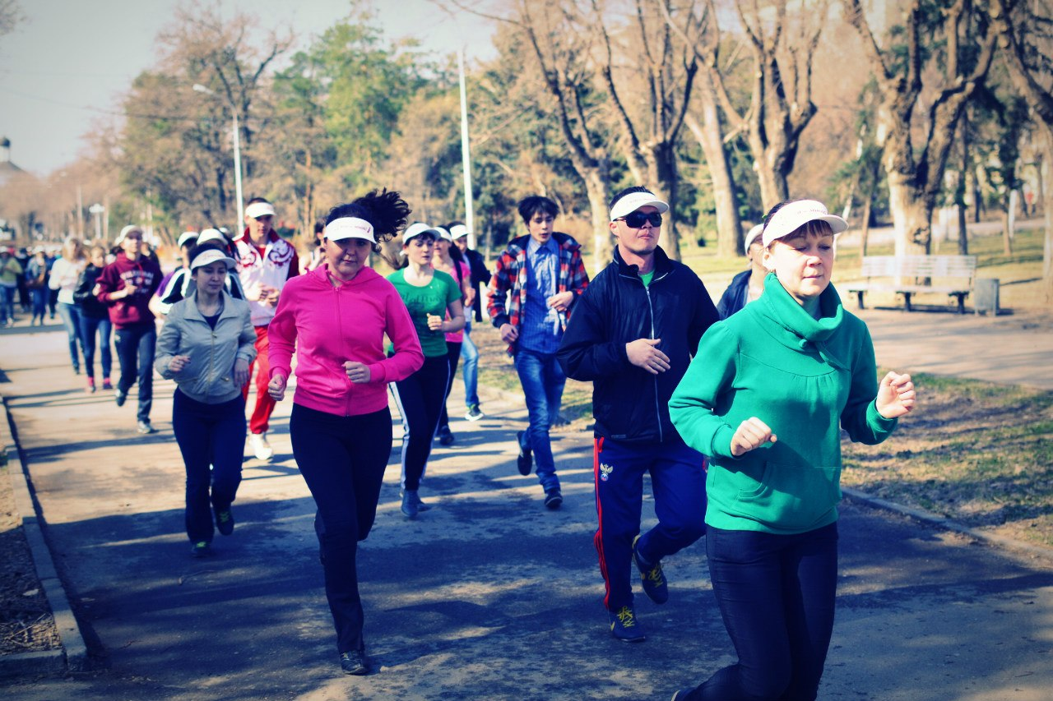
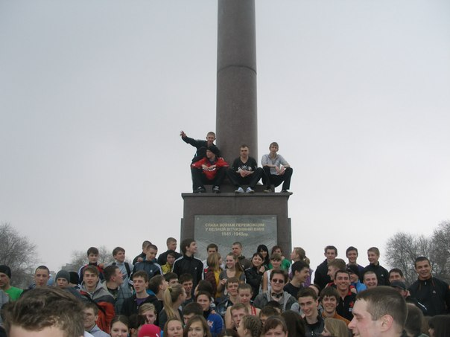
And it’s important to provide mass sprints, which also can help us to keep fit and not to use transport at least sometimes.
LOGO

