Slide 1
Jerry Uelsmann
I have gradually confused photography with life.

Slide 2
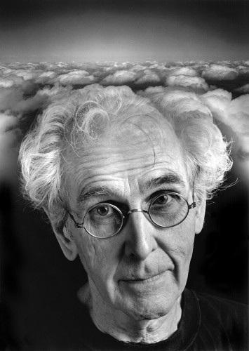
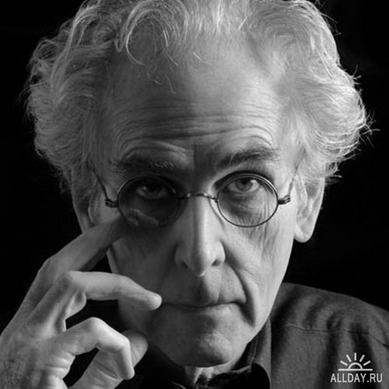

Slide 3
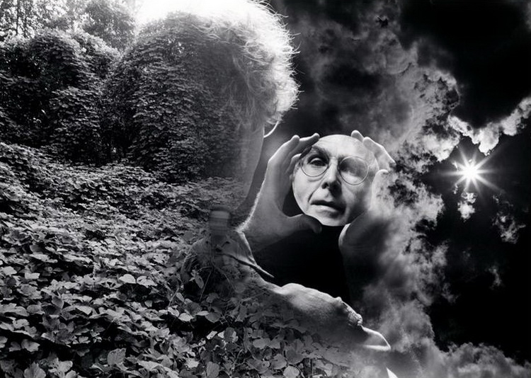
Uelsmann was born in Detroit, Michigan. While attending public schools, at the age of fourteen, there sparked an interest in photography. He believed that through photography he could exist outside of himself, to live in a world captured through the lens. Despite poor grades, he managed to land a few jobs, primarily photographs of models. Eventually Uelsmann went on to earn a BA from the Rochester Institute of Technology and M.S. and M.F.A. degrees from Indiana University. Soon after, he began teaching photography at the University of Florida in 1960. In 1967, Uelsmann had his first solo exhibit at The Museum of Modern Art which opened doors for his photography career.

Slide 4
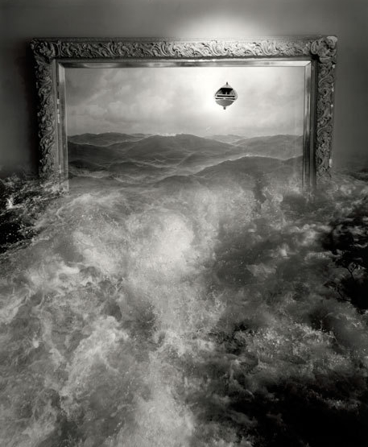
Uelsmann is a master printer, producing composite photographs with multiple negatives and extensive darkroom work. He uses up to a dozen enlargers at a time to produce his final images, and has a large archive of negatives that he has shot over the years. The negatives that Uelsmann uses are known to reappear within his work, acting as a focal point in one work, and background as another. Similar in technique to Rejlander, Uelsmann is a champion of the idea that the final image need not be tied to a single negative, may be composed of many. During the mid-twentieth century, when photography was still being defined, Uelsmann didn't care about the boundaries given by the Photo Secessionists or other realists at the time, he simply wished to share with the viewer the images from his imagination and saw photomontage as the means by which to do so. Unlike Rejlander, though, he does not seek to create narratives, but rather "allegorical surrealist imagery of the unfathomable". Uelsmann is able to subsist on grants and teaching salary, rather than commercial work.

Slide 5
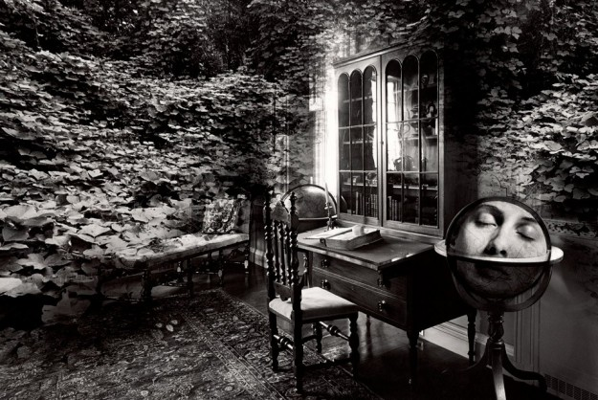
Today, with the advent of digital cameras and image editing software, photographers are able to create a work somewhat resembling Uelsmann's in less than a day. However, at the time Uelsmann was considered to have almost "magical skill" with his completely analog tools. At the time Uelsmann's work first came to popular attention, photos were still widely regarded as unfalsifiable documentary evidence of events. However, Uelsmann, along with Lucas Samaras, was considered an avant garde shatterer of this popular mindset and help to expand the artistic boundaries of photography.

Slide 6
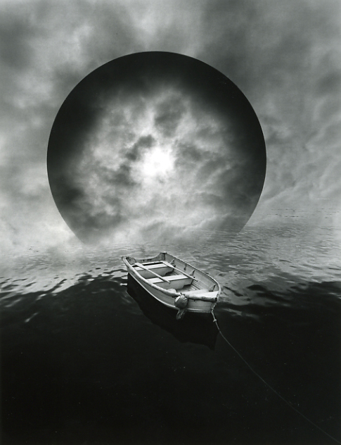
Despite his works' affinity with digital techniques, Uelsmann continues to use traditional equipment. "I am sympathetic to the current digital revolution and excited by the visual options created by the computer. However, I feel my creative process remains intrinsically linked to the alchemy of the darkroom."Today he is retired from teaching and currently lives in Gainesville, Florida with his third wife, Maggie Taylor.Uelsmann has one son, Andrew, who is a graduate student at the University of Florida. But to this day, Uelsmann still produces photos, sometimes creating more than a hundred in a single year. Out of these images, he likes to select the ten he likes the most, which is not an easy process

Slide 7
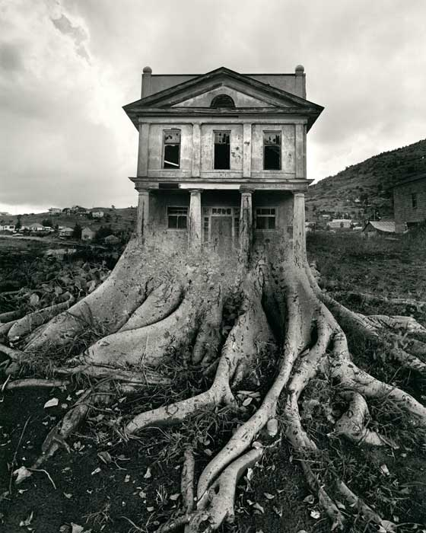

Slide 8
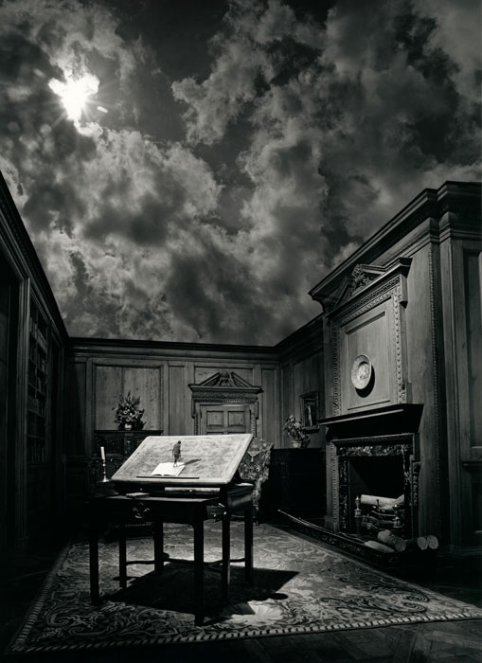

Slide 9
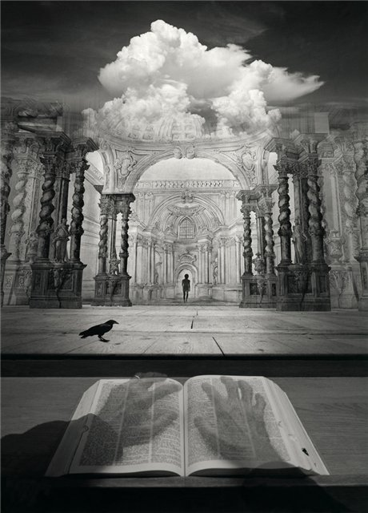

Slide 10
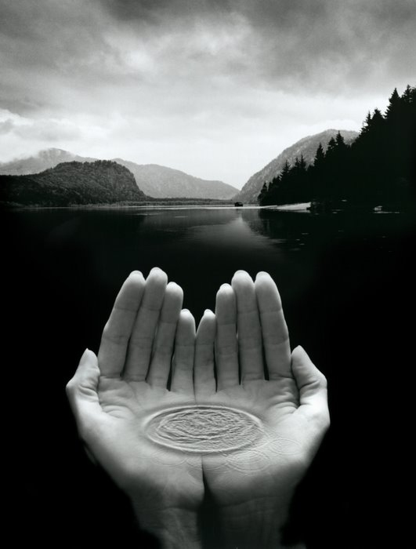

Slide 11
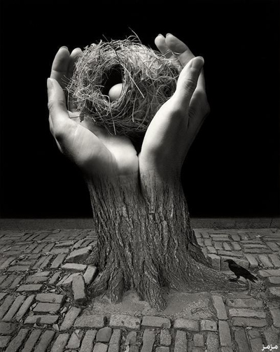

Slide 12
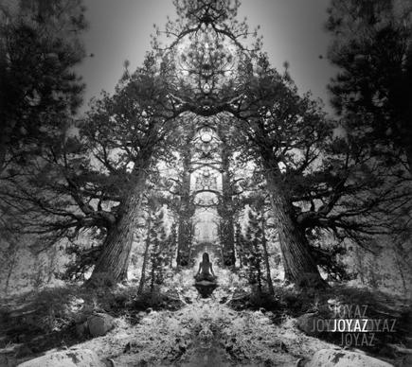

Slide 13
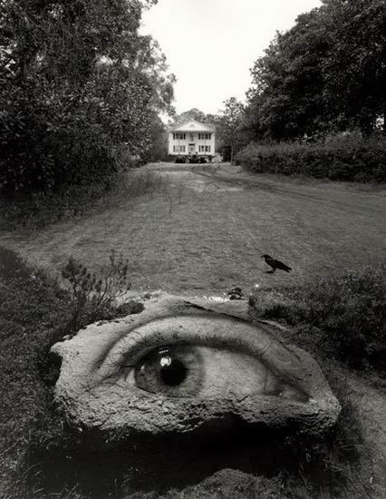

Slide 14
