Slide 1
USA Dollar
Olesya Savega

Slide 2
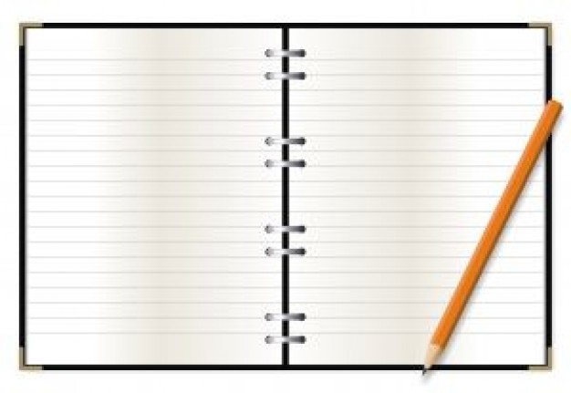
Definitions, names and dates:
USA Dollar
Federal Reserve System
Richard Milhous Nixon
Ben Shalom Bernanke
1785
1794
23 December, 1913

Slide 3
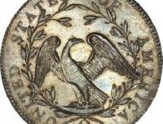
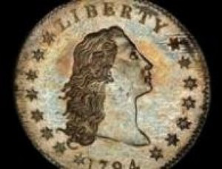
History of the Dollar of United States
Dollar comes from the word “Yoahimstaler” the name of the coin of the XVI century, which was made near silver mine in Yahymiv in Chech Republic. “Yaihimstaler” means “hill of Yahymiv”. Later the word “Yoahimstaler” was shortened to “taller” and dutchmen changed it into a “doller”. Englishmen turned it into “dollar”. In America Spanish coin of 8 reals was called a dollar. Government of the USA introduced american
money in 1785 and dollar became the main currency. The first dollars in the USA started to produce in 1794.
1794

Slide 4
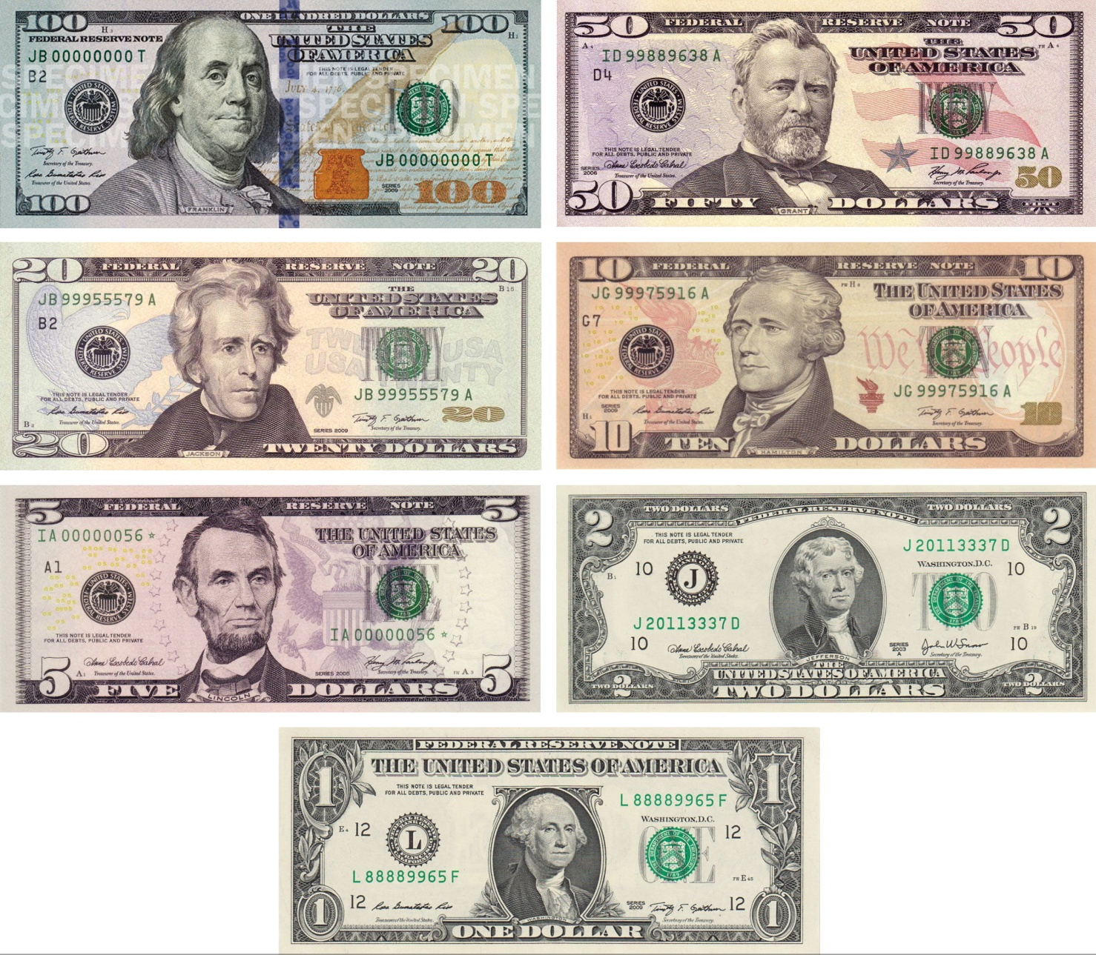
Modern Bills

Slide 5
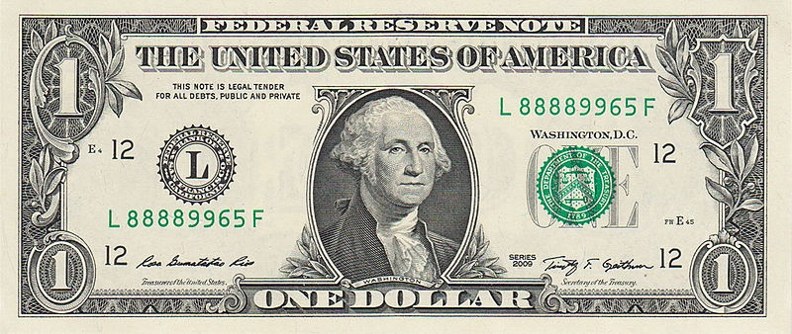
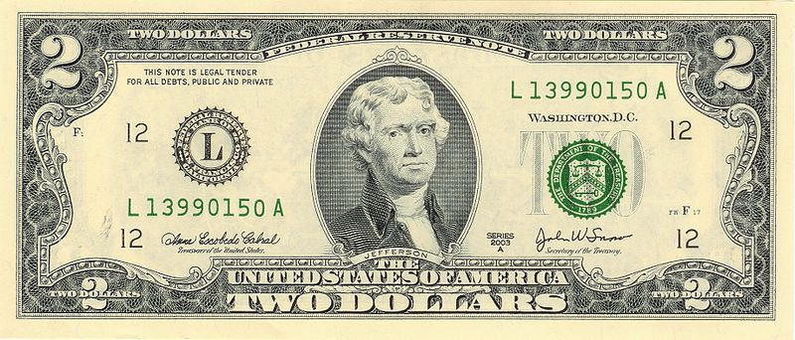
George Washington
1963
2009
Thomas Jefferson
1976
2009

Slide 6
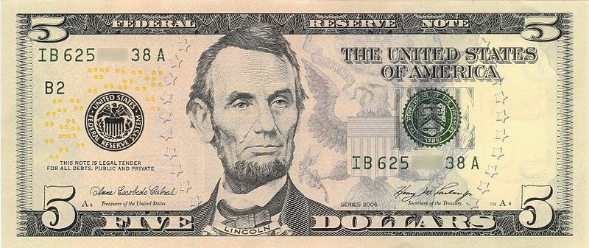
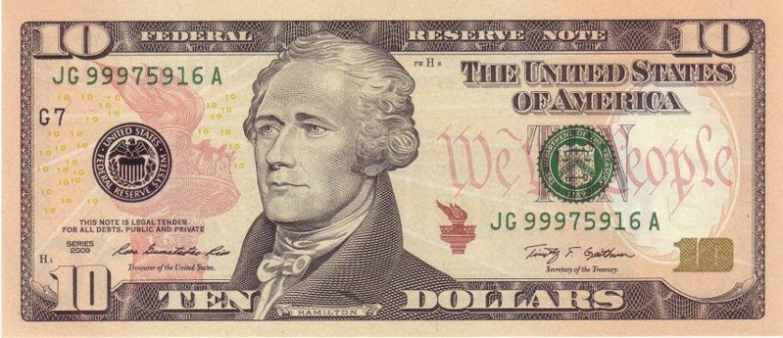
Abraham Lincoln
2006
2013
Alexander Hamilton
2004
2009

Slide 7
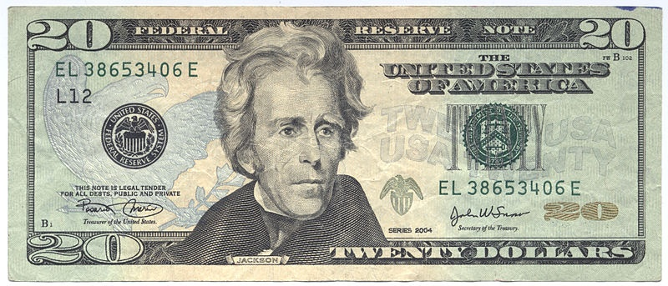
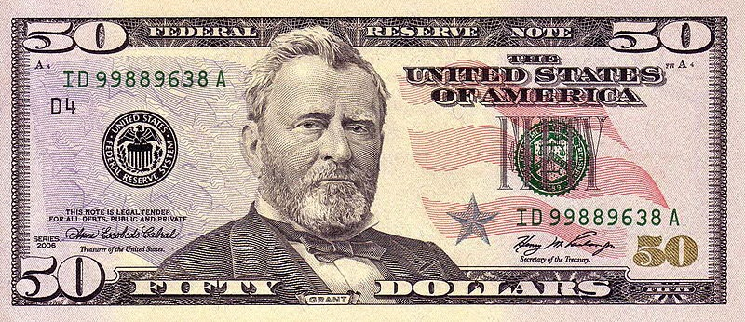
Andrew Jackson
2004
2009
Ulysses Grant
2004
2009

Slide 8
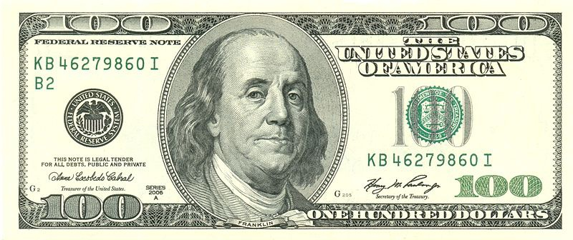
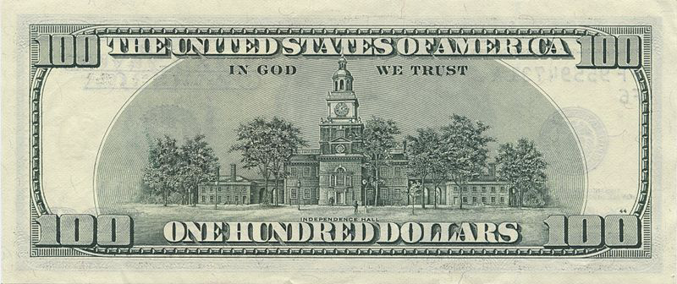
Benjamin Franklin
2009
2013

Slide 9
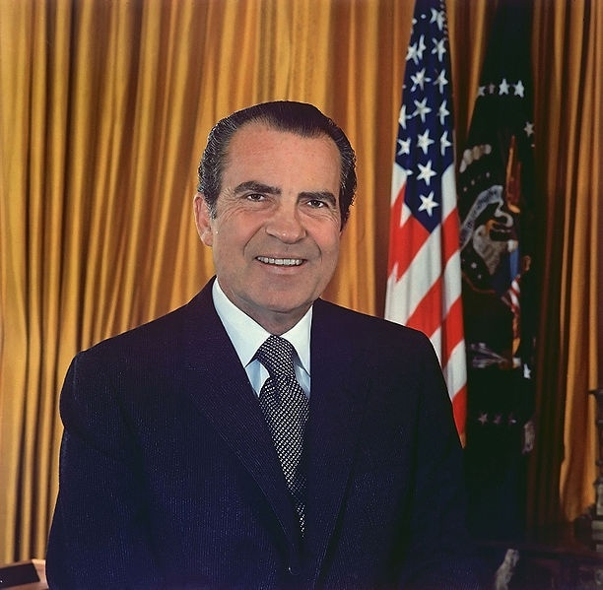
37-th President of the United States
Richard Milhous Nixon

Slide 10
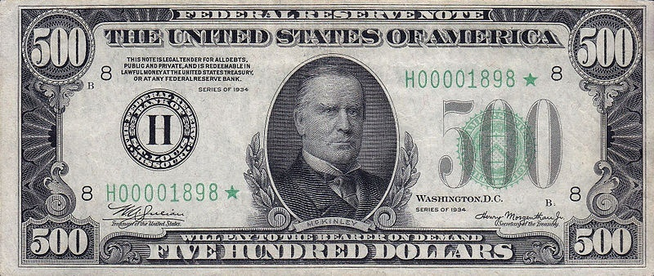
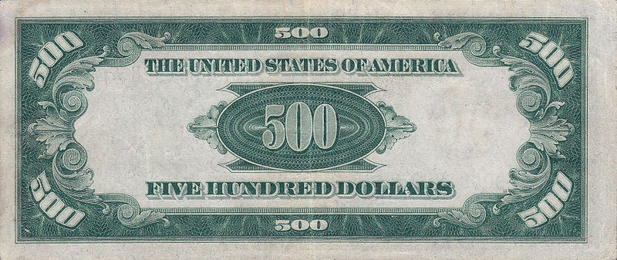
McKinley
1934

Slide 11
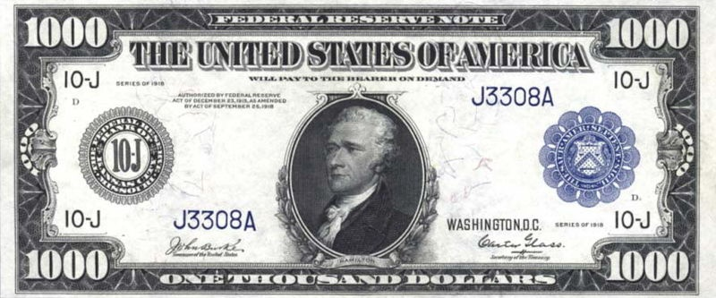
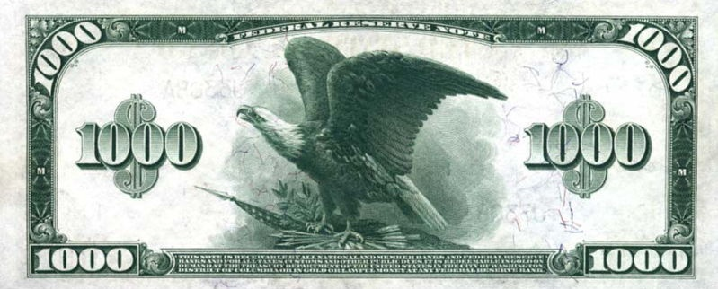
Hamilton
1918

Slide 12
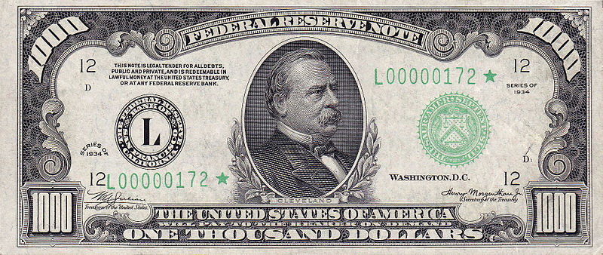
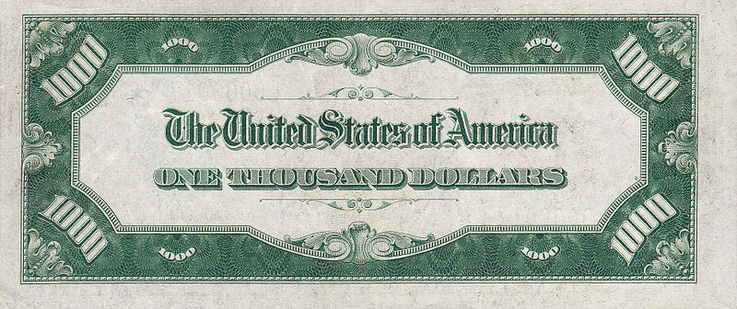
Cleveland
1934

Slide 13
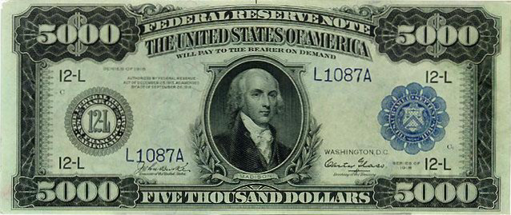
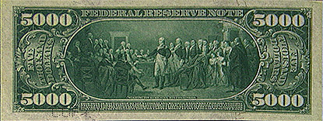
Madison
1918

Slide 14
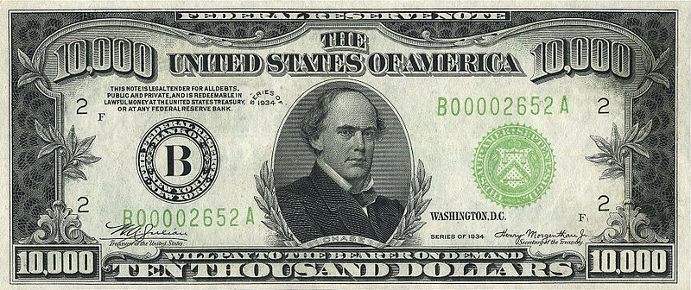
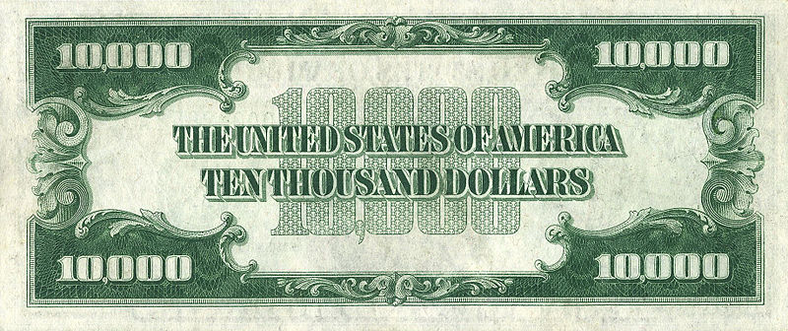
Chase
1934

Slide 15
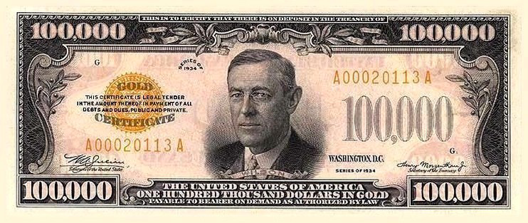
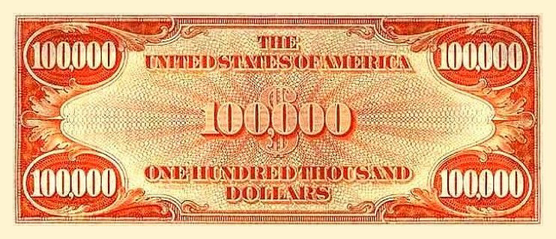
Wilson
1934

Slide 16
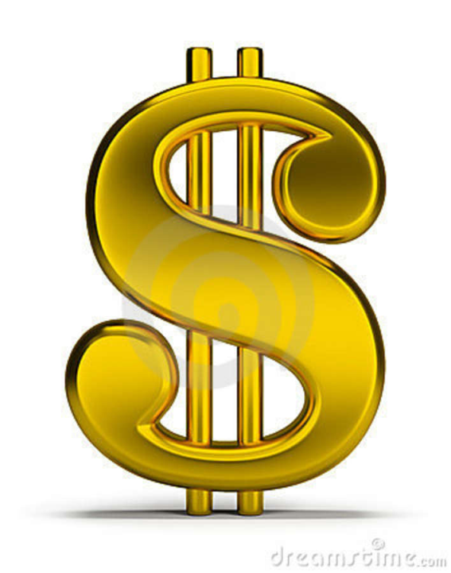
Dollar sign
The symbol $, usually written before the numerical amount, is used for the U.S. dollar. The sign was the result of a late 18th-century evolution of the scribal abbreviation "ps" for the peso.
Another popular explanation is that it comes from the Pillars of Hercules on the Spanish Coat of arms on the Spanish. These Pillars of Hercules on the silver Spanish dollar coins take the form of two vertical bars and a swinging cloth band in the shape of an "S".
Yet another fictional explanation suggests that the dollar sign was formed from the capital letters U and S written or printed one on top of the other.

Slide 17
Nicknames
The colloquialism “buck” is often used to refer to dollars of various nations, including the U.S. dollar. This term, dating to the 18th century, may have originated with the colonial leather trade. It may also have originated from a poker term.
“Greenback” is another nickname originally applied specifically to the 19th century. Demand Note dollars created by Abraham Lincoln to finance the costs of the Civil War for the North.
In French-speaking areas of Louisiana, the dollar is referred to as "piastre" or "piasse" (pronounced "pee-as") and the French holdover "sou" (pronounced "soo") is used to refer to the cent.
In Panama, the equivalent of buck is "palo" (literally "stick").
In Ecuador, the dollar is referred to as "plata" (literally "silver").
In Peru, a nickname for the U.S. dollar is "coco", which is a pet name for Jorge , a reference to the portrait of George Washington on the $1 note.
Cubans call the U.S. dollar "fula". Loosely translated from Cuban jargon meaning bad.

Slide 18
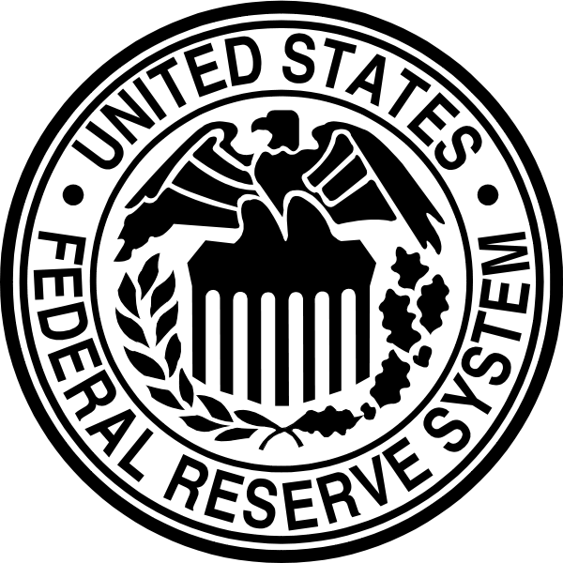
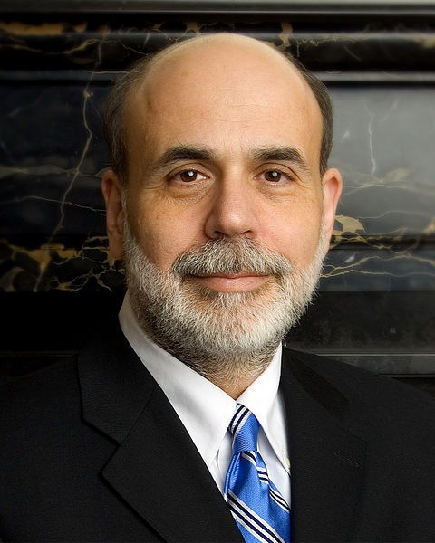
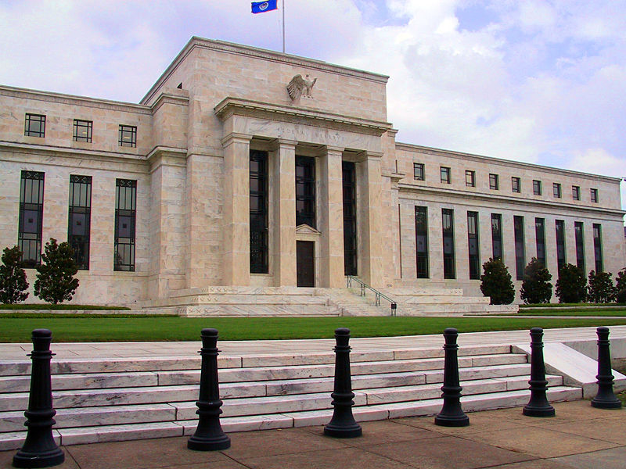
Federal Reserve System
Ben Shalom Bernanke
Washington, USA

Slide 19
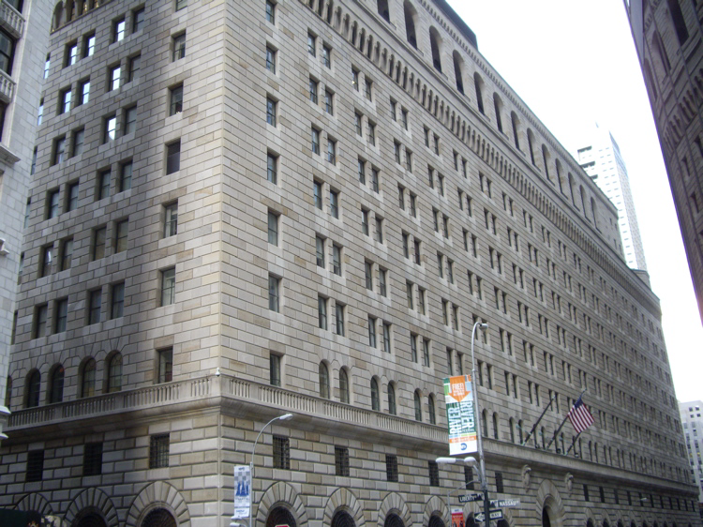
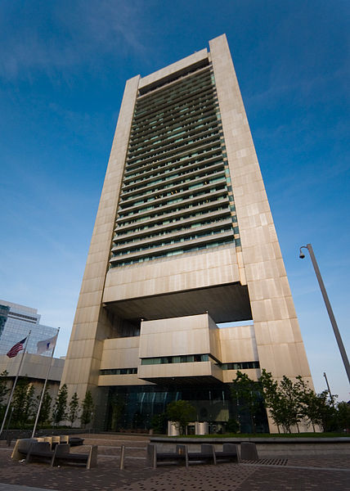
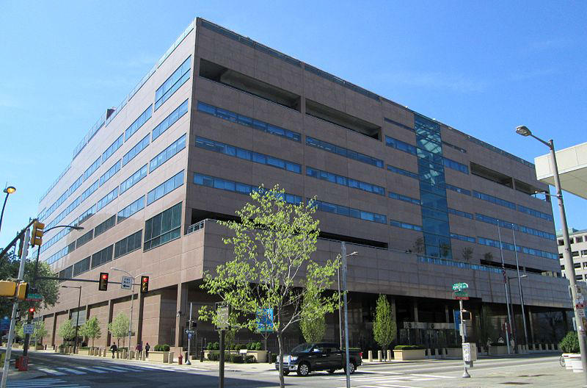
New York ( B )
Philadelphia ( C )
Boston
( A )

Slide 20
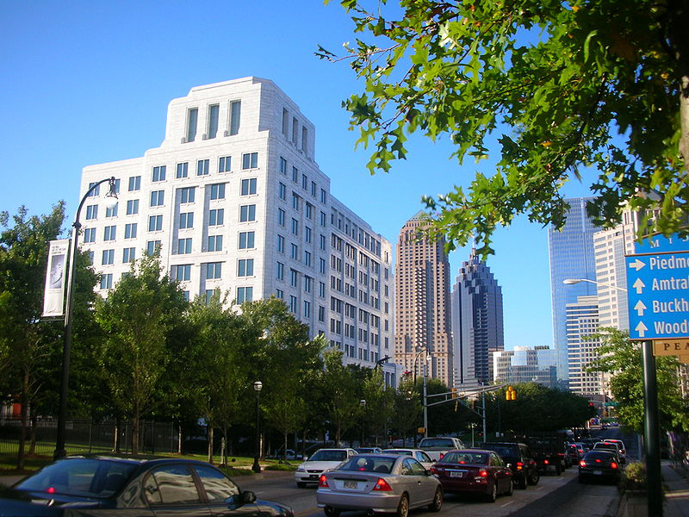
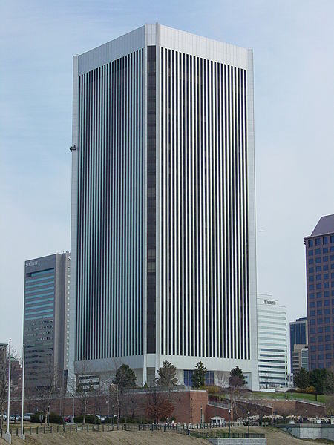
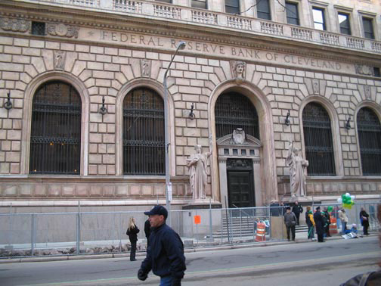
Atlanta ( F )
Cleveland ( D )
Richmond ( E )

Slide 21
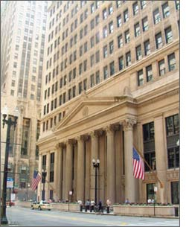
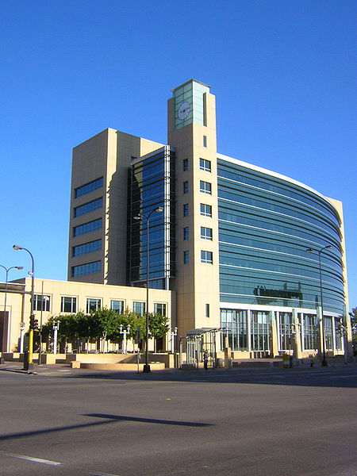
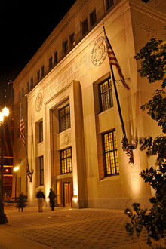
Chicago ( G )
Minneapolis ( I )
St. Louis ( H )

Slide 22
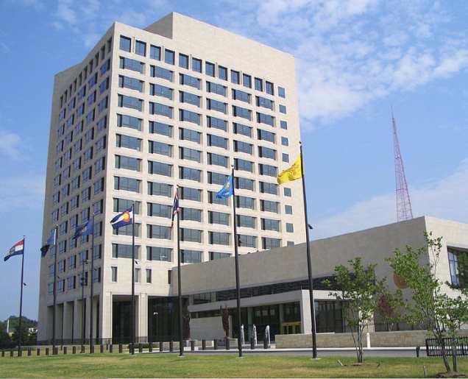
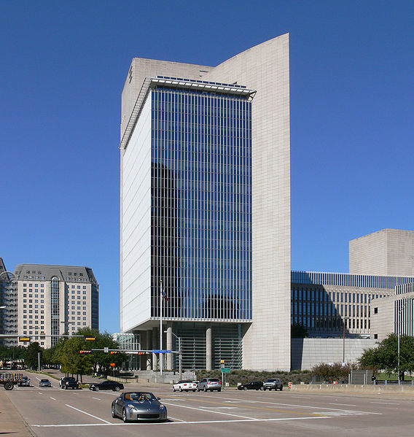
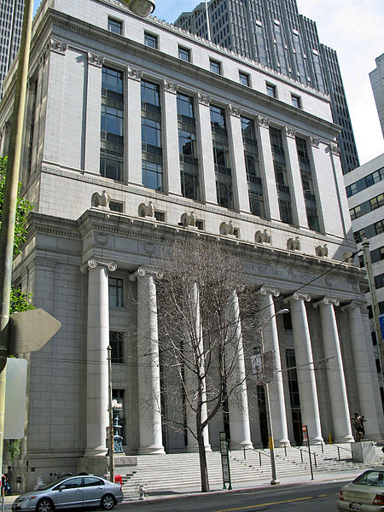
Kansas City ( J )
San Francisco ( L )
Dallas ( K )

Slide 23
Living Dollar
22 months
25
months
24
months
55
months
18
months
60
months

Slide 24
Currencies
Year | Buy | Sell
2004 | 5.29 | 5.33
2005 | 5.07 | 5.14
2006 | 5.02 | 5.05
2007 | 5.02 | 5.04
2008 | 4.72 | 4.79
2009 | 7.60 | 7.66
2010 | 7.91 | 7.94
2011 | 7.97 | 8.00
2012 | 8.06 | 8.11
2013 | 8.12 | 8.15
2014 | 8.40 | 8.47

Slide 25
Questions
When was dollar introduced by government of the USA?
What happened in 1794?
Who is pictured on $1?
Do the USA has the main Central Bank?
Where is Federal Reserve System situated?
How many months does $100 live?

Slide 26
Answers
Dollar was introduced in 1785.
The first dollars in the USA started to produce in 1794.
On the bill of $1 is the first president of the USA George Washington.
The USA hasn’t the main Central Bank.
Federal Reserve System is situated in Washington, USA.
$100 lives 60 months.

Slide 27
Sources
http://en.wikipedia.org/wiki/United_States_dollar
http://en.wikipedia.org/wiki/Federal_Reserve_System
http://tables.finance.ua/ru/currency/cash/~/ua/USD/0#2:0
http://en.wikipedia.org/wiki/Federal_Reserve_Bank
https://www.mint.com/blog/trends/the-origins-of-the-u-s-dollar/
http://en.wikipedia.org/wiki/Federal_Reserve_Note
http://en.wikipedia.org/wiki/Richard_Nixon

Slide 28
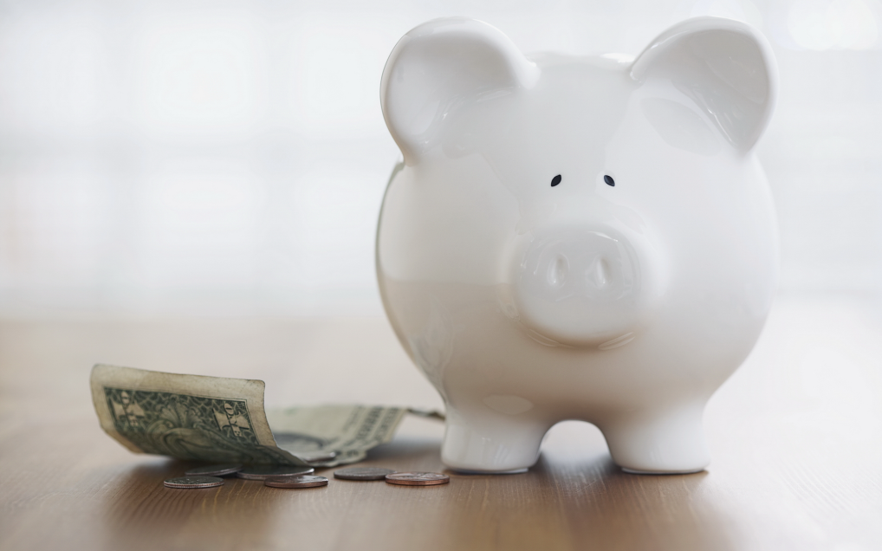
Thank you very much for your kind attention!

