Slide 1
How to reconcile family and work
Iryna Honcharova

Slide 2
What is more important?
Finding a suitable work/family life balance is a challenge that all parents face. Each of us has his family. To provide it with all the necessary things, we spend a lot of time at work. But we can not forget those for whom we work.

Slide 3
What to do?
Sure, it's nice when family is financially secure and enjoys life. But if the cost of achieving this status - frequent family conflicts, the goal is not justified

Slide 4
What is better?
Passion for money makes people less happy. At the same time, those who are looking for money to support his family do not feel negative emotions

Slide 5
Achieving a balance between work and family is not easy, and sometimes impossible. Our children need mothers and fathers. Kids don‘t care about the size of the house or the presence of a new car. They need parental love

Slide 6
Family needs time
Instead of long hours working day better to select a walk with children.

Slide 7
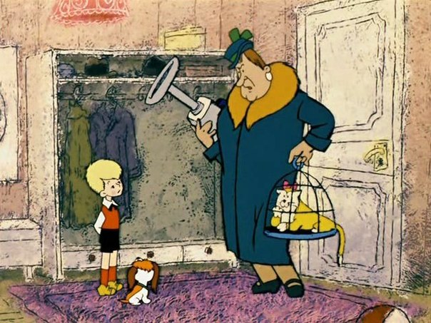
What is more important?
Your kids will not grow with a nanny. No one can care for them better than you. Think about it.

Slide 8
Important role in helping families spending time together play employers or «bosses». They should understand the situation of their workers. The government should reduce working hours and increase wages.

