Slide 1
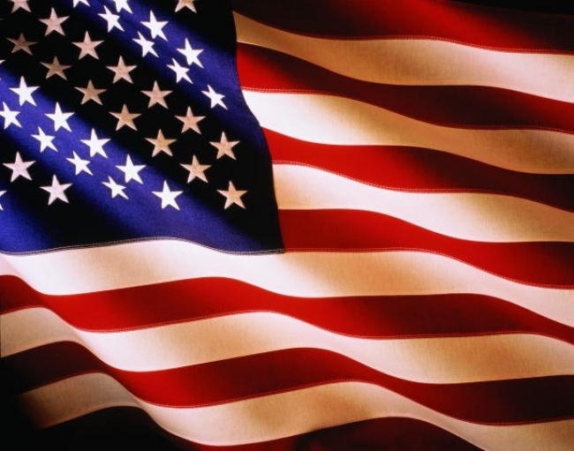
Attractions USA

Slide 2
Bryce Canyon National Park, Utah

Slide 3
Mount McKinley, Alaska

Slide 4
The Golden Gate Bridge in San Francisco

Slide 5
Pali Coast, Hawaii

Slide 6
New York at night

Slide 7
Fire waterfall in Yosemite National Park

Slide 8
Big Sur. Wild Coast of California

Slide 9
Grand Canyon National Park in Arizona

Slide 10
Death Valley in California

Slide 11
Night Las Vegas

Slide 12
Anzhelika Yakymiv

