Slide 1
Canada, New Zealand, Australia

Slide 2
New Zealand

Slide 3
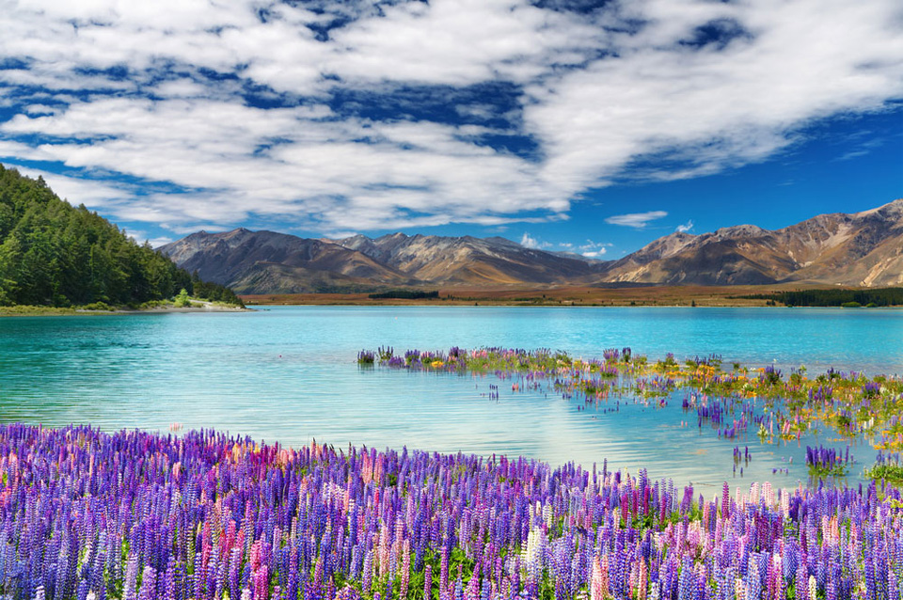
New Zealand is an island country in the southwestern Pacific Ocean. The country geographically comprises two main landmasses – that of the North Island, or Te Ika-a-Māui, and the South Island, or Te Waipounamu – and numerous smaller islands.

Slide 4
Population:4,509,461
Area: 268,021 km2

Slide 5
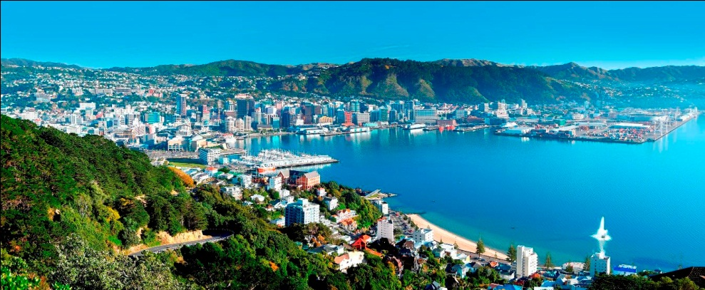
Capital: Wellington

Slide 6
Largest city: Auckland

Slide 7
Official languages:

Slide 8
Highest point : Mount Cook at 3,754 metres

Slide 9
Economy: New Zealand is heavily dependent on international trade, particularly in agricultural products.

Slide 11
“God Defend New Zealand”

Slide 12
Canada

Slide 13
Canada is a country in North America consisting of 10 provinces and 3 territories. Located in the northern part of the continent.

Slide 14
Population: 35,158,300
Area: Total 9,984,670 km2

Slide 15
Capital: Ottawa

Slide 16
Calgary

Slide 17
Toronto

Slide 18
Official languages:

Slide 19
Lake Superior

Slide 20
Lake Huron

Slide 21
McKenzie river

Slide 22
Yukon river

Slide 23
Economy: many industries such as cars electrical goods.

Slide 25
“O Canada”

Slide 26
Australia

Slide 27
Australia officially the Commonwealth of Australia, is a country comprising the mainland of the Australian continent, the island of Tasmania, and numerous smaller islands.

Slide 28
Population: 23,377,368
Area: Total 7,692,024 km2

Slide 29
Capital: Canberra

Slide 30
Sydney

Slide 31
National language: English

Slide 32
The Great Barrier Reef

Slide 33
Mount Augustus

Slide 34
Mount Kosciuszko

Slide 35
“Advance Australia Fair”

