Slide 1
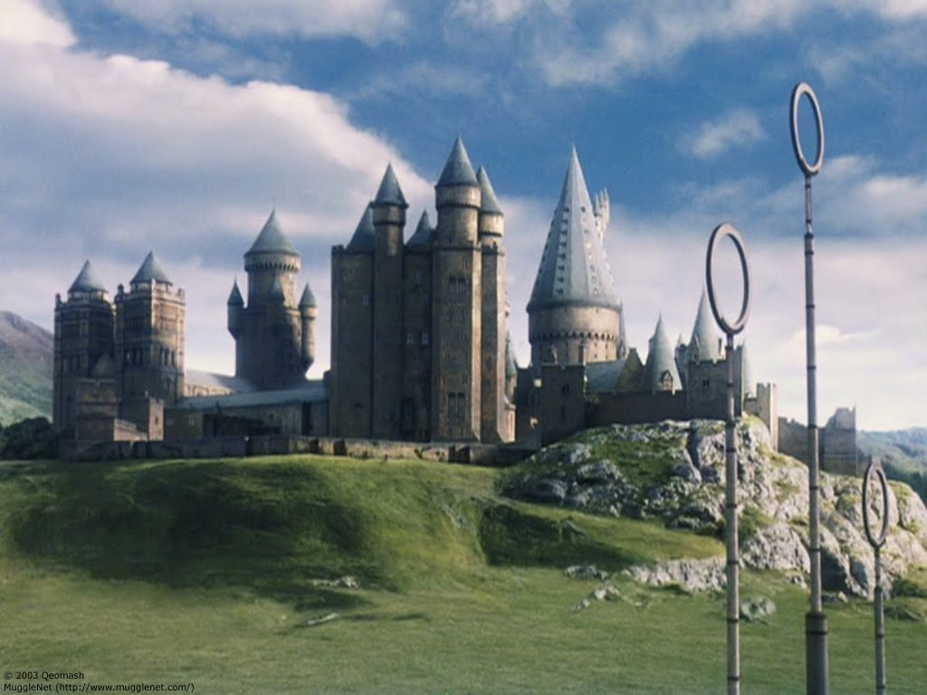
My ideal school

Slide 2
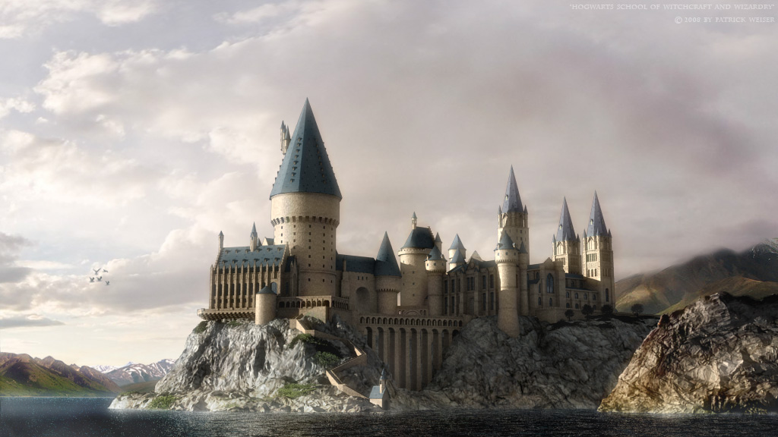
Hogwarts School of Witchcraft and Wizardry is a British wizarding boarding school teaching the magical arts, located in Scotland inside Hogwarts Castle. The castle is in the mountains near a loch. The precise location of the school can never be uncovered because it has been rendered Unplottable. Similarly, most wizarding schools locations are protected in order to prevent their ways of teaching being revealed, as well as protect the students and schools themselves from any harm.

Slide 3
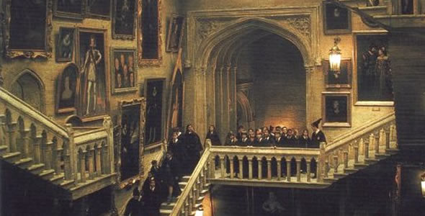
Established around the 9th or 10th century, Hogwarts is considered to be one of the finest magical institutions in the wizarding world, though other notable schools include Beauxbatons Academy of Magic and the Durmstrang Institute. Children with magical abilities may be enrolled at birth, and acceptance is confirmed by owl post at age eleven.
The school's motto is "Never tickle a sleeping dragon".

Slide 4

Term begins on 1 September. Students usually reach Hogwarts via the Hogwarts Express, which leaves from Platform 9¾ of London's King's Cross Station at 11 a.m. sharp.
There seemed to be other ways of entering the school, such as via brooms or Floo powder, or simply Apparating to a nearby location such as Hogsmeade. Missing the Hogwarts Express for any reason is a very serious problem but will not cost the student points as long as they get there before the term has officially started.

Slide 5
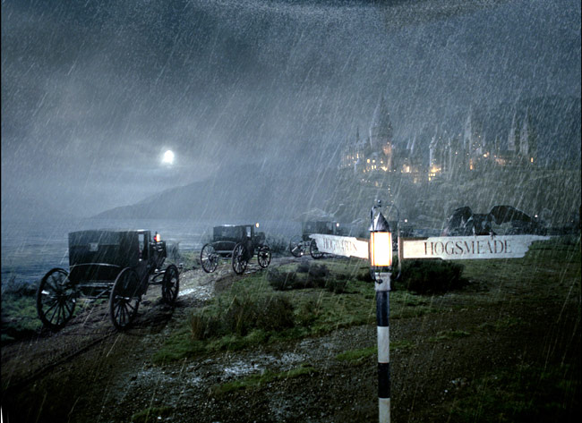
Older students travel on the road in carriages pulled by thestrals (invisible to any that hasn't witnessed death) to the castle. The Welcoming Feast takes place in the Great Hall. This feast includes the Sorting ceremony, followed by a few words from the current Headmaster or Headmistress, the banquet starts after this, including large quantities of food and drink. The feast is closed with a few more words from the Headmaster, but it also included the usual "start-of-term notices".
After dinner, students are led to their house common room by a prefect. This is a special time for new students to get comfortable with their surroundings, because the next day classes begin, 2 September. The class schedules are handed out during breakfast by the Heads of House. After two weeks of classes, the Quidditch team trials and flying lessons for the first years usually occur.

Slide 6
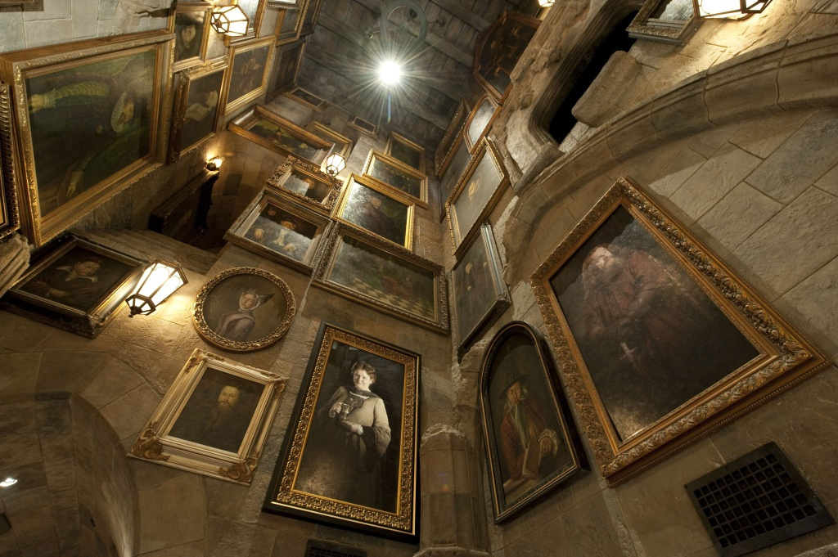
Hogwarts' school year is structured in a similar way to other non-magical schools and colleges in the UK, with a three-term year punctuated by holidays at Christmas and Easter and bounded by the long summer holiday of nine weeks. Students have the option of staying at Hogwarts for the winter and spring holidays. Those who choose to stay at the castle do not have lessons and attend a feast on Christmas Day. Students also do not have classes the week of Easter, but this is much less enjoyable due to the large amount of work that the teachers assign students at this time in preparation for final exams.

Slide 7
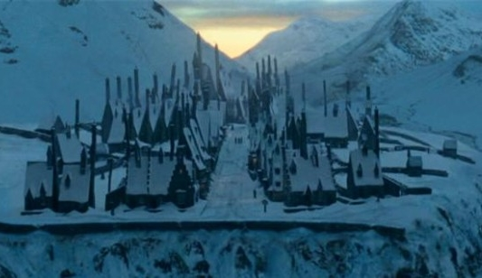
Other than the breaks and weekends, students do not receive holidays. However, students third year and above may visit Hogsmeade, the local village, occasionally. There are normally four feasts per year: the start-of-term feast at the beginning of the school year, end-of-term feast at the end of the school year, and feasts at Halloween and Christmas. Feasts are also called to mark special occasions, as in Goblet of Fire, when there was a feast to celebrate the beginning of the Triwizard Tournament.

Slide 8
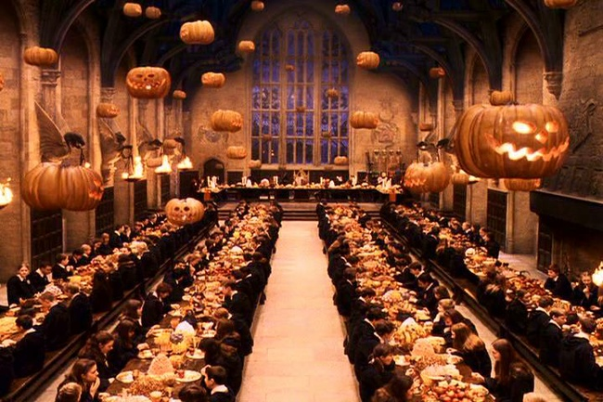
Classes will proceed normally and the next notable event occurs on the evening of 31 October: the Hallowe'en feast. Decorations include giant pumpkins and flocks of hundreds of bats flying across the halls. The served foods include pumpkin treats, tarts, cakes and all sorts of magical sweets.

Slide 9
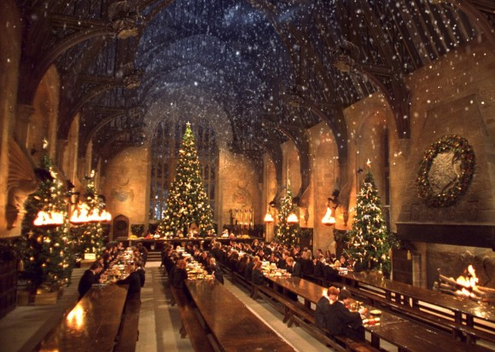
The Quidditch season starts usually with the first Quidditch match in the first weeks of November. In the second week of December, the Deputy Head takes names of those who are staying at Hogwarts over the Christmas holidays. The first term usually ends about a week before Christmas and most of the students and some of the teachers go home by the school train.

Slide 10
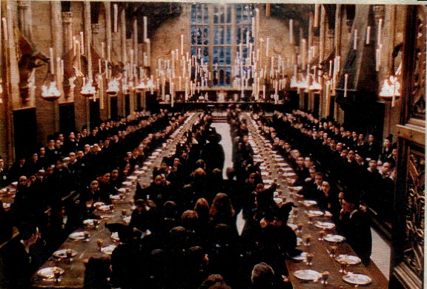
Shortly after 6 January (Epiphany aka Twelfth Night), the Hogwarts Express returns to Hogsmeade; the second term begins. The exact dates of the beginning of the Easter holidays vary every year. During these holidays, the students may go home. The final exams are held the first week of June and the results come out on the second week. In the evening before the Hogwarts Express goes back to London, the End-of-Term Feast is held. The Hogwarts Express returns to London during the third week of June. Some staff and all students leave Hogwarts for summer holiday.

Slide 11
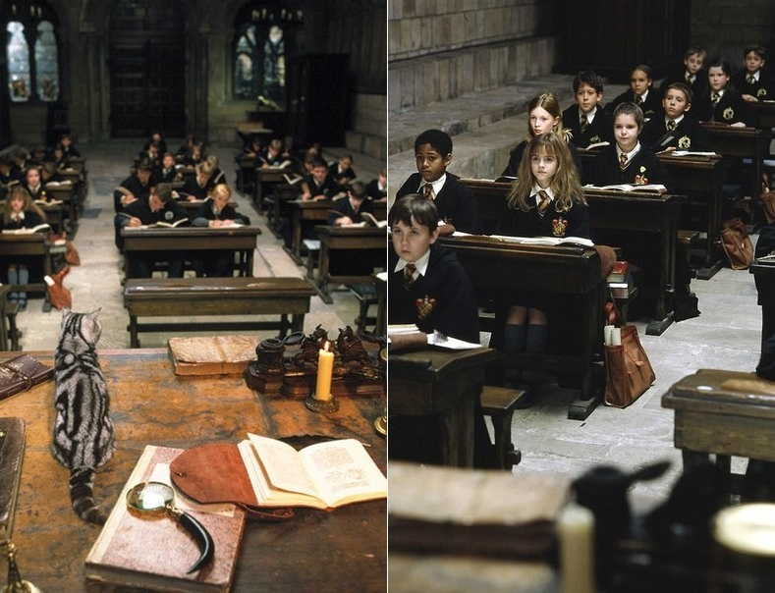
Hogwarts has in its faculty an abundance of wise and talented professors. Each specialises in a specific subject. Other staff positions include that of school nurse, caretaker, librarian, and Keeper of the Keys and Grounds of Hogwarts.
. There are a variety of classes taught at Hogwarts School of Witchcraft and Wizardry. These include both the core curriculum and the electives, available from third year forward. Some classes may be dropped in sixth year.

Slide 12
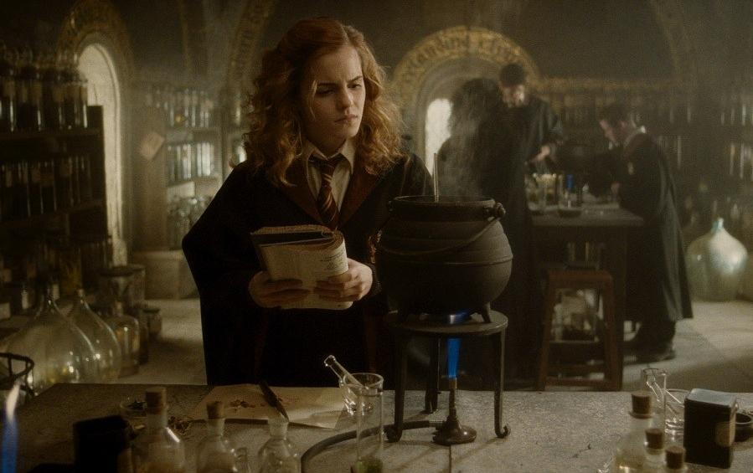
Numerous lessons are described, instructing the students in various branches of magic. Transfiguration, Defence Against the Dark Arts, Charms, Potions, Astronomy, History of Magic, and Herbology are compulsory subjects for the first five years. At the end of their second year, students are required to add at least two optional subjects to their syllabus for the start of the third year. The five choices are Arithmancy, Ancient Runes, Divination, Care of Magical Creatures, and Muggle Studies.

Slide 13
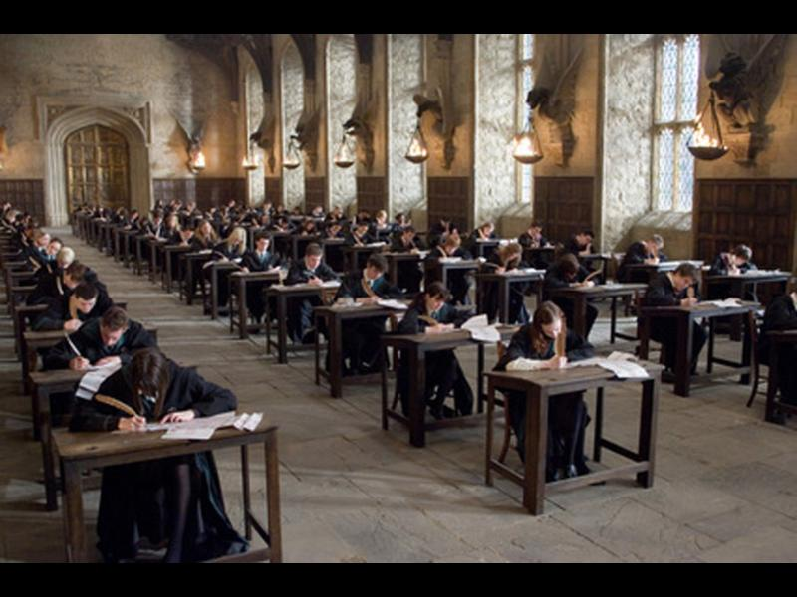
Grading on routine homework seems to be along the same lines as that for Muggle students. Hogwarts students also have difficult exams as they progress higher in the system. O.W.L.s (Ordinary Wizarding Levels) are a set of standardised tests for fifth year students which determine what courses a student may continue to study in their final years at Hogwarts. N.E.W.T.s (Nastily Exhausting Wizarding Tests) are optional levels of education for exceptional students, much like A levels for Muggle students. To progress to N.E.W.T.-level, students must receive certain high marks on O.W.L. exams. N.E.W.T tests occur at the end of the seventh year and cannot be retaken.

Slide 14
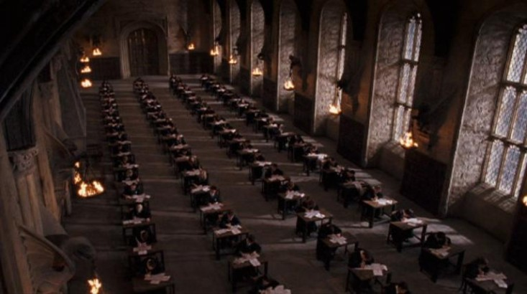
Ordinary Wizarding Level Grading System
O - Outstanding (Pass, always continue to N.E.W.T.)
E - Exceeds Expectations (Pass, usually continues to N.E.W.T.)
A - Acceptable (Pass, rarely continue to N.E.W.T)
P - Poor (Fail, may repeat subject)
D - Dreadful (Fail, may not receive O.W.L. credit)
T - Troll (Fail, with distinction. More than one T may mean refusal into other N.E.W.T.s)

Slide 15
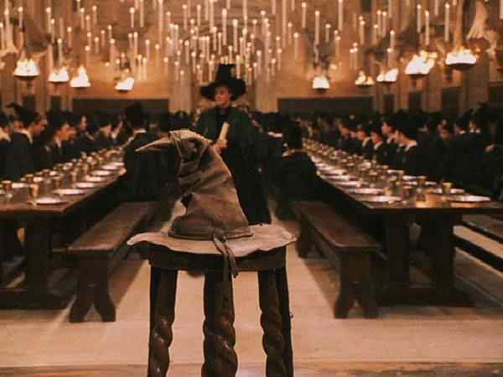
The day begins at 7:30 a.m. with breakfast in the Great Hall. During breakfast, the mail arrives in a flurry of hundreds of owls. A bell chime signals the start of the first class at 9 a.m. The bell chimes again in one hour to signal the start of the next class.
There are four class periods before lunch (though NEWT student may have breaks during some of these), scheduled according to house. After lunch, there is another break and two more classes.

Slide 16
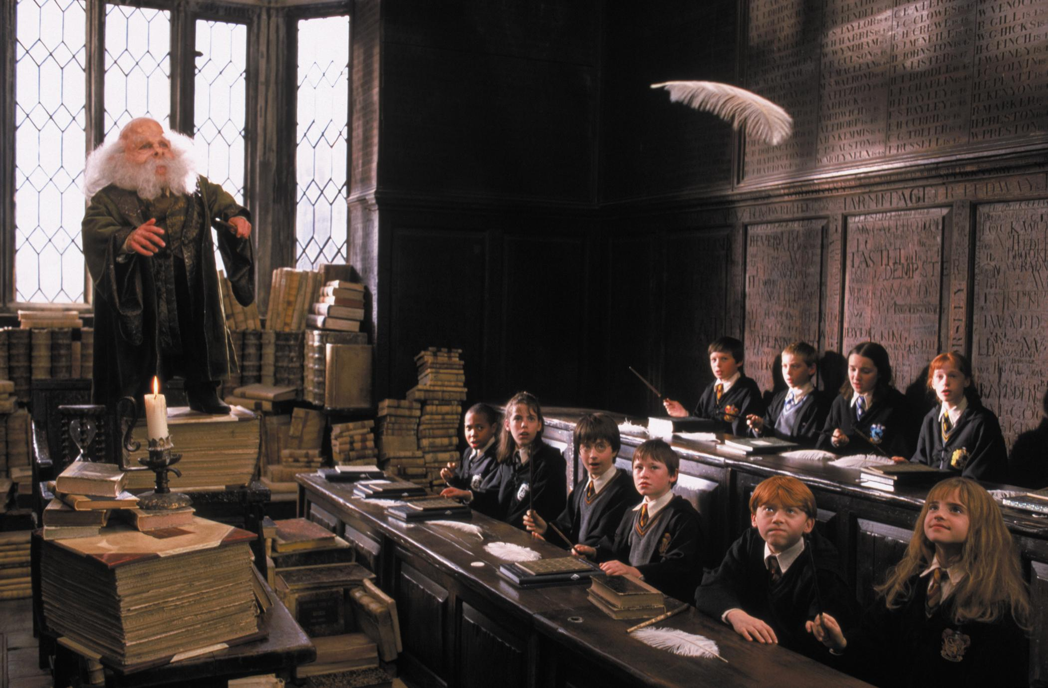
Dinner is served in the Great Hall toward evening, after which the students are expected to be in their house common rooms for studying and socializing.
There is an Astronomy class at night on Wednesday every week (usually midnight).
The students must be in bed or in the common rooms by a certain time, after which is called after hours. The times are different for different years (for example, fifth years are allowed to be in the halls until 9:00)

