Slide 1
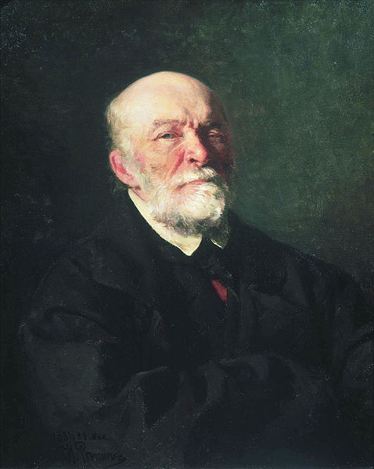
Mykola Pyrohov (1810-1881)
Yaroslav Nadvornyj
11-B

Slide 2
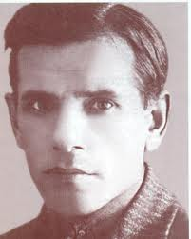
Family and early years
Mkola Ivanovich Pirogov was born on 13/25 November 1810 in Moscow, the son of a military officer.
His father Ivan served as treasurer of the Moscow refreshment depot with the rank of Major.
Secondary education Mykola got home first, and then in a private hostel. At fourteen he entered the Moscow State University for medical school.

Slide 3
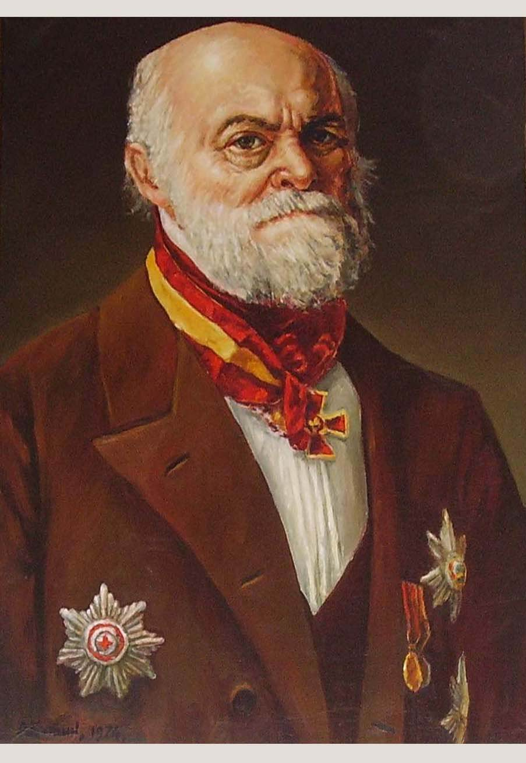
Early successes
At age 26 Pirogov was promoted to professor and head of the surgical clinic in Derpt University.
Five years Pirogov was invited to Petersburg Medical-Surgical Academy, where he stayed for almost 15 years until his retirement. Here he created the first in the anatomical institute.

Slide 4
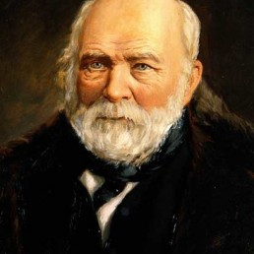
Greatest achievements
Much of the credit Pirogov to the country and, above all, to the Russian army. Pirogov was a member of four wars.
His experience Pirogov outlined
four classical literature on military
surgery, which also formed the basis
of all modern medical aid to the
wounded on the battlefield.

Slide 5
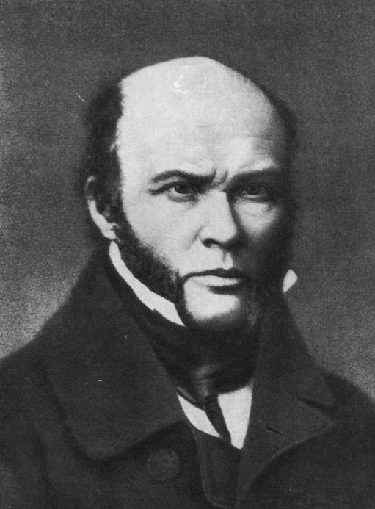
Contributed to scientific understanding
Mykola Ivanovich Pirogov rightly considered the "father of Russian surgery", the founder of field surgery. Pirogov world's first used ether anesthesia in war.
October 16, 1846 - was first carried
out extensive surgery under full ether
anesthesia.

Slide 6
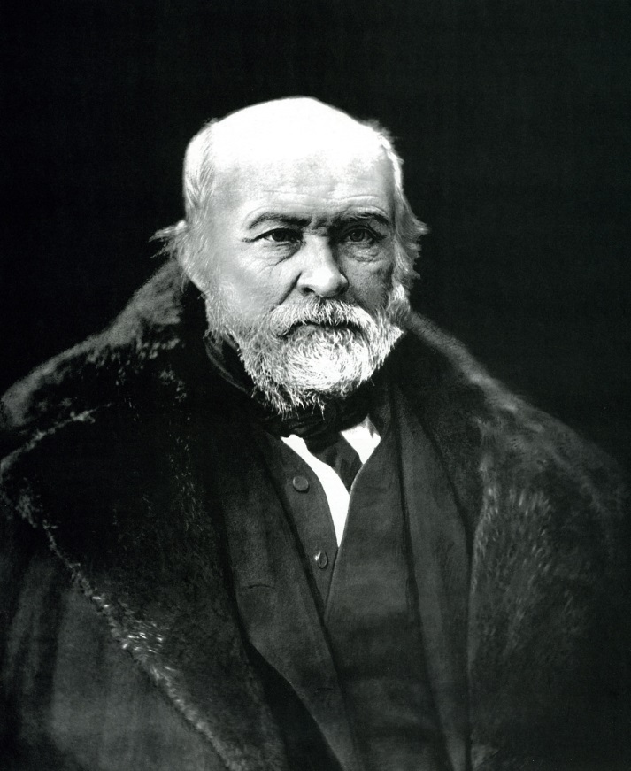
Helped people
Pirogov world's first organized and used women's care for the wounded in the fighting.
He’s first organized and founded the "Sisters of the Holy Cross community care for the wounded and sick.“
Pirogov as the world's first proposed, organized and applied his famous - sort of wounded, which later grew all medical evacuation of the wounded.

Slide 7
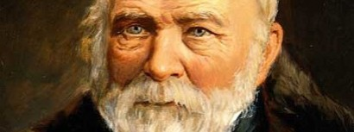
Mykola Pirogov Died 23 November 1881
The main significance of the Pirogov is that their selfless work and mostly disinterested surgery, he turned to science, arming physicians scientifically sound methodology surgery.

Slide 8
Thank You

