Slide 1
Diego Rodríguez de Silva y Velázquez
(June 6, 1599 – August 6, 1660)
By Daryna Moroz
Form 10-A
Hrebinka gymnasium

Slide 2
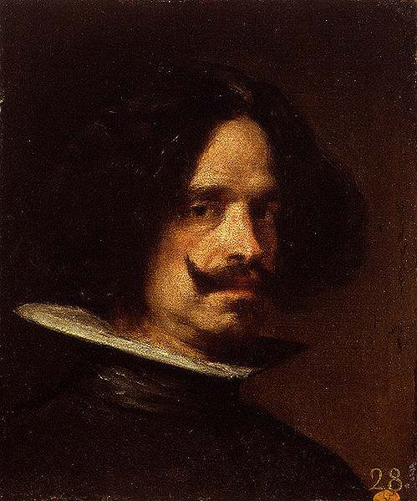
Diego Velázquez was a Spanish painter who was the leading artist in the court of King Philip IV and one of the most important painters of the Spanish Golden Age.

Slide 3
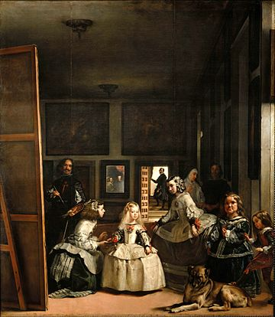
He was an individualistic artist of the contemporary Baroque period, important as a portrait artist.
Culminating in the production of his masterpiece Las Meninas (1656). This is my favorite work.

Slide 4
First trip to Italy (1629–30)

Slide 5
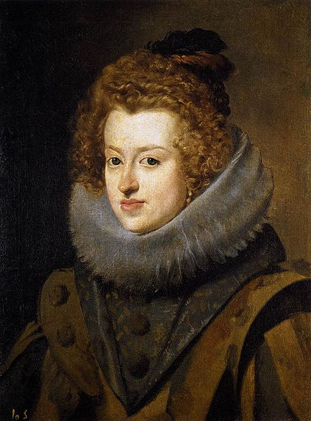
Title: Portrait of Maria Anna;
Date: 1630;
Dimensions (cm): 59.5 × 45.5
Collection: Museo del Prado, Madrid.

Slide 6
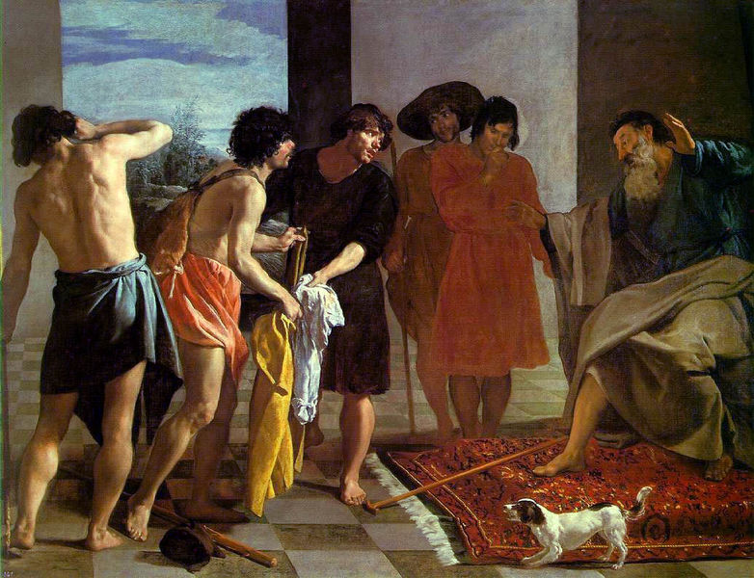
Title:Joseph's Tunic;
Date: 1630;
Dimensions (cm): 223 × 250;
Collection: El Escorial,San Lorenzo de El Escorial.

Slide 7
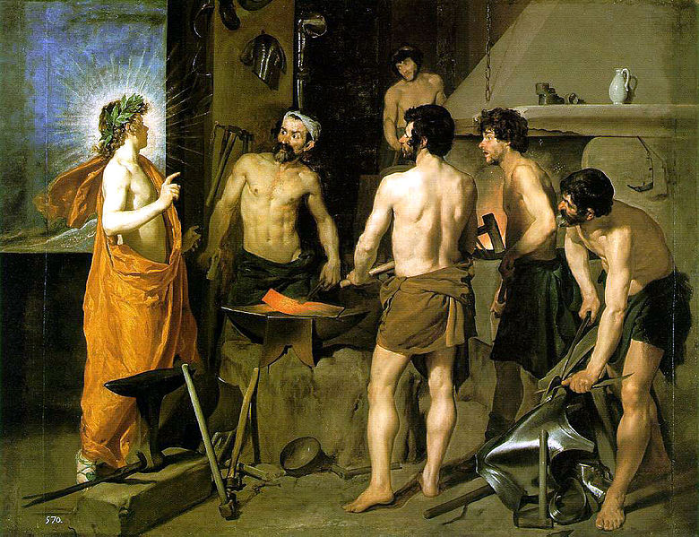
Title: Apollo in the Forge of Vulcan;
Date: 1630;
Dimensions (cm): 222 × 290;
Collection: Museo del Prado, Madrid.

Slide 8
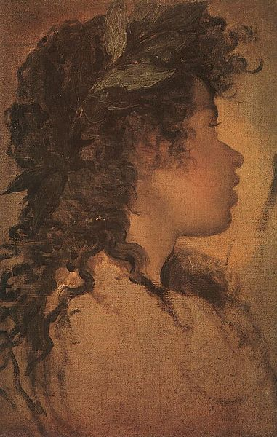
Title: Cabeza de Apolo;
Date: 1630;
Dimensions (cm): 36 × 25;
Collection: Private collection, New York.

Slide 9
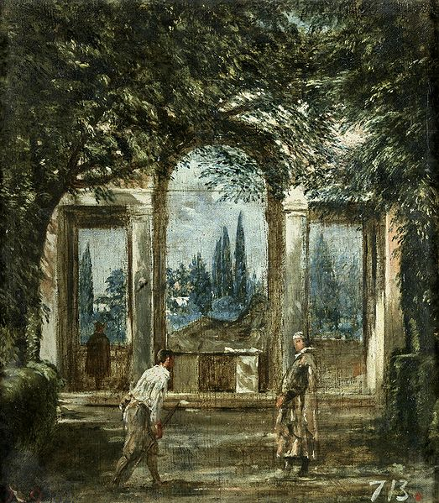
Title: El Pabellón de Cleopatra-Ariadna;
Date: 1630;
Dimensions (cm): 44.5 × 38.5;
Collection: Museo del Prado, Madrid.

Slide 10
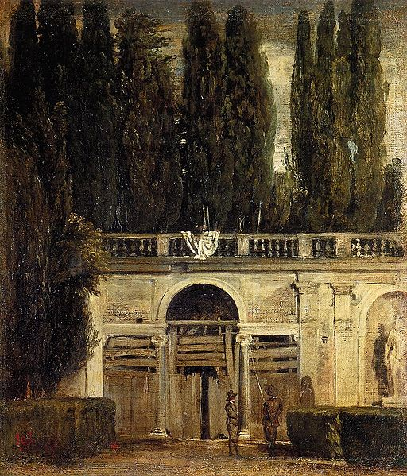
Title: View of the Garden of the Villa Medici;
Date: 1630;
Dimensions (cm): 48.5 × 43;
Collection: Museo del Prado, Madrid.

Slide 11
Second trip to Italy (1649–51)

Slide 12
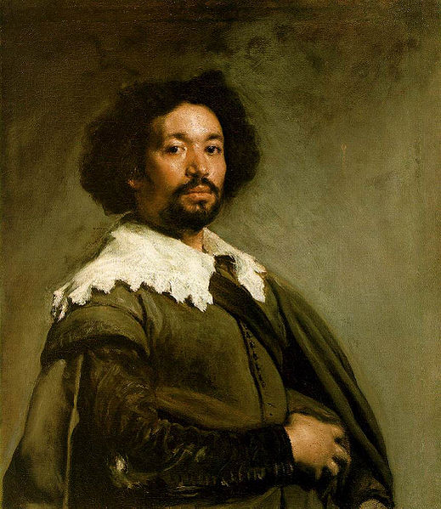
Title: Portrait of Juan de Pareja;
Date: 1649–1650;
Dimensions (cm): 81.3 × 69.9;
Collection: Metropolitan Museum of Art, New York.

Slide 13
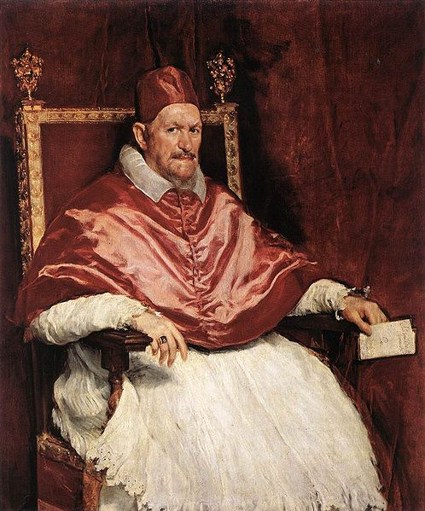
Title: Portrait of Innocent X;
Date: 1650;
Dimensions (cm): 140 × 120;
Collection: Doria Pamphilj Gallery, Rome.

Slide 14
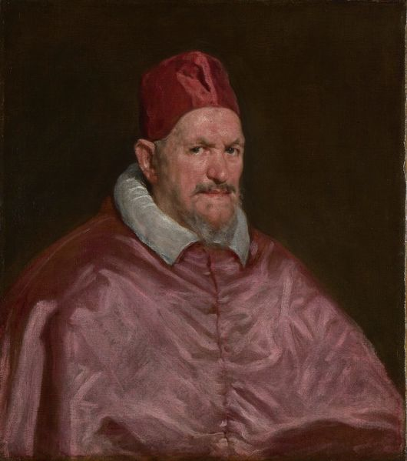
Title: Innocent X;
Date: 1650;
Dimensions (cm): 82 × 71.5;
Collection: Apsley House, London.

Slide 15
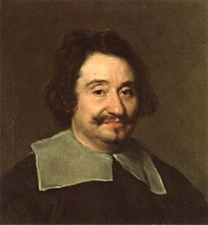
Title: El llamado barbero del Papa;
Date: 1650;
Dimensions (cm): 50.5 × 47;
Collection: Museo del Prado, Madrid.

Slide 16
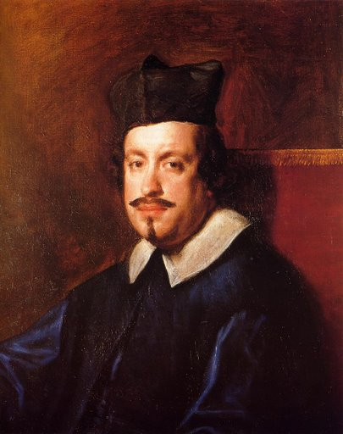
Title: Camillo Massimi;
Date: 1650;
Dimensions (cm): 73.6 × 58.5;
Collection: Kingston Lacy, Dorset .

Slide 17
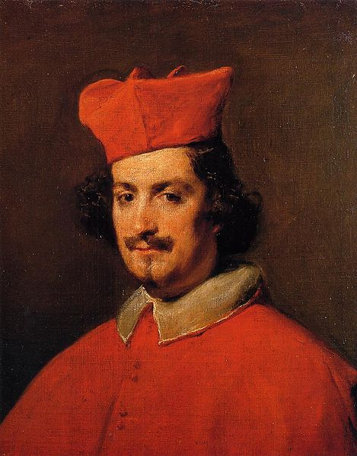
Title: El cardenal Astalli;
Date: 1650–1651;
Dimensions (cm): 61 × 48.5;
Collection: Hispanic Society of America, New York.

Slide 18
Thank you for your attention!

