Slide 1
Презентація на тему: My Dream Profession
Підготував :
Учень 10 класу
Кійко Едуард
Світлодолинське 2013

Slide 2
I hope, you like ☺

Slide 3
Plan
Professions in the World
I Would Like to Be a ...
Education
Football Emotions
Working Everyday
Each Coach Want to Win
The Most Famous Coaches
Quotes of Great Coaches

Slide 4
Professions in the world
There are a lot of professions in the world, they are dangerous and safe, indoors and outdoors, traveling a lot and less.
doctor
farmer
police
taxi
lawyer
pilot
actor
teacher

Slide 5
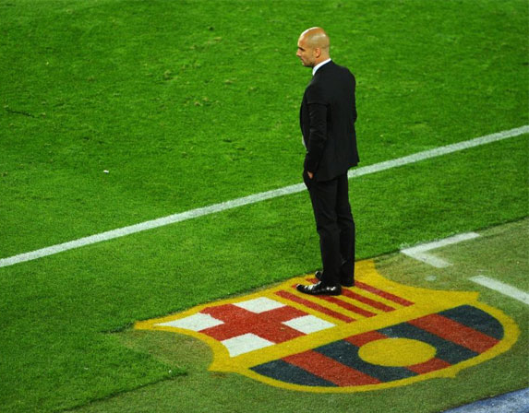
As for me . . .
As for me, I dream about profession, like a football coach !

Slide 6
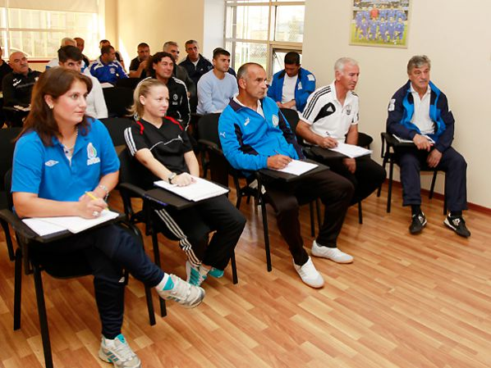
Education
To be a football coach people have to pass coach’s exams
It’s a really funny, when famous footballers are sitting down the tables and learning.

Slide 7
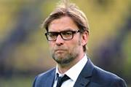
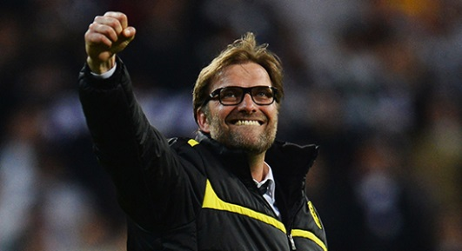
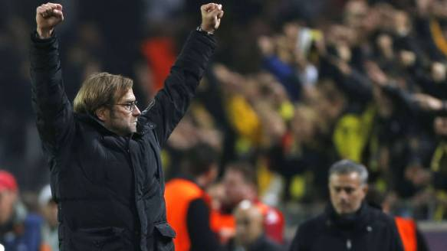
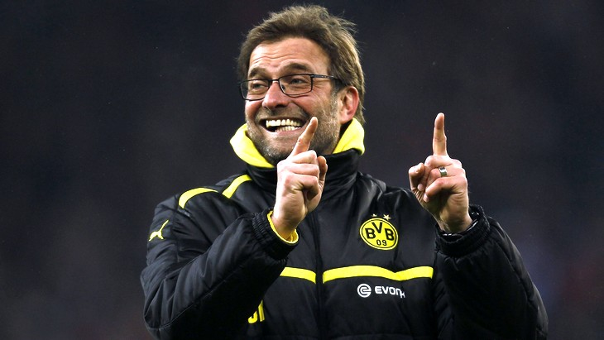
Football Emotions
Football is very affective game!
Jurgenn Klopp ,
Borussia Dortmund coach

Slide 8
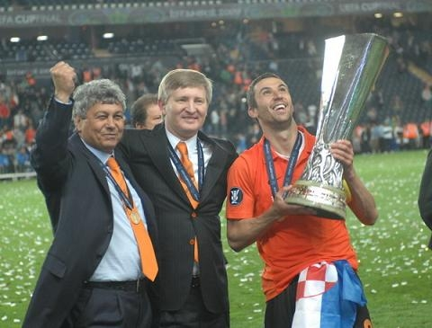
Everyday Work
Football coaches are working hard every day to reach achievements with their teams.

Slide 9
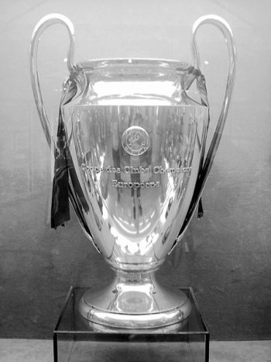
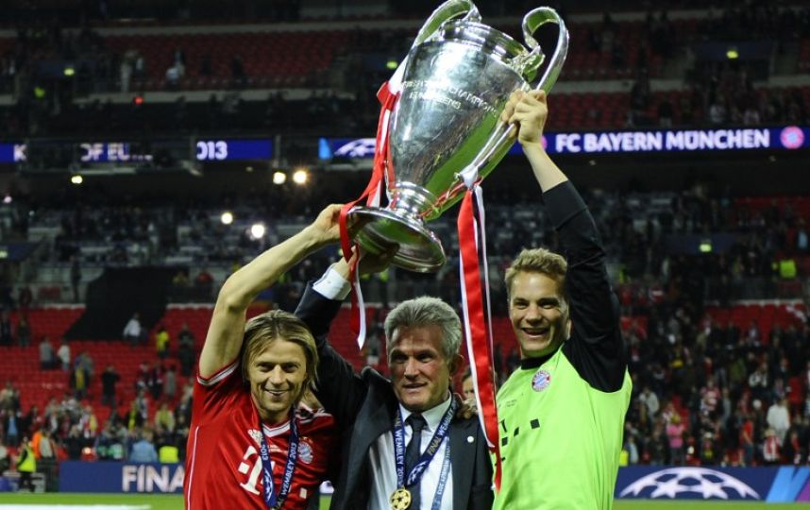
The Main Trophy
European Champions League is the greatest trophies in the world

Slide 10
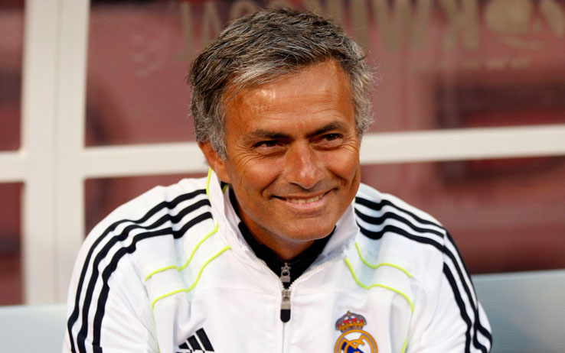
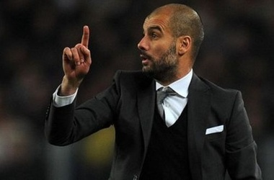
The Most Famous Coaches
There are a lot of football teams and coaches, but only singles are successful.
Jose Mourinho and Pep Guardiola

Slide 11
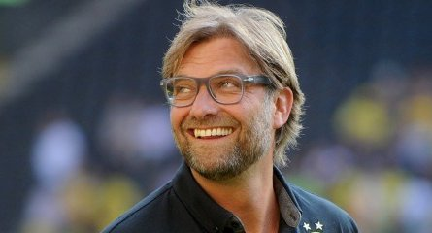
Quotes of Great Coaches
I have bad news. Guys from Frankfurt really can play football !
© Jurgen Klopp

Slide 12
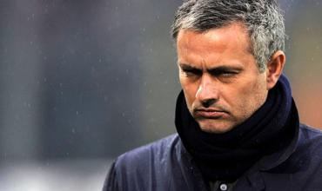
Quotes of Great Coaches
Came into my team and you will never lose
© Jose Mourinho

Slide 13
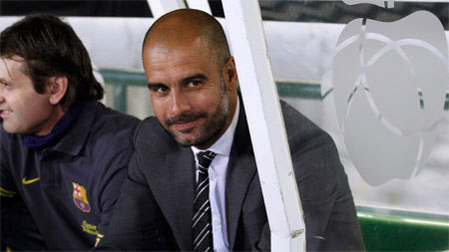
Quotes of Great Coaches
You can’t run more quickly, than the ball is flying
© Pep Guardiola

Slide 14
Thank You for Your Attention

