Slide 1
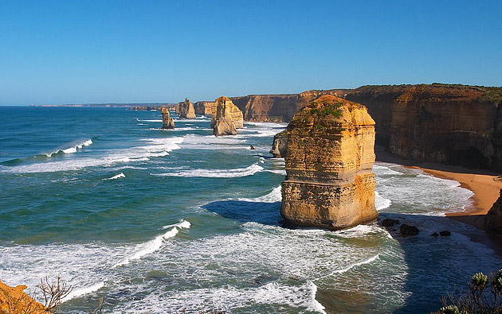
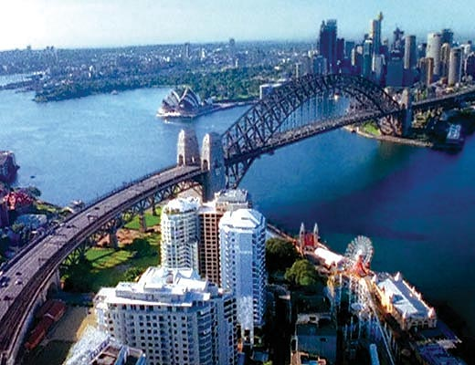
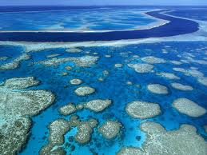
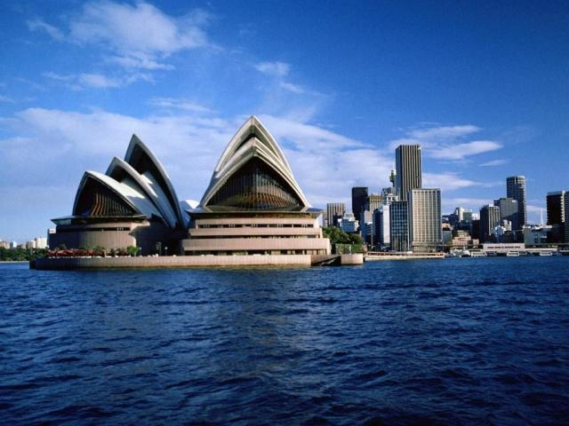
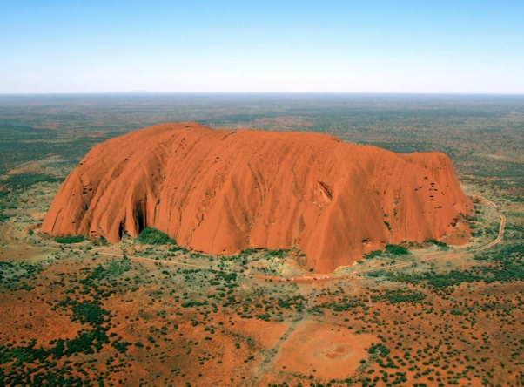
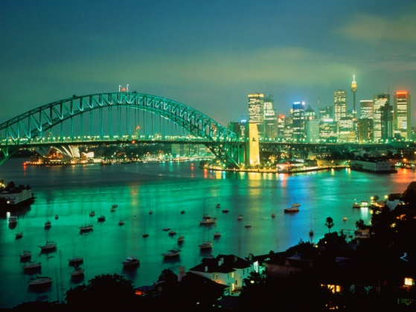
Australia

Slide 2
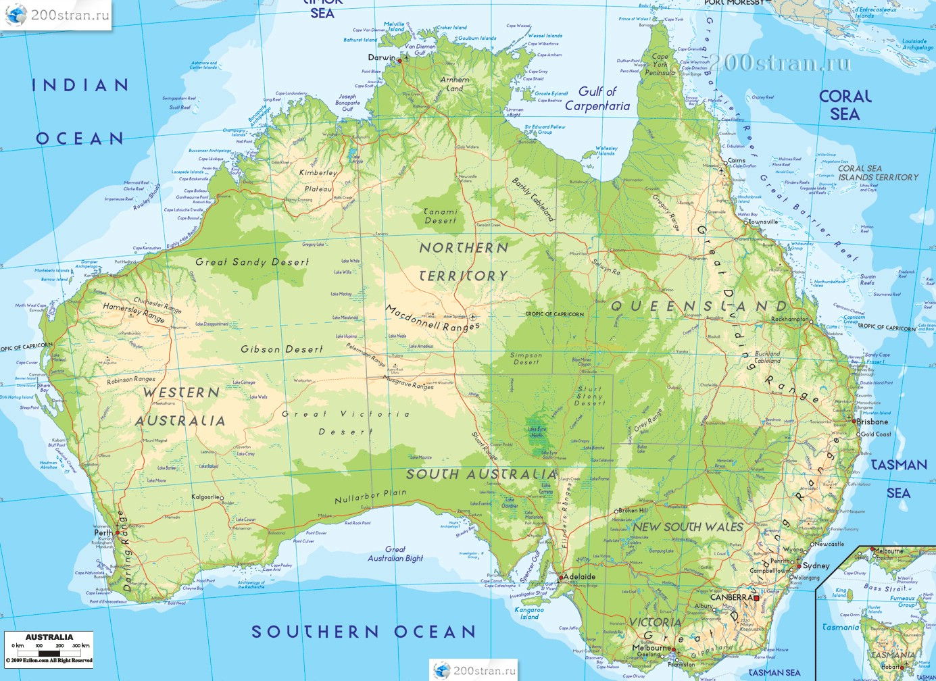
Map of Australia

Slide 3
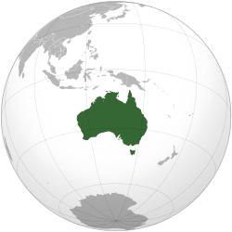
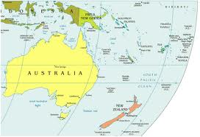
Australia as a continent:
- Area of ​​7687 sq km ²
- Coastline 19,600 km
- The northernmost point of Cape York
- Southernmost Point Cape of South East
- Westernmost point of Cape Stipe Point
- Eastern-most point of Cape Byron
- Population: 20 million inhabitants
- Population density: 3 persons / km ²

Slide 4
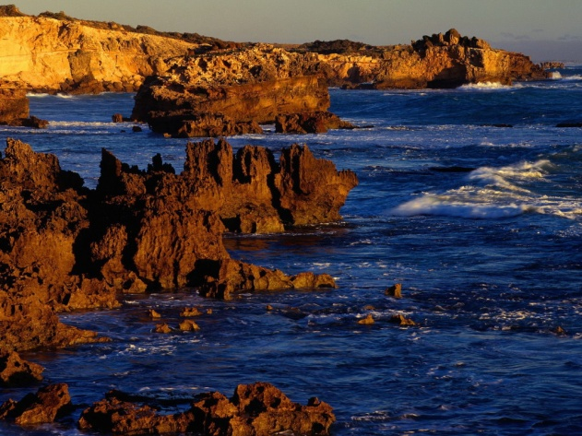
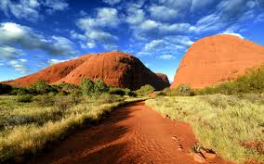
Australia as a continent:
Australia - a continent located in the southern hemisphere. Washed by the waters of the Indian Ocean and the Pacific Ocean. It is the smallest and farthest from the other continent on the globe.
The first in 1606 on the west coast of Cape York Peninsula landed Dutch navigator Willem Janszoon. Junior Matthew Flinders (1774-1814), who first explored the Australian coast and made his card, used the term "Australia" in their work.
Along the east coast of Australia in 2300 km Great Barrier Reef stretches.

Slide 5
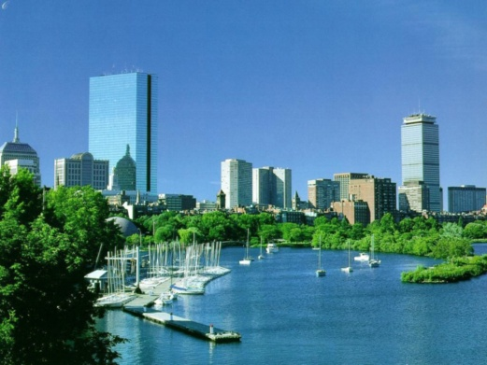
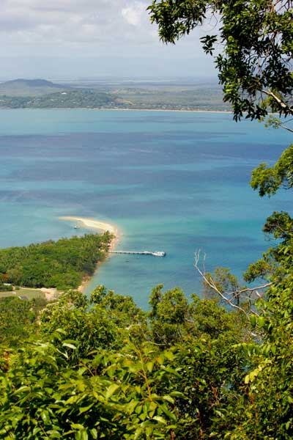
Australia as a continent:
Australia - is equal to the continent. The driest inhabited continent on the planet, only the south-eastern and south-western part have a temperate climate.
The Great Barrier Reef, the largest coral reef in the world, stretching for 2,000 km from the east coast. Mount Augustus, which is the largest monolith in the world, is located in Western Australia. The highest mountain on the Australian continent - Mount Kosciusko (2228 m), but the highest point of the territory that belongs to Australia - is Mawson Peak (2745 m, Heard Island)

Slide 6
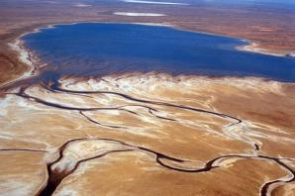
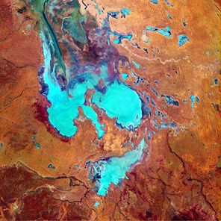
Ayr
Ayr - shallow, salty, seasonal lake in central Australia in the middle of the so-called "Depression Lake Eyre." When full, is the largest lake in the continent. The level of the lake at 16 meters below sea level. The average area of ​​about 9.5 thousand km ², rainy period to 15 thousand km ². Endorheic lake, periodically fed by the waters year Cooper Creek Varburton and Fink.

Slide 7
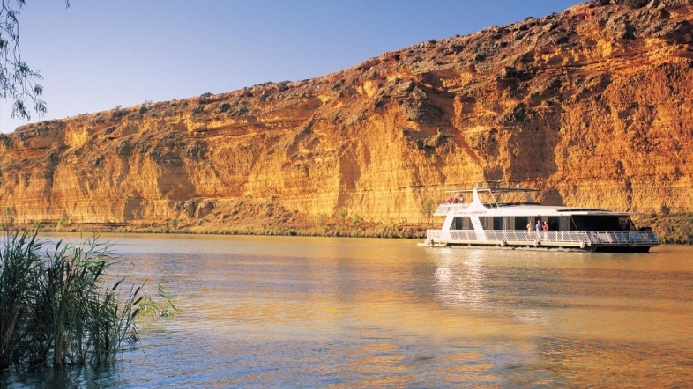
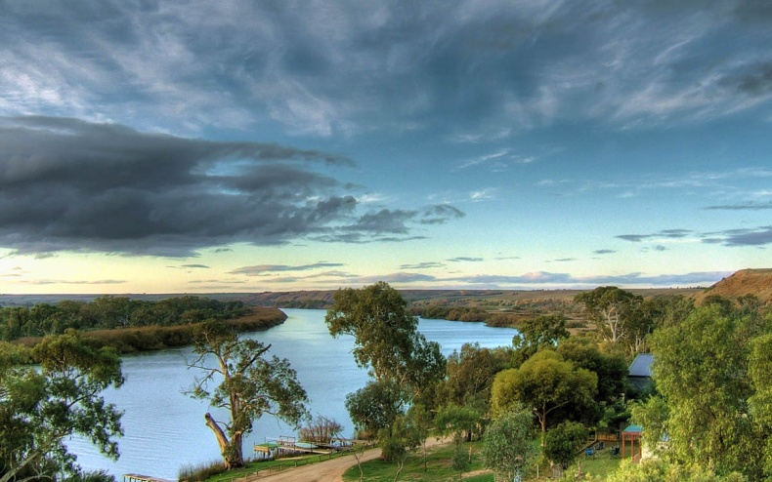
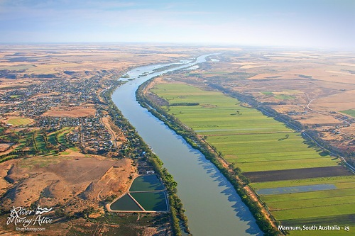
Length of 2575 km (from the source, the Darling - 3750 km).
Originates on the western slopes of the Snowy Mountains in the Australian Alps and empties into the shallow bay. Origins same Murray are at the foot of the high peaks of the continent - Mount Kosciuszko. Of course it is far to the Himalayan or Alpine peaks - height "Australian Mont Blanc" is less than two and a half miles, but still for Australia is a unique vertex, because its the only one of the local mountains, year-round snow blanket wraps.
Murray

Slide 8
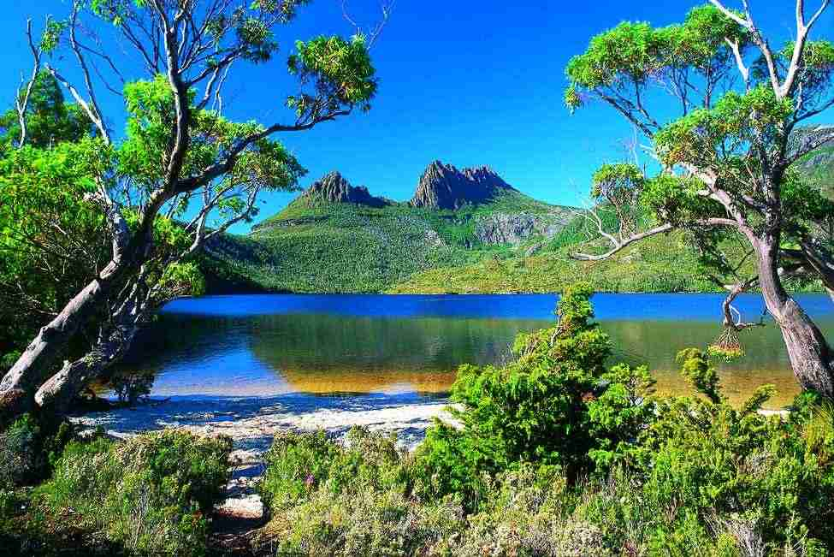
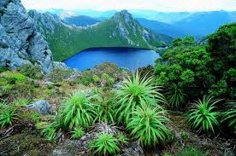
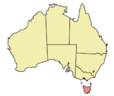
Tasmania - Australia's largest island, disconnected from her Bass Strait. Because of mountainous terrain in the island are many rivers. In rivers built hydropower plants fully meet the needs of state in power. Major rivers - Teymar-Macquarie (north) and Deruent (south) on the central plateau many lakes of glacial origin.

Slide 9
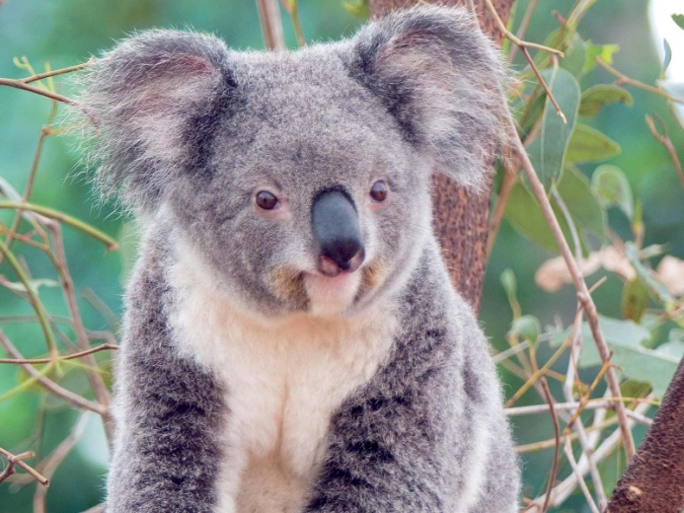
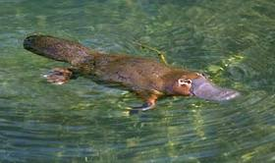
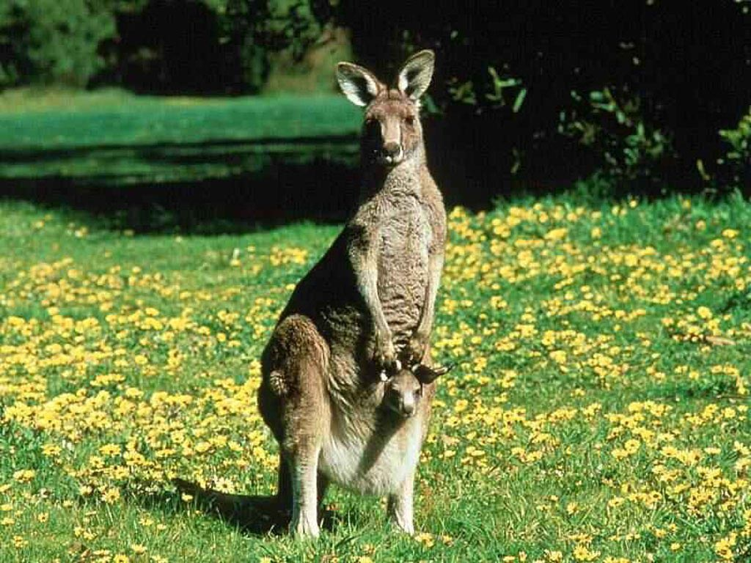
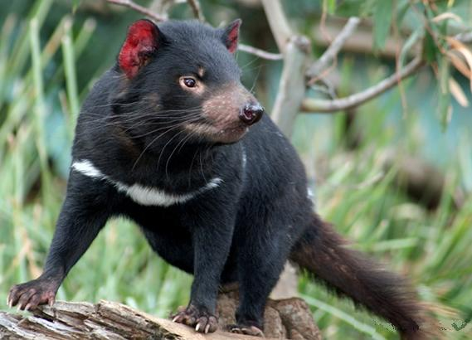
Animals Australia
koala
platypus
Tasmanian devil
kangaroo

Slide 10
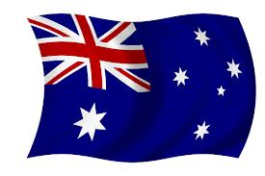
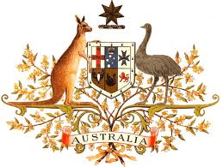
Australia as a nation:
Emblem of Australia
Flag of
Australia

Slide 11
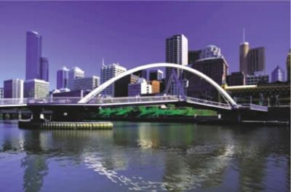
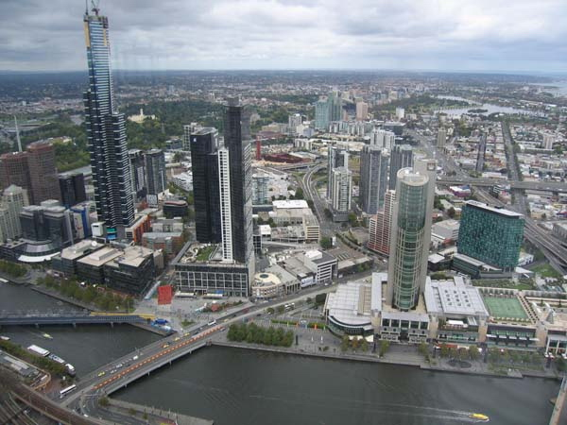
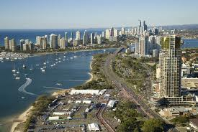
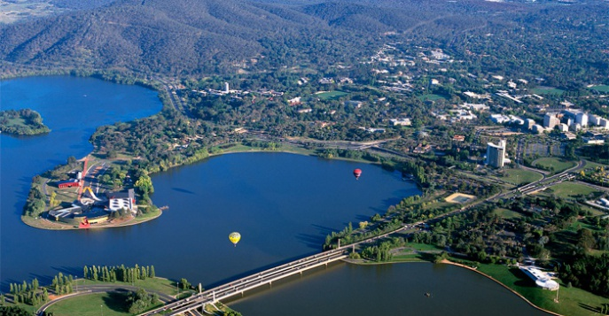
The capital of Australia - Canberra.

Slide 12
Official language - English.
Currently, 88% of Australia's population lives in cities and consists of 82% of Anglo-Australians, 7% - with British, 2% - the Italians, 1% - of the Greeks, by 7% - of Asians and 1% - with Aboriginal people.
As of July 1, 2007 Australia's population was 20,001,546 people. The majority of the population - descendants of immigrants XIX and XX centuries., Most of which came from the UK and Ireland. During the period after the First World War the population increased by 4 times by the implementation program to stimulate immigration.

Slide 13
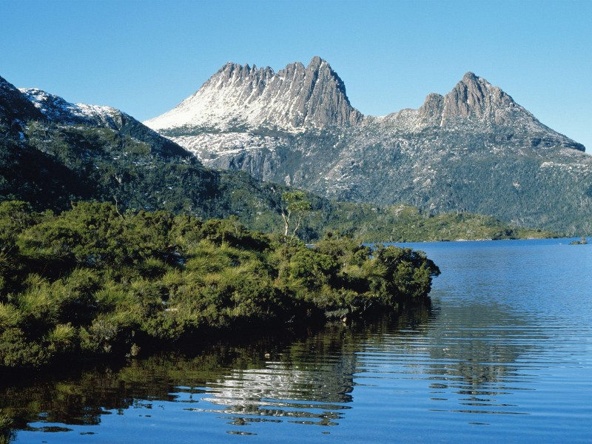
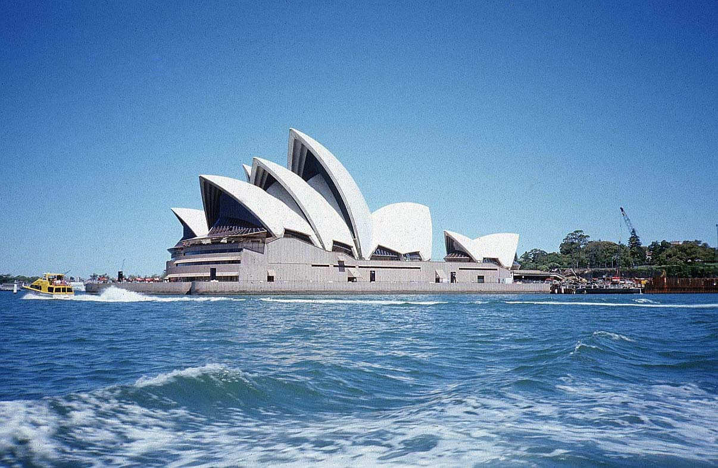
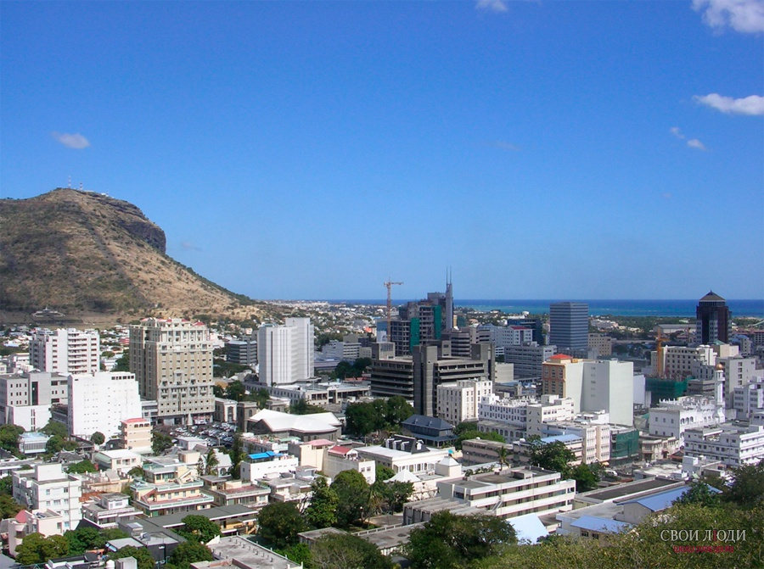
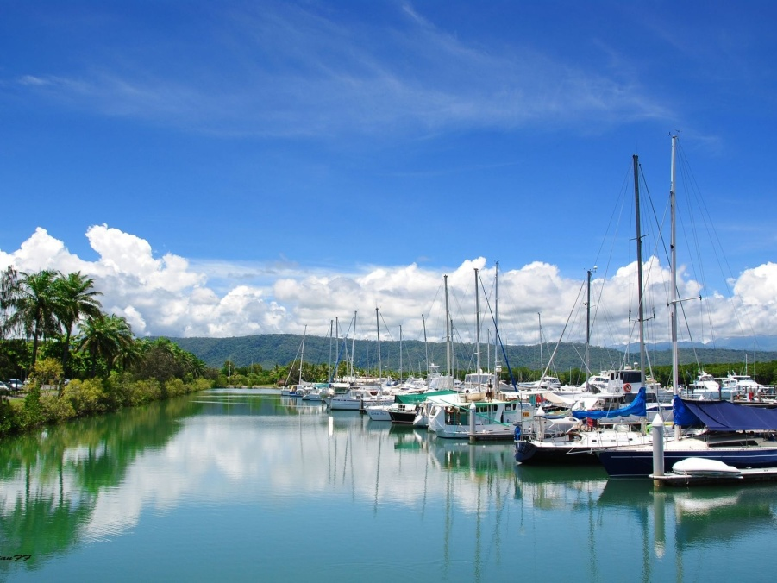
Beautiful photos of Australia

Slide 14
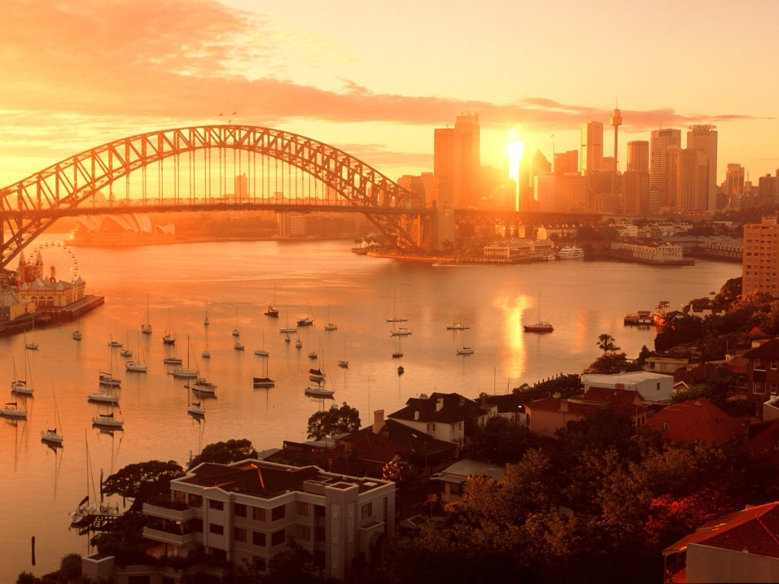
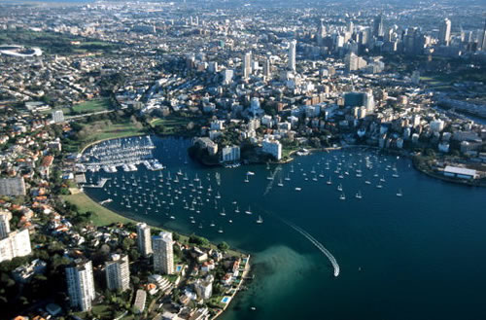
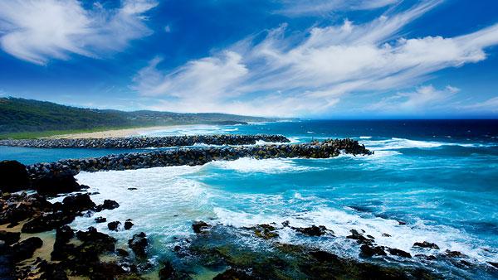
Beautiful photos of Australia

