Slide 1
New South Wales
Newly Risen, How Brightly You Shine

Slide 2
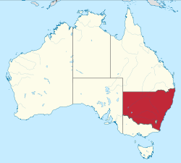
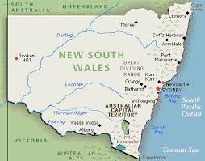
New South Wales (abbreviated as NSW) is a state on the east coast of Australia. It borders Queensland to the north, Victoria to the south , South Australia to the west, the Tasman Sea to the east and surrounds the whole of the Australian Capital Territory. New South Wales's capital city is Sydney, which is also the state's most populous city. As of June 2013, the estimated population of New South Wales was 7.4 million , making it Australia's most populous state. Just under two-thirds of the state's population, 4.67 million, live in the Greater Sydney area . Inhabitants of New South Wales are referred to as New South Welshmen.

Slide 3
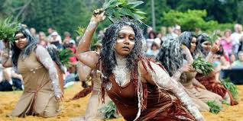
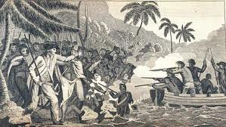
The original inhabitants of New South Wales were the Aboriginal tribes who arrived in Australia approximately 40,000 to 60,000 years ago. Prior to European settlement there were an estimated 250,000 Aboriginal people in the region. The European discovery of New South Wales was made by Captain James Cook during his 1770 survey along the unmapped eastern coast of the Dutch-named continent of New Holland, now Australia. In his original journal(s) covering the survey, in triplicate to satisfy Admiralty Orders, Cook first named the land "New Wales". However, in the copy held by the Admiralty, he "revised the wording" to "New South Wales".

Slide 4
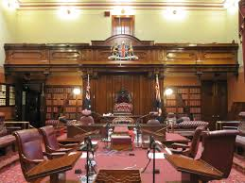
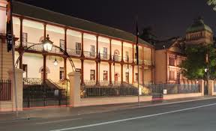
Executive authority is vested in the Governor of New South Wales, who represents and is appointed by Queen Elizabeth II. The current Governor is Marie Bashir. The Governor commissions as Premier the leader of the parliamentary political party that can command a simple majority of votes in the Legislative Assembly. The Premier then recommends the appointment of other Members of the two Houses to the Ministry, under the principle of responsible or Westminster government. It should be noted, however, that as in other Westminster systems, there is no constitutional requirement in NSW for the Government to be formed from the Parliament—merely convention. The Premier is Barry O'Farrell of the Liberal Party.

Slide 5
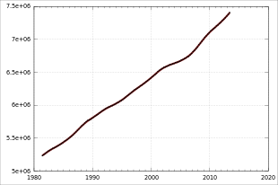
Population
The estimated population of New South Wales at the end of June 2010 was 7.24 million people. The population grew by 1.5% over the preceding year, lower than the national rate of 1.7%.
The principal ancestries of New South Wales's residents (as surveyed in 2011) are:
25.0% Australian
24.2% English
7.4% Irish
6.0% Scottish
4.3% Chinese
62.9% of NSW's population is based in Sydney.

Slide 6
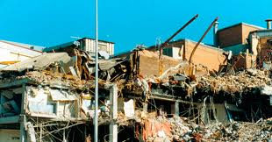
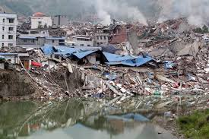
Some interesting facts
New South Wales takes up approximately 10% of Australia's total land mass, with a total area of 802,000 square kilometres .
Newcastle to the north of Sydney is the states second largest city, and was devastated by an earthquake in 1989 that killed 13 people. It is Australia's worst reported earthquake

Slide 7
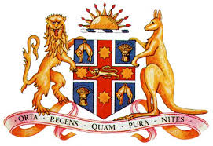
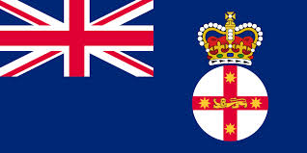
As well as enjoying a healthy rivalry with Queensland to the north, New South Wales, and particularly Sydney, enjoy a healthy rivalry with Victoria and Melbourne to the south. The two biggest cities in Australia often compete with each other to the title of 'most liveable city in the world' and often try to out do each other with their various efforts.
New South Wales is a Constitutional Monarchy. Queen Elizabeth II is the Sovereign, represented by the Governor of New South Wales.

Slide 8
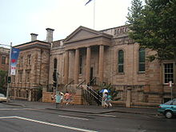
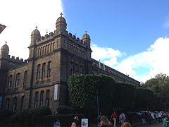
New South Wales hosts the world's largest representative touch football competition every year.
NSW has one of the largest education systems in the world, a large volunteer fire brigade with one of the largest fleets of fire trucks in the world. NSW has the second largest fleet of taxis in the world (after New York). NSW on its own is in the top 20 ranked countries at the olympics for medals .

Slide 9
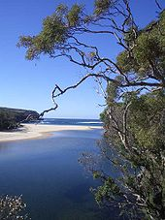
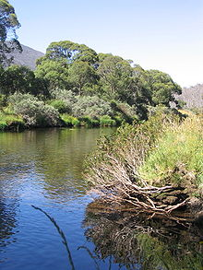
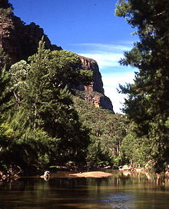
New South Wales has more than 780 national parks and reserves covering more than 8% of the state. These parks range from rainforests, spectacular waterfalls, rugged bush to marine wonderlands and outback deserts, including World Heritage areas.

Slide 10
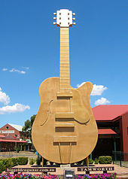
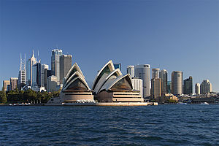
As Australia's most populous state, New South Wales is home to a number of cultural institutions of importance to the nation. In music, New South Wales is home to the Sydney Symphony Orchestra, Australia's busiest and largest orchestra. Other major musical bodies include the Australian Chamber Orchestra. Sydney is host to the Australian Ballet for its Sydney season (the ballet is headquartered in Melbourne). Apart from the Sydney Opera House, major musical performance venues include the City Recital Hall and the Sydney Town Hall.

Slide 11
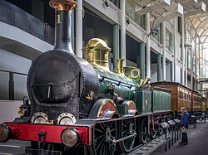
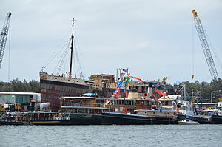
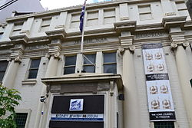
Major museums include the natural history-focussed Australian Museum, the technology and arts-and-crafts focussed Powerhouse Museum, the Sydney Maritime Museum which focuses on Australia's maritime history, and the history-focussed Museum of Sydney. Other museums include the Sydney Jewish Museum.
Sydney is home to five Arts teaching organisations, which have all produced world famous students: The National Art School, The College of Fine Arts, the National Institute of Dramatic Art (NIDA), the Australian Film, Television & Radio School and the Conservatorium of Music

