Slide 1
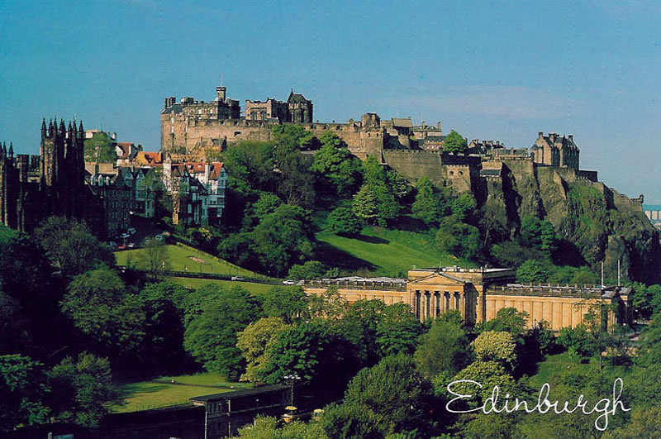
Edinburgh
Підготувала учениця
10 класу
Хустського НВК №1
Лемак Андріана

Slide 2
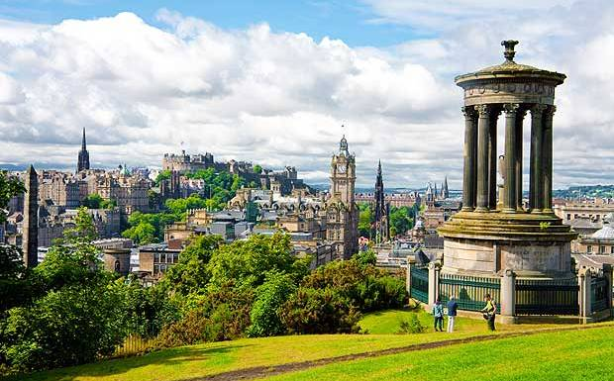
Edinburgh is the capital city of Scotland, situated in Lothian on the southern shore of the Firth of Forth. It is the second most populous city in Scotland and the seventh most populous in the United Kingdom. The population in 2012 was 482,640.

Slide 3
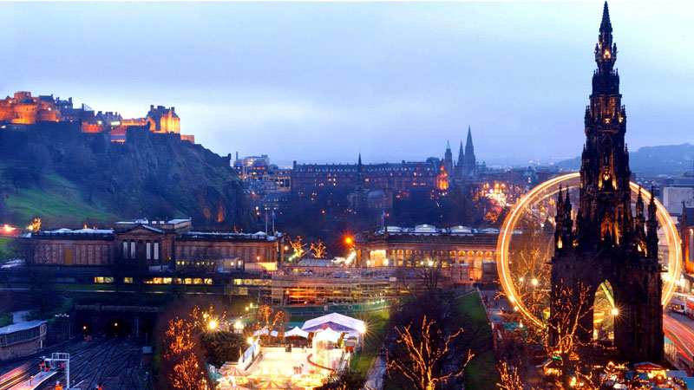
Edinburgh has been recognised as the capital of Scotland since at least the 15th century, but political power moved south to London after the Union of the Crowns in 1603 and the Union of Parliaments in 1707. After nearly three centuries of unitary government, a measure of self-government returned in the shape of the devolved Scottish Parliament, which officially opened in Edinburgh in 1999. The city is also the annual venue of the General Assembly of the Church of Scotland and home to many national institutions such as the National Museum of Scotland, the National Library of Scotland and the Scottish National Gallery.

Slide 4
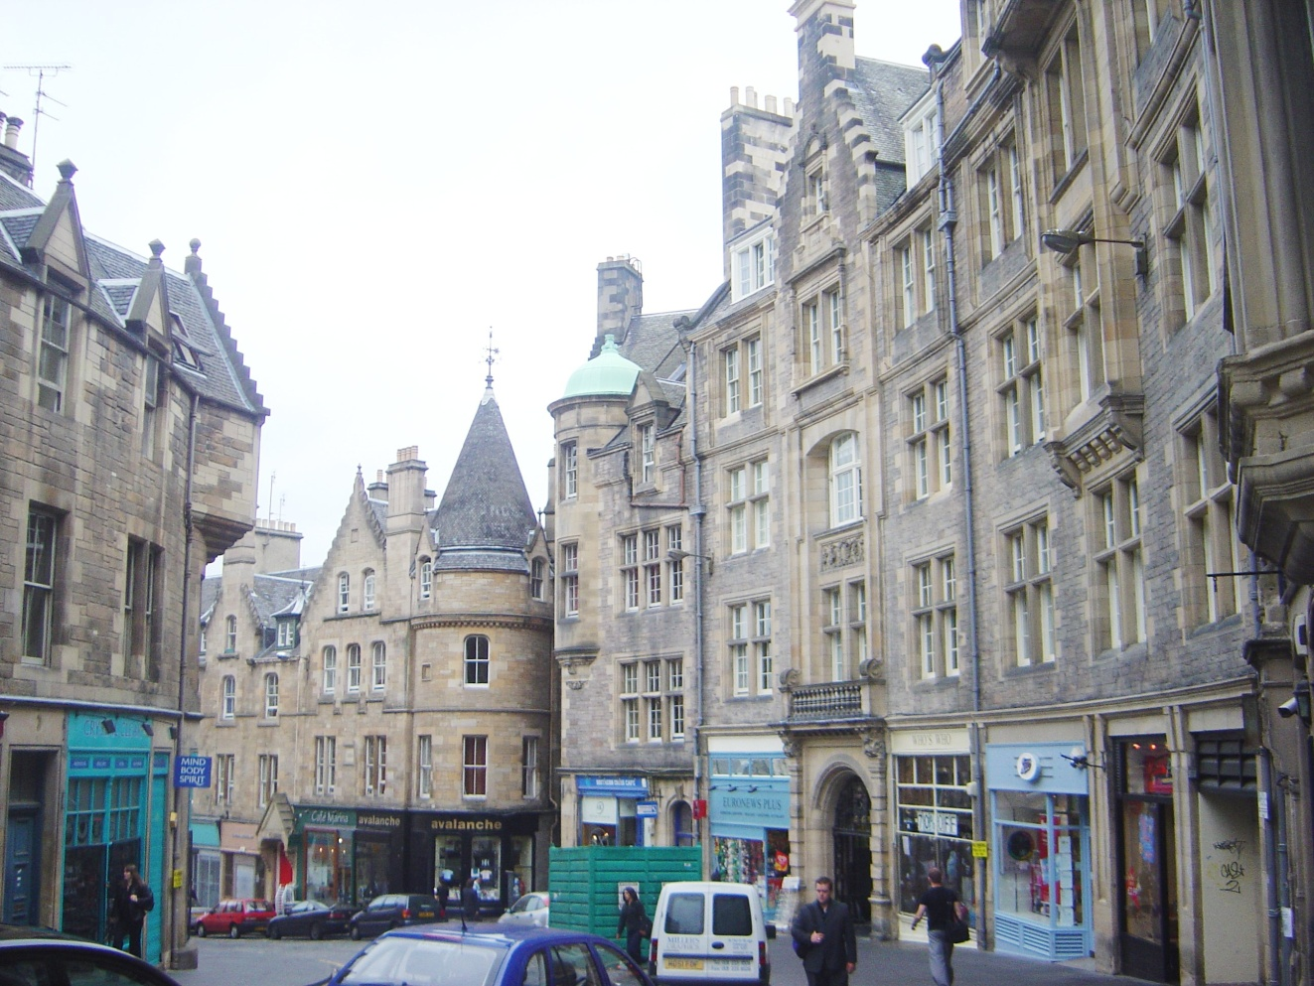
Edinburgh is one of the most vibrant, beautiful and interesting cities in the world, which is regularly voted a must-visit destination. The city is home to many fantastic arts and culture attractions, while it hosts world-famous art events throughout the year.

Slide 5
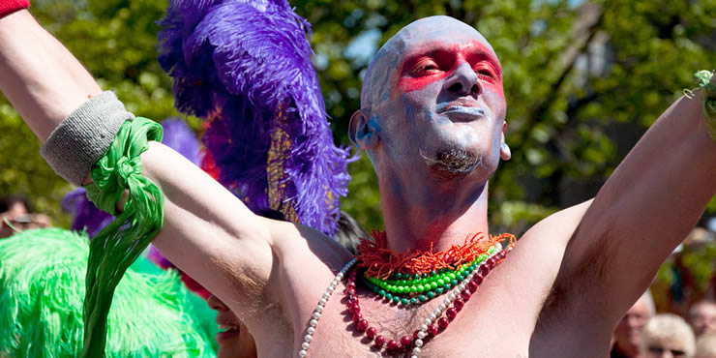
Throughout the Lothians you can find out more about the local culture in museums, or why not visit the art and craft shops, in both the towns and villages and in the city of Edinburgh, to pick up a gift or treat for yourself?
The calendar of events and festivals peaks in summer with a spectacular range of music, theatre, dance, comedy and literature. Take in star-studded premieres at the Edinburgh International Film Festival, or contemplate life, love and literature at the Book Festival. The Fringe covers everything from comedy to street theatre, and with the jazz and blues, mela and international festivals, and the stirring Military Tattoo, there is entertainment in abundance.

Slide 6
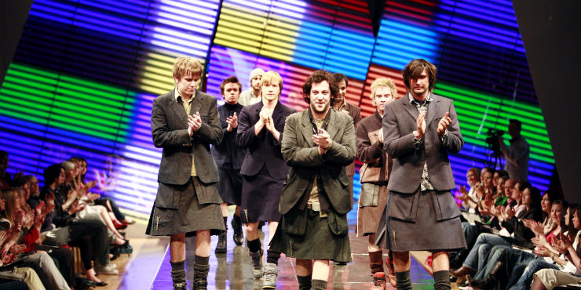
In Edinburgh, the stunning Scottish National Gallery contains some of the world’s most important collections, while the National Gallery of Modern Art is set in sculptured parkland that is itself a work of art. The magnificently refurbished National Portrait Gallery re-opened in 2011, as did one of the city’s top attractions - the National Museum of Scotland.

Slide 7
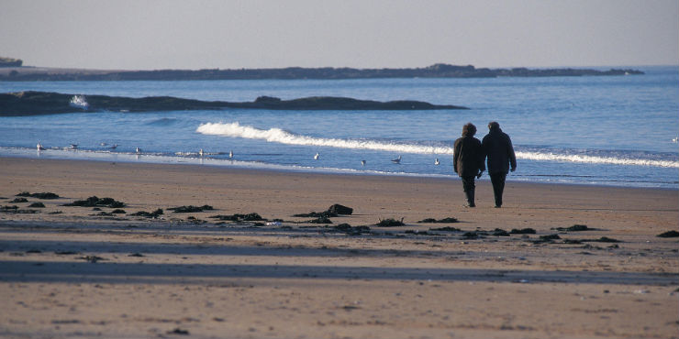
Right on the capital’s doorstep, the Lothians are a paradise for keen walkers and adventure-lovers. Head to the Pentland Hills Regional Park, where you will find 60 miles (100 km) of paths, enabling easy strolls through forests, scenic reservoirs and tougher treks through stunning upland scenery. The hills here reach nearly 2,000 ft at Scald Law - the highest point in the region - and offer wonderful views. You can also take the chairlift to the top of Midlothian Snowsports Centre, where you can ski and snowboard all year round or just enjoy the panoramic views across the city to the Firth of Forth.

Slide 8
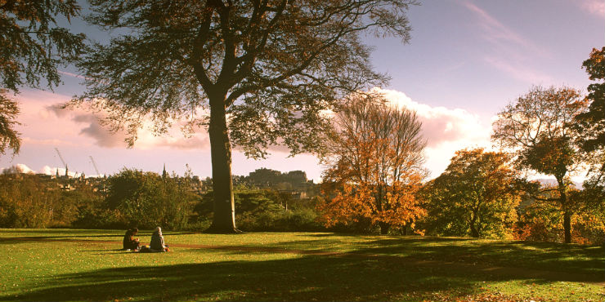
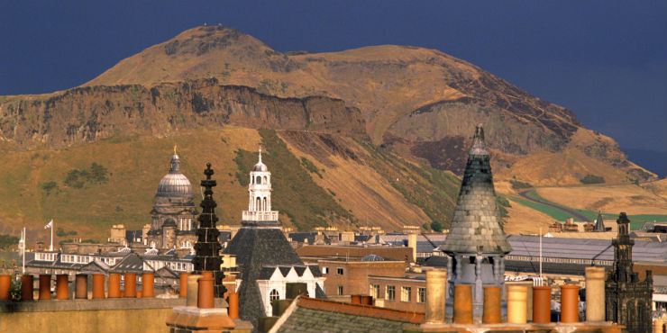

Slide 9
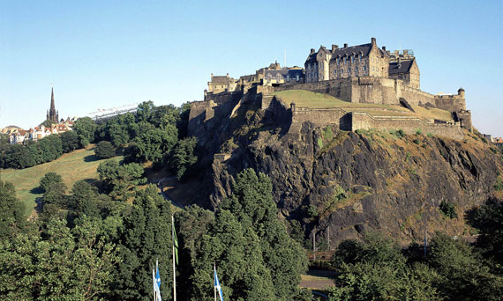
With over 4,500 listed buildings, Edinburgh is world-renowned for its rich architectural heritage. The two main areas of particular interest in this historic city are the Old Town, which includes the medieval fortress of Edinburgh Castle, and the neoclassical New Town which dates back to the 18th century. The juxtaposition of medieval architecture with neoclassical terraces gives Edinburgh its own unique character.

Slide 10
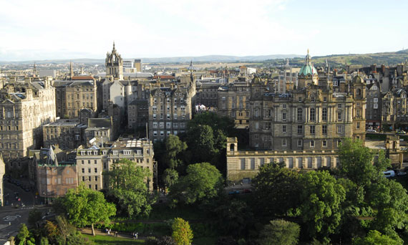
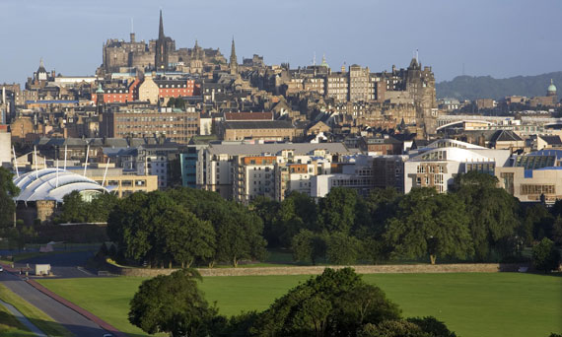
The Old Town features the tourist hub of the Royal Mile, a long street exactly one Scots mile long, featuring a medieval castle, narrow closes, Reformation buildings, kirks, turrets and plenty of nooks and crannies. Head over to the New Town and you will find the grand Georgian Terraces, more suited to the figures of the Scottish Enlightenment who wished to escape the over-crowded Old Town.

Slide 11
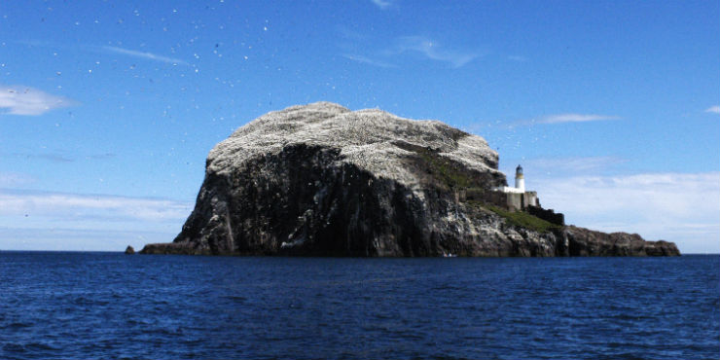
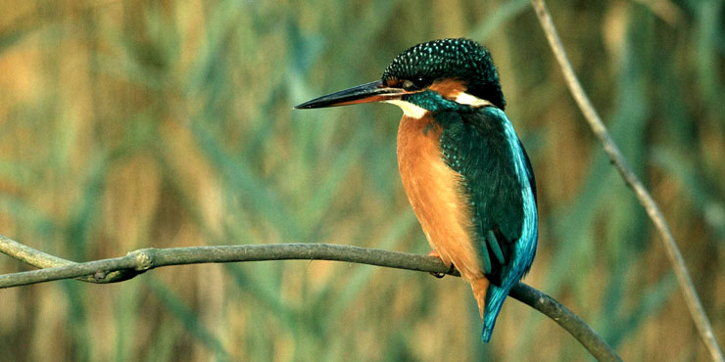
The bustling city of Edinburgh is peppered with green spaces that offer not only a pleasant escape but also a home to many different species of wildlife, including several not usually associated with an urban setting, such as otters and grey herons.
Elsewhere across the region, the variety of country parks and Local Nature Reserves provide good access to all manner of woodland wildlife, particularly those offering nature trails and ranger-led walks.
East Lothian in particular is a hotspot for birdwatchers, thanks to the large numbers of native and migrant species who visit, plus the massive seabird colonies found out on the islands of the Firth of Forth.

Slide 12
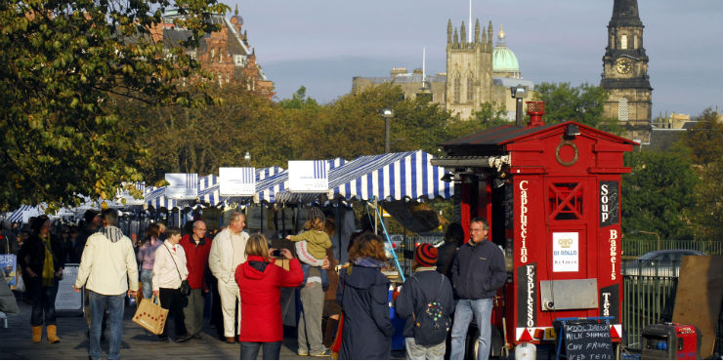
Once you’ve been inspired by the delicious flavours on the menu, head along to the regular farmers’ markets, from Edinburgh to Haddington, and pick up fresh local produce direct from the producers, or stop by farm and specialist food shops. There’s always a fantastic selection of everything from seafood and seasonal fruit and vegetables to beef and lamb.

Slide 13
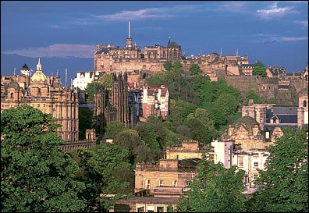
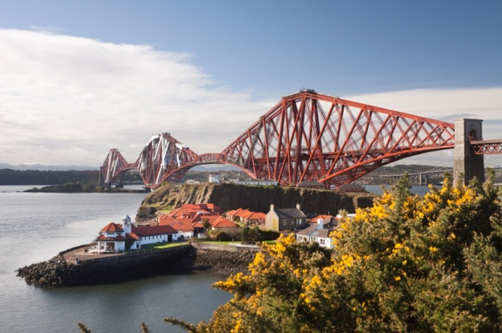
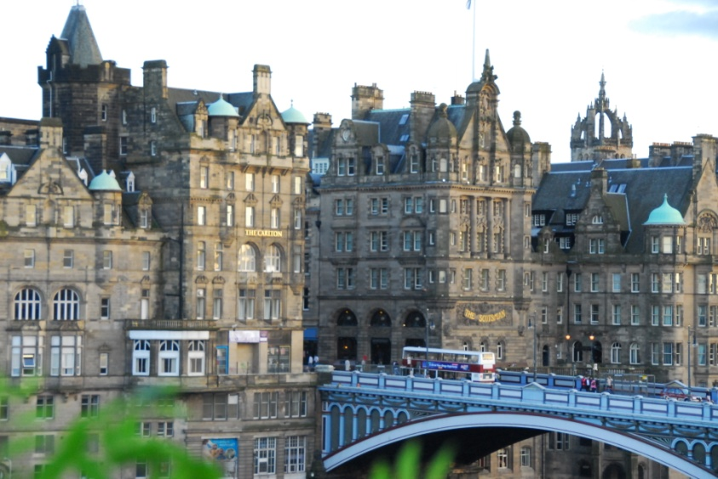
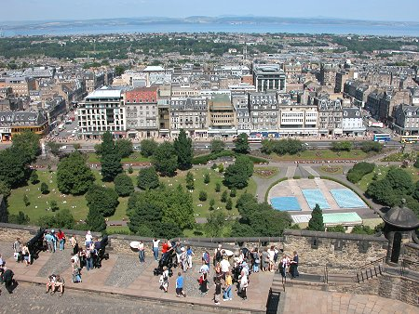
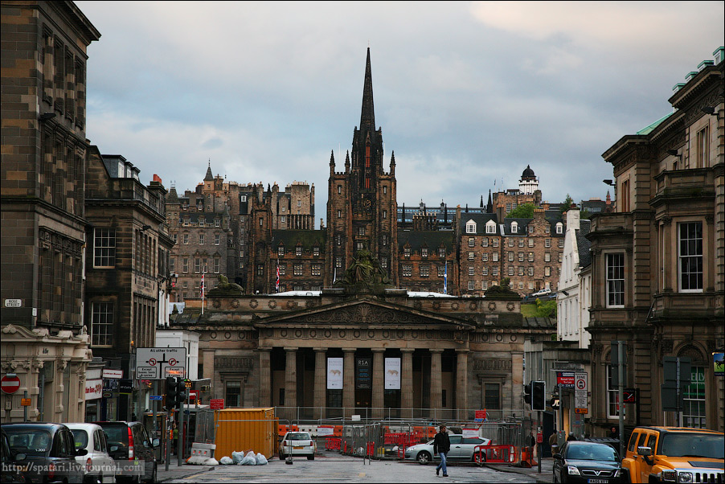
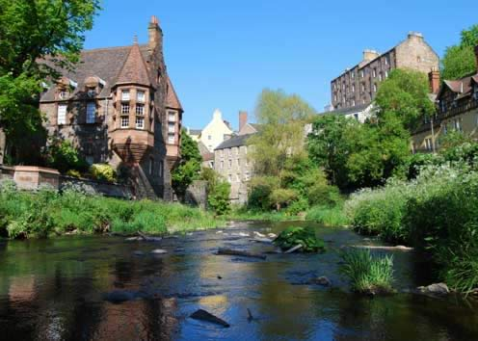
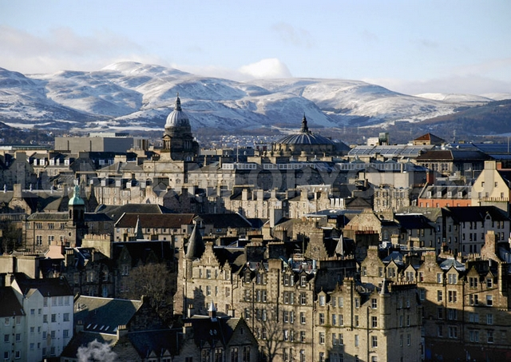
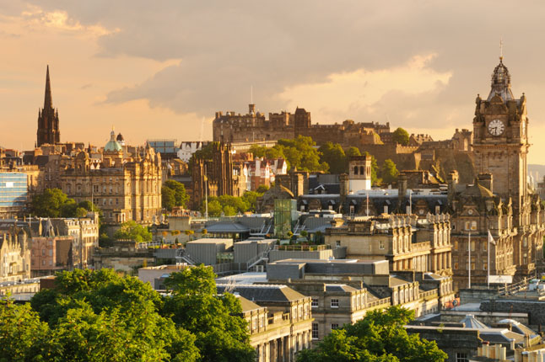

Slide 14
