Slide 1
World Heritage Sites in Canada

Slide 2
Banff National Park
Canada's oldest national park, established in 1885 in the Canadian Rockies. The park accommodates numerous glaciers and ice fields, dense coniferous forests and alpine scenery. The main commercial center of the park - the town of Banff in the valley of the Bow River.

Slide 3
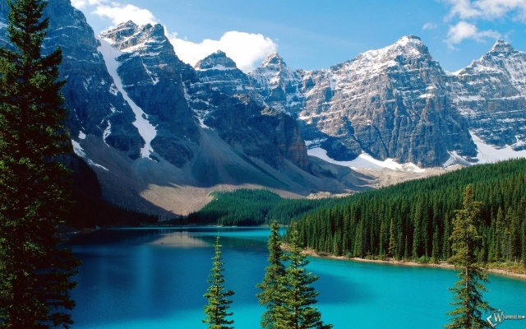
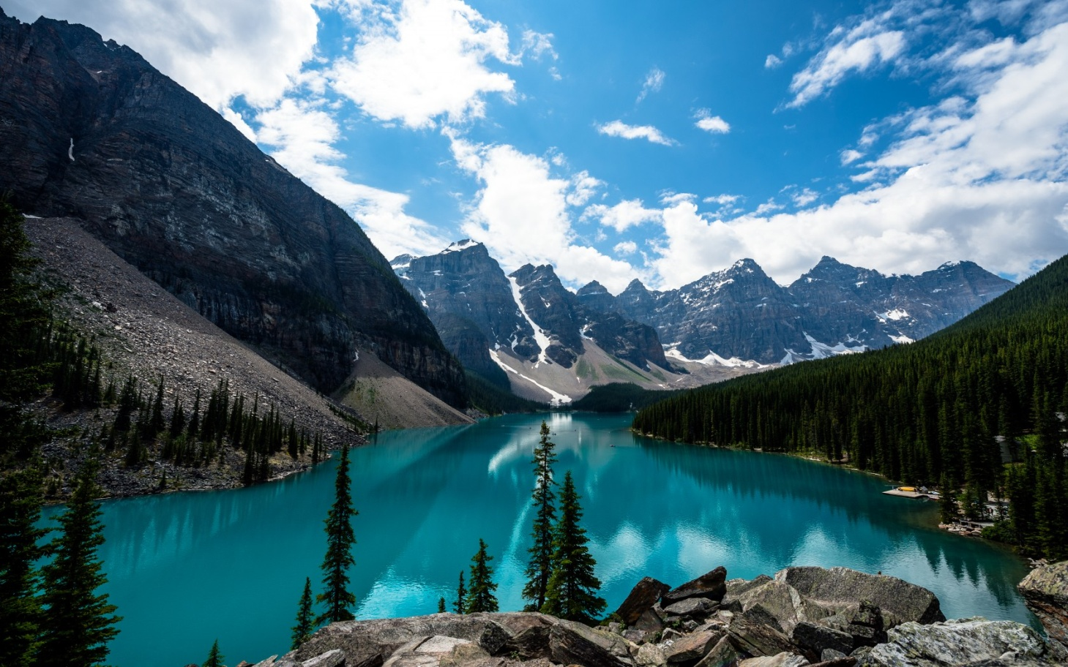
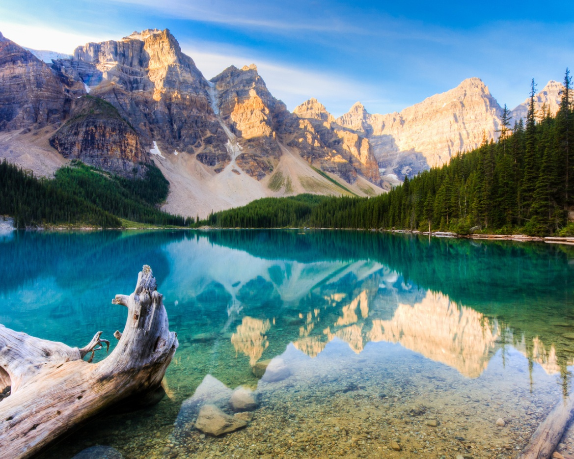
Moraine Lake (glacial lake)

Slide 4
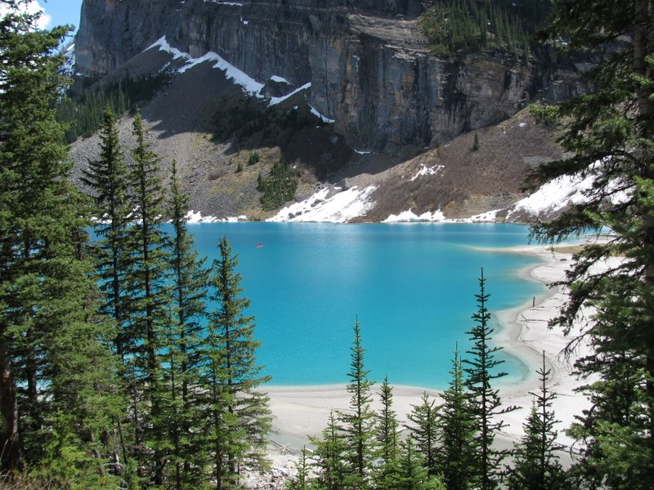
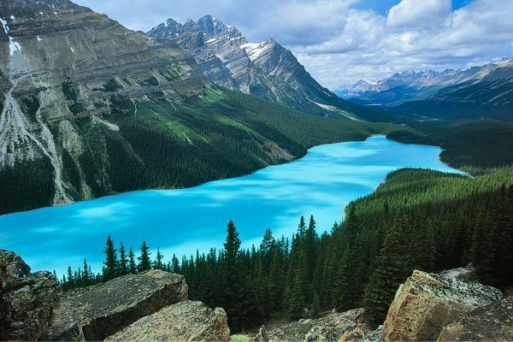
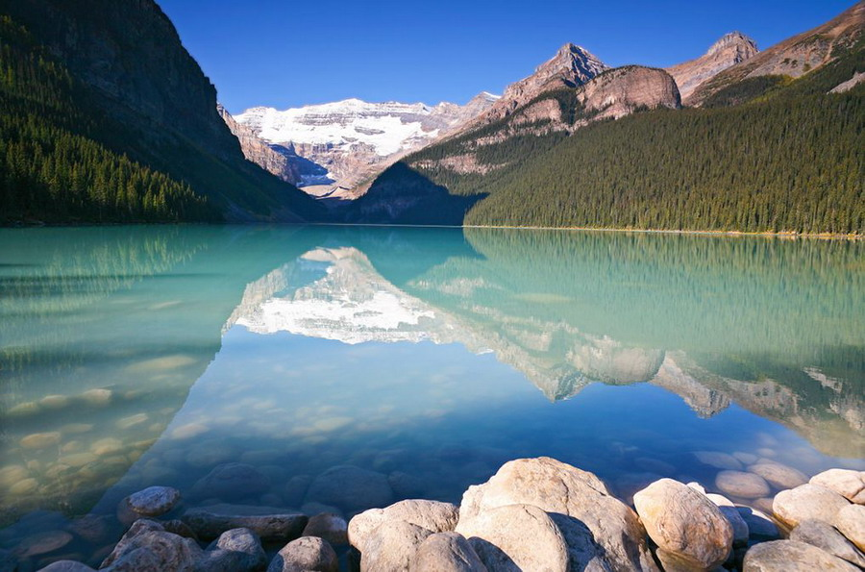
Lake Louise

Slide 5
Castle Mountain

Slide 6
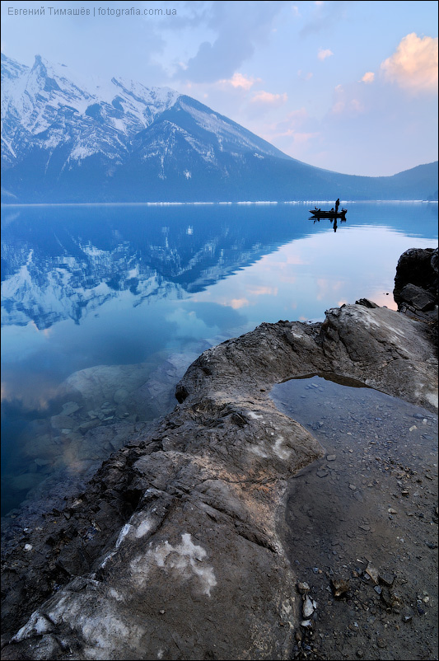
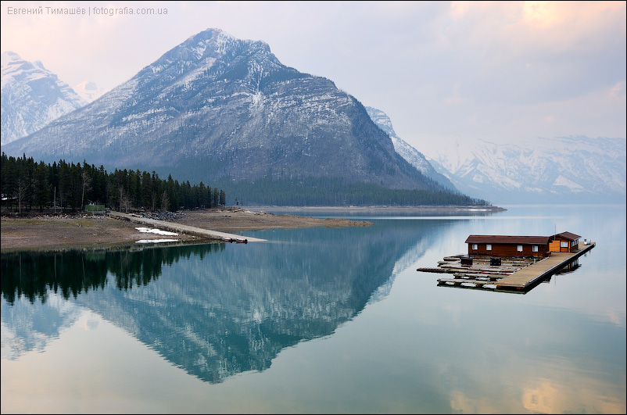
Lake Minnewanka

Slide 7
Kootenay National Park
Park holds a luxurious mountains, lakes, as well as cold springs. This site was mined "red earth", or red ocher to paint. In the park there as hot springs and cold springs. Hot springs are in Sinclair Canyon and Redwall Fault. Cold springs, rich in iron, located in the Paint Pots

Slide 8
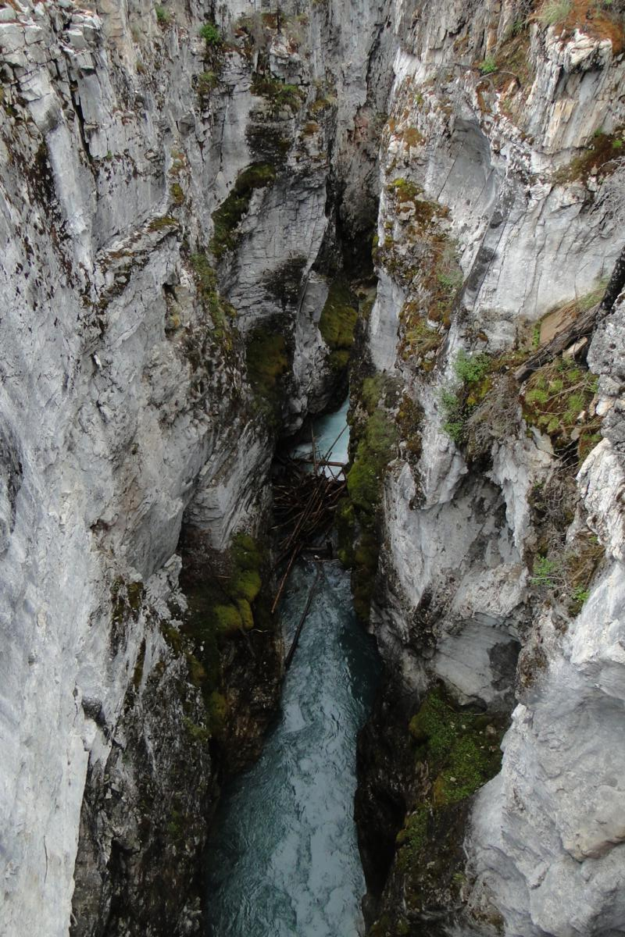
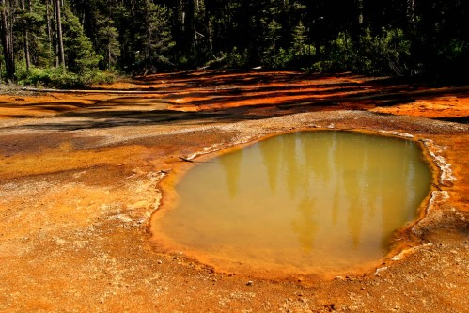

Slide 10
«Red earth»

Slide 11
Jasper National Park
The park was founded in 1907. Located in the province of Alberta. Is the largest reserve in the Rockies. The park is one of the most visited tourist destination of environmental facilities in Canada. There are hotels, ski slopes, golf courses and other recreational infrastructure.

Slide 16
Yoho National Park
Park received the name from the exclamation of the Cree. The park is situated in mountainous terrain with a large difference in altitude, from the glaciers on the mountain tops, to the numerous lakes, waterfalls in the valleys, as well as canyons and limestone caves. Often there are fossils.

Slide 19
