Slide 1
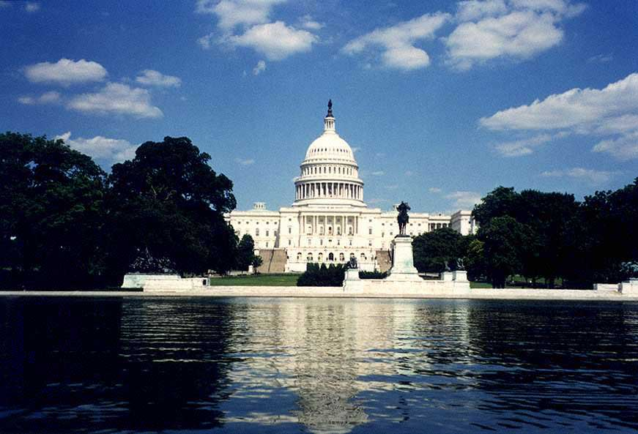
Washington D.C.

Slide 2
Washington D.C.
Washington is the capital of the United States of America. The city is on the left bank of the Potomac River. It was named after the first President George Washington.
The population of the city is nearly three million people.

Slide 3
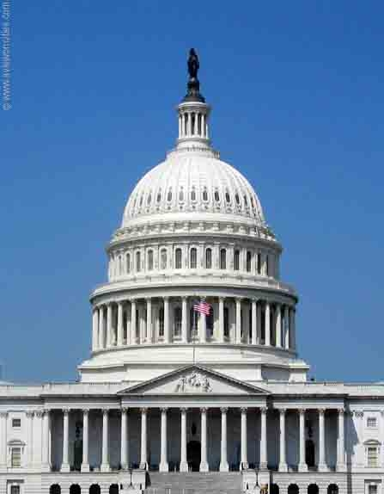
The Capitol
The Capitol is the centre of the city. It was built according to the plans of William Thornton who was an amateur architect. It was made of stone and marble and contains 540 rooms. It is situated on Capitol Hill.
The U.S. Capitol is one of the most recognized buildings in the world, serves as a symbol of democracy, the home of the House and Senate and a tourist attraction visited by millions every year.

Slide 4
The White House
The White House is the home and office of the U.S. president.
The White House took 8 years to build. The interior has been restored and remodeled over the years. It has 132 rooms.
The building has the simple elegance of gracious American Home. It reflects the design of manor houses in Ireland, England and France.

Slide 5
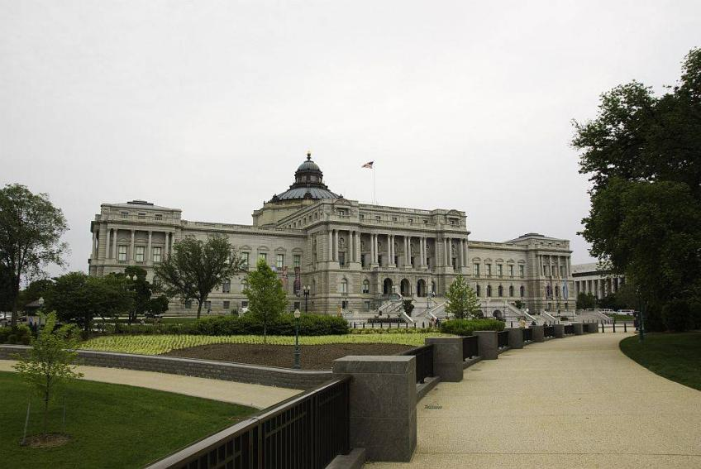
The Library of Congress
The Library of Congress in Washington, DC, is the world’s largest library containing more than 128 million items including books, manuscripts, films, photographs, sheet music and maps. Created in 1800, the Library of Congress was originally located in the U.S. Capitol Building.

Slide 6
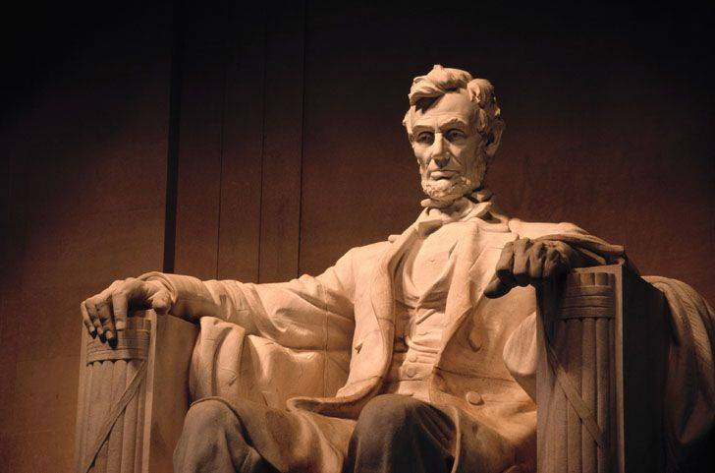
The Lincoln Memorial
The Lincoln Memorial occupies a prominent space on the National Mall in Washington, DC and is a tribute to President Abraham Lincoln, who fought to preserve nation during the Civil War, from 1861-1865.
The Lincoln Memorial has been the site of many famous speeches and events since its dedication in 1922.

Slide 7
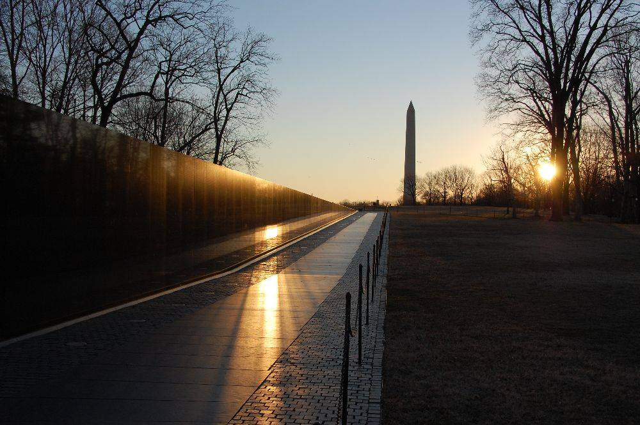
The Vietnam Memorial
The Vietnam Veterans Memorial pays tribute to those who served in the Vietnam War. The memorial is a black granite wall inscribed with the names of 58,209 American’s killed or missing in the Vietnam conflict. The veterans names are listed in chronological order of when the casualty occurred and an alphabetical directory helps visitors locate names.

Slide 8
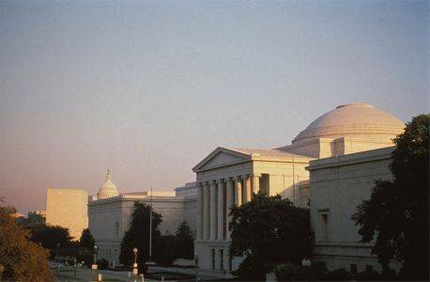
The National Gallery of Arts
The National Gallery of Art in Washington, DC is a world-class art museum that displays one of the largest collections of masterpieces in the world including paintings, drawings, prints, photographs, sculpture, and decorative arts from the 13th century to the present. The National Gallery of Art collection includes an extensive survey of works of American, British, Italian, Flemish, Spanish, Dutch, French and German art.

Slide 9
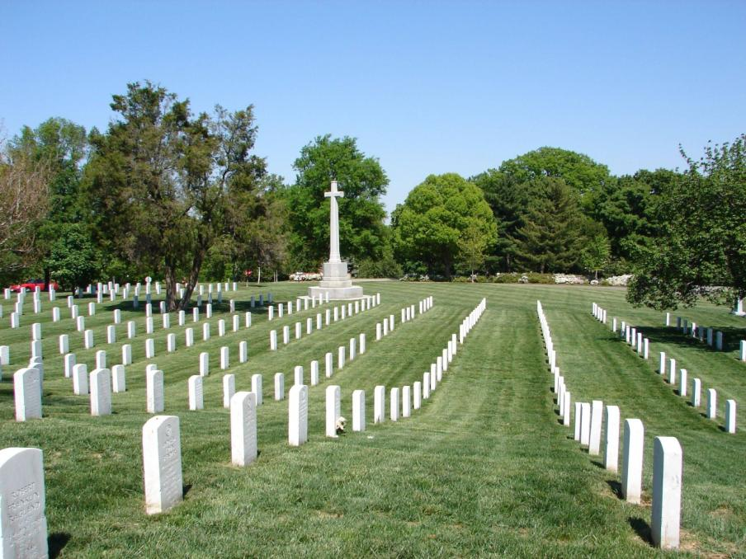
Arlington National Cemetery
Arlington National Cemetery in Arlington, Virginia, serves as a cemetery and a memorial to America's war heroes. More than four million people visit Arlington National Cemetery each year, attending graveside services and special ceremonies to pay tribute to veterans and historical figures.

Slide 10
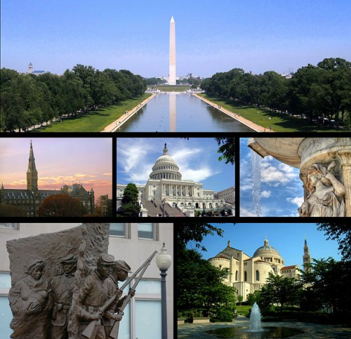
Washington is a large scientific and cultural centre. Many research and designing institutes are concentrated here. There are five universities in the city and the National Academy of sciences.

