Slide 1
George Washington
February 22, 1732 – December 14, 1799

Slide 2
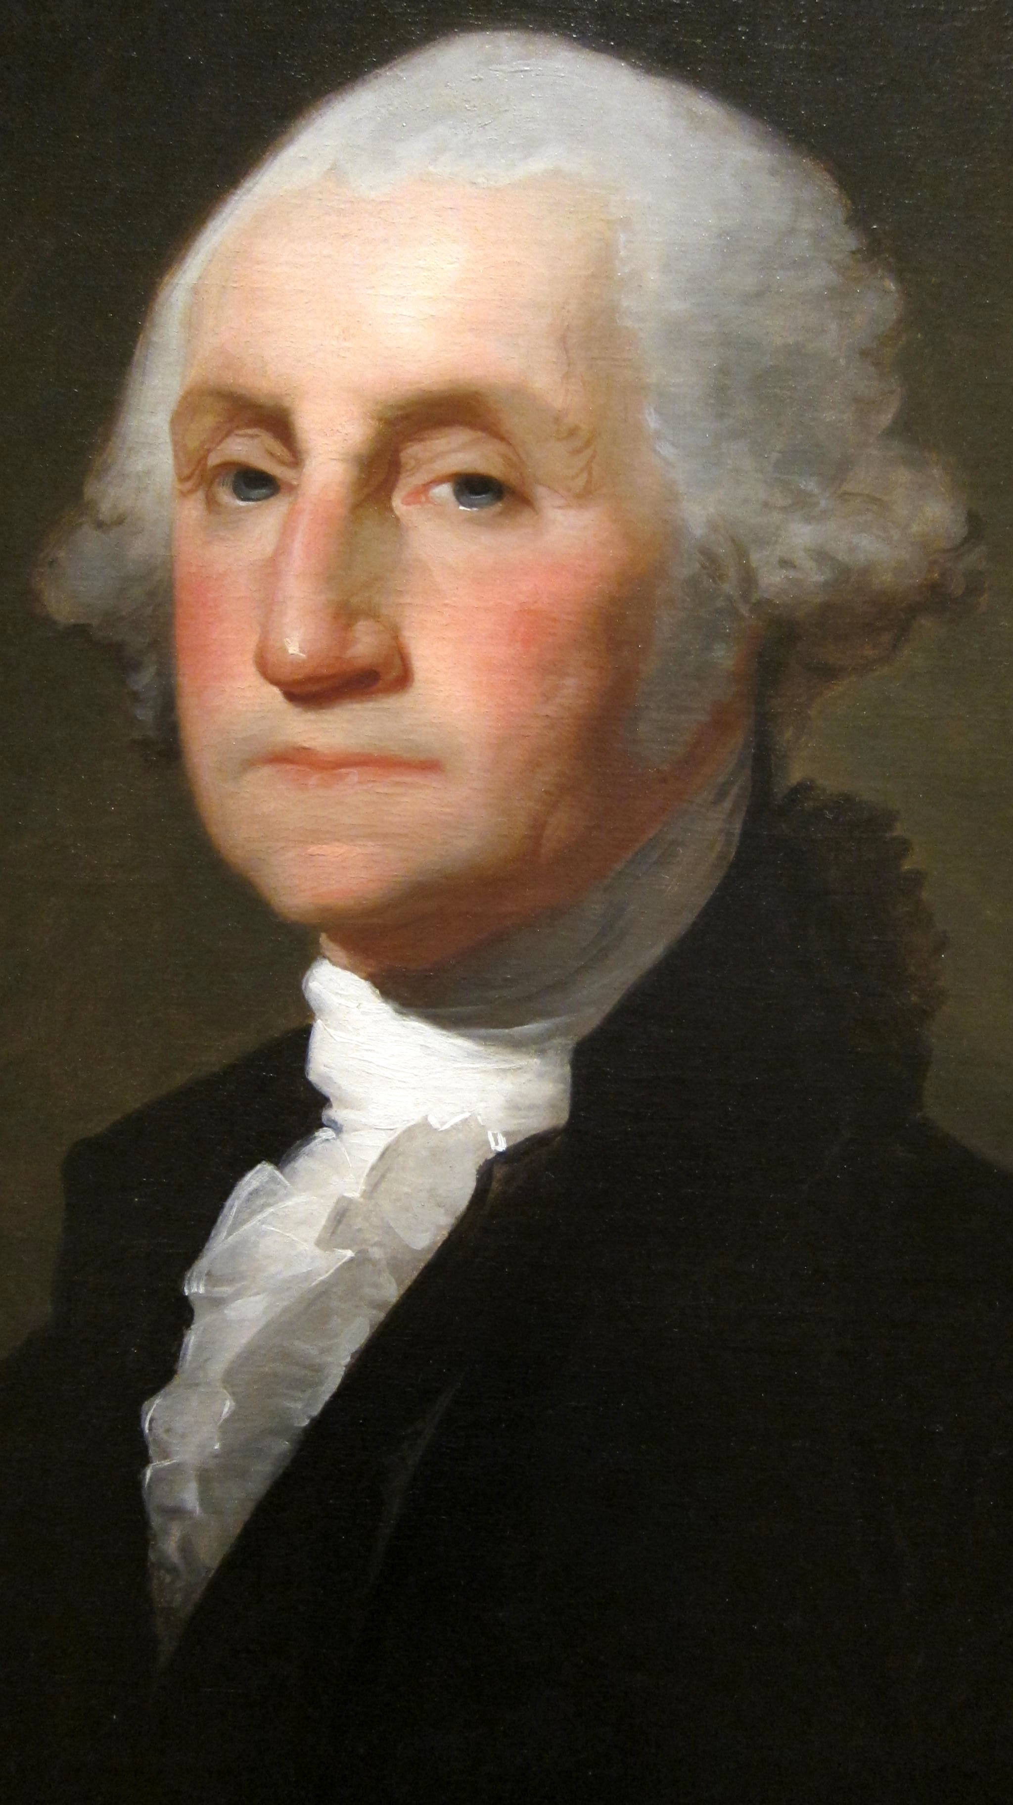
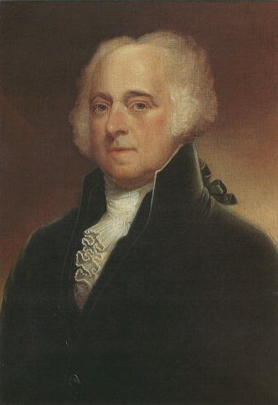
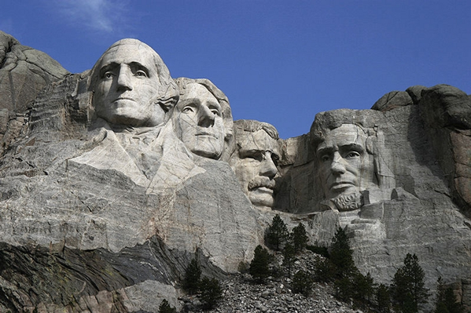
George Washington (1732-1799) was the first President of the United States of America. His Vice-President was John Adams (1735-1826), who was later voted the second President of the USA.

Slide 3
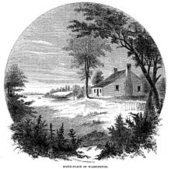
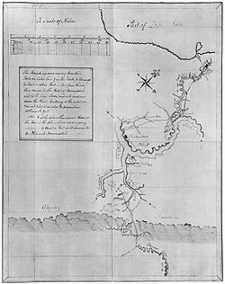
Early Life
George Washington was born on February 22, 1732, in Virginia. Washington's father died when George was 11 years old.
French and Indian War
As a young man, Washington joined the Virginia militia. After many heroic battles, Washington became a colonel and the leader of Virginia's militia. The British eventually won the French and Indian War.

Slide 4
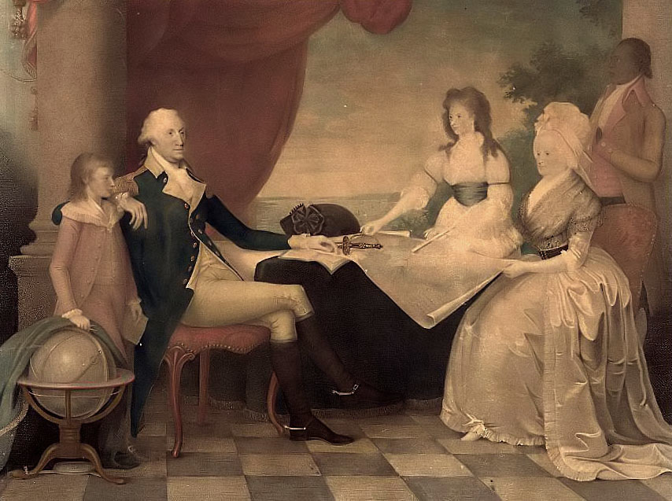
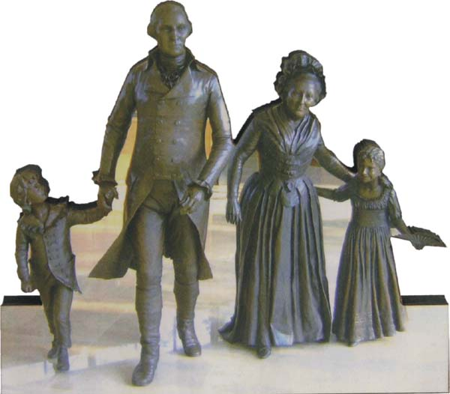
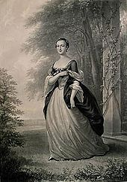
Marriage
Washington married Martha Custis in 1759. Martha was a rich widow who had two children, Martha and John. Their home in Virginia was called Mt. Vernon. George and Martha did not have children together.

Slide 5
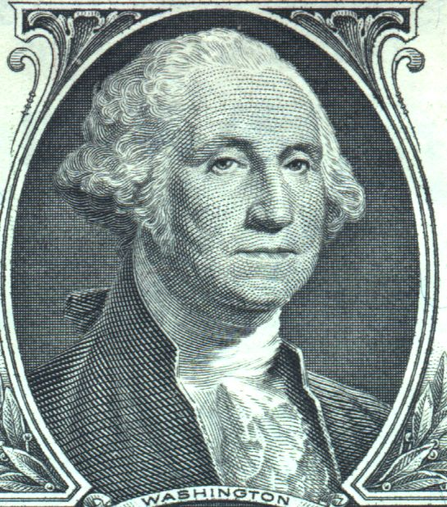
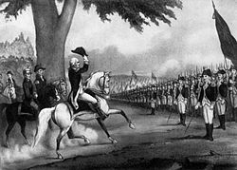
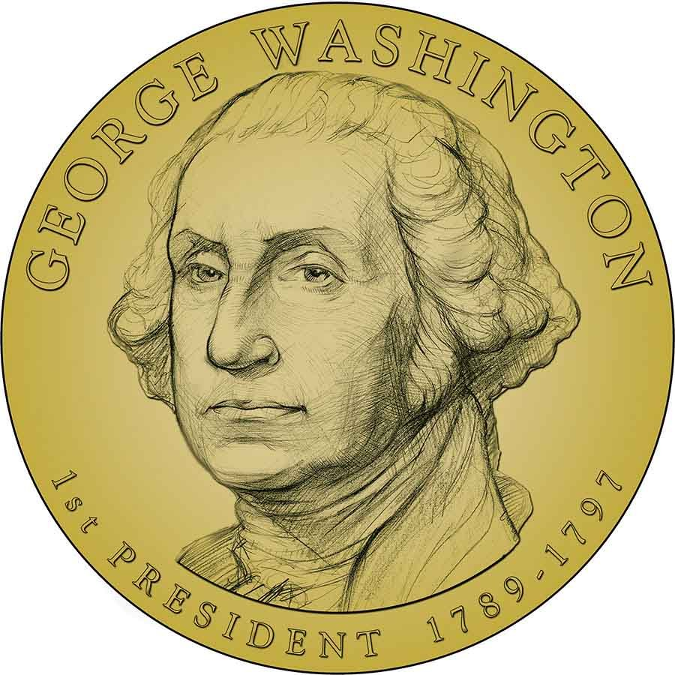
A Start in Politics
In 1758, Washington was elected to the House of Burgesses in Virginia (the local governing body of Virginia).
Revolutionary War
In 1775, Washington was chosen as the Commander in Chief of the Colonial Army. In 1776, the Colonists declared their independence from the British.
Due to the brilliant planning of George Washington and some help from the French late in the War, the British were defeated in 1781 after many bloody battles. The Americans were now independent of the British.

Slide 6
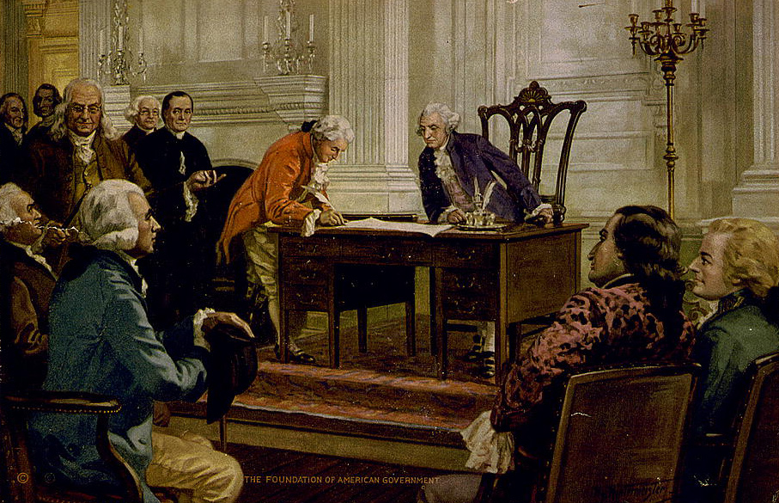
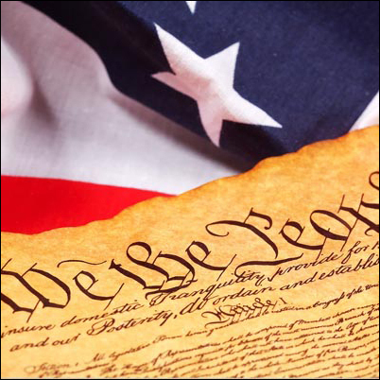
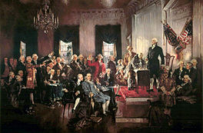
The US Constitution
In 1787 Washington presided over the Constitutional Convention in Philadelphia, Pennsylvania, during which the US Constitution was written.
The US Constitution outlined a representative government with checks and balances among three branches of government : the Executive (the President), the Legislative Branch (law makers), and the Judicial Branch (judges and courts). The Constitution was ratified in 1788 -- it went into effect in 1789. The next step was to set up this new, revolutionary form of government.

Slide 7
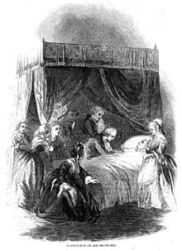
President of the US
Washington was unanimously elected President of the United States of America by electors in early 1789 and again in 1792. John Adams was his vice-president. Washington's first inauguration took place in New York. Washington's second inauguration took place in Philadelphia, Pennsylvania. Washington refused a third Presidential term, saying in his farewell speech that a longer rule would give one man too much power.
Washington died on December 14, 1799. After his death, the nation's capital was moved from Philadelphia to a location on the border of Virginia and Maryland near Washington's home, and was named Washington, District of Columbia in his honor.

Slide 8
Thank you for your attention!
Made by Natasha Akoieva
Form 11-A
2013

