Slide 1
generation gap
Krepak Katerina, Ilina Maria

Slide 2
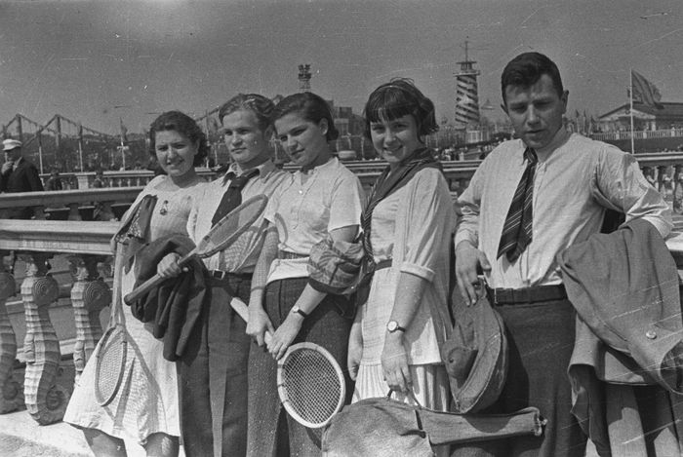
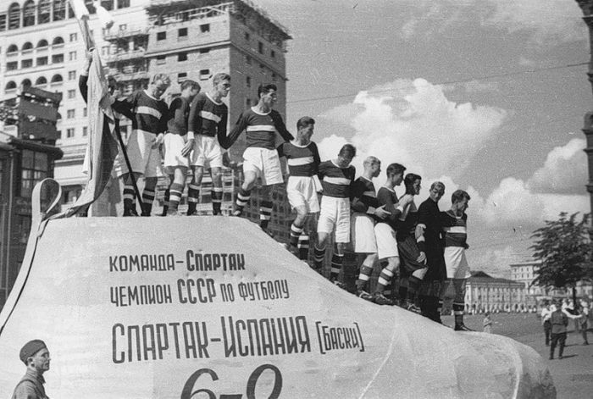
We ask ourselves, our parents and our grandparents about their childhood and their relationships with their own parents.

Slide 3
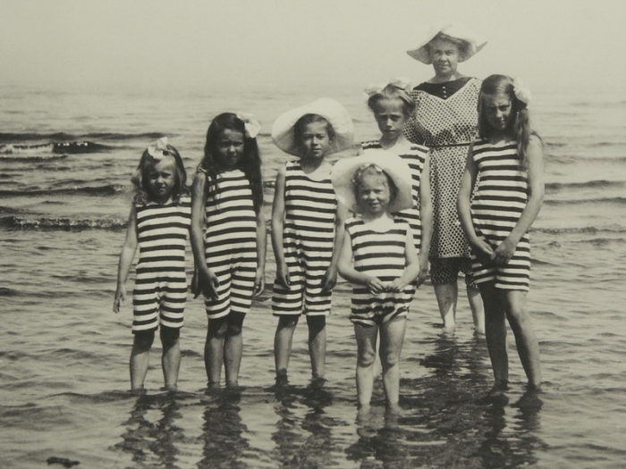
Firstly we asked them about their household chores. Results we get are very interesting. Every generation has it`s own responsibilities.
Our grandparents should take care about all the house.
Our parents should do little less things about house. But they had many responsibilities, too.
Our generation is much more carefree. We haven`t so many responsibilities as our parents and grandparents.

Slide 4
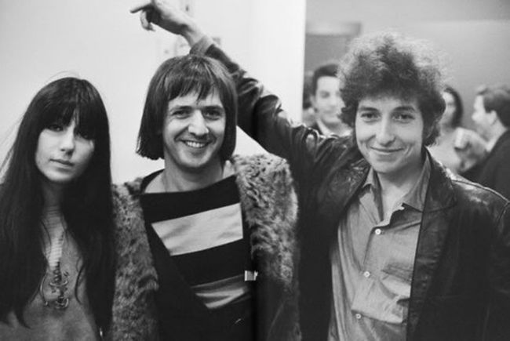
Our second question was about their free time. How do they spent it?
Our grandparents spent much time going in for sport. They also had some discos.
Our parents had more free time. They spent it with their friends. Of course, they does sports.
Our generation spent time on-line. We are going in for sports, too. Fortunately, nowadays reading is very popular among teens.

Slide 5
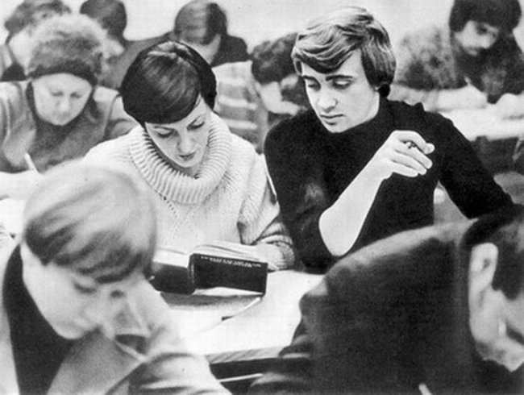
Also we ask our parents and our grandparents about their friends.
Our grandparents spent few time with their friends. They only hadn`t much time.
Our parents spent only their weekends with their friends.
Our generation has much free time. But we spent time on-line. So, we meet each other rarely.

Slide 6
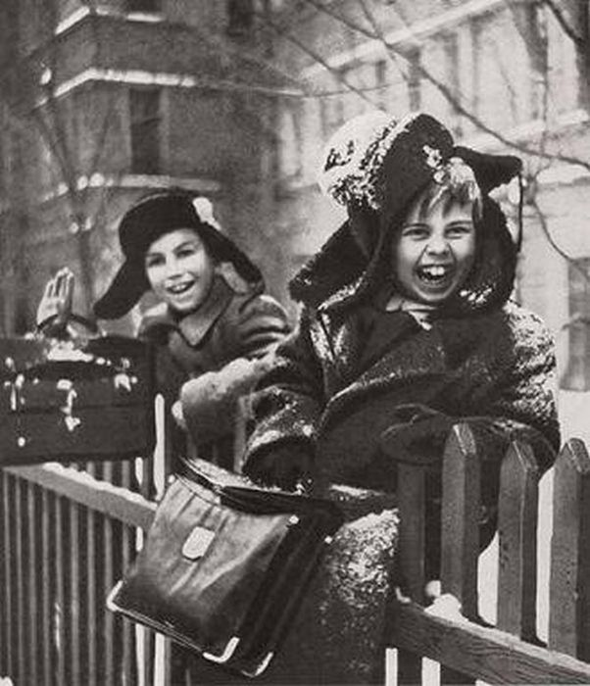
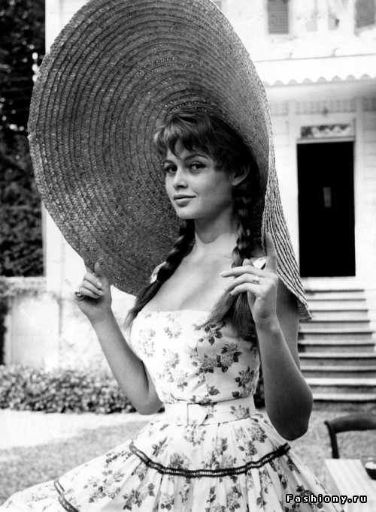
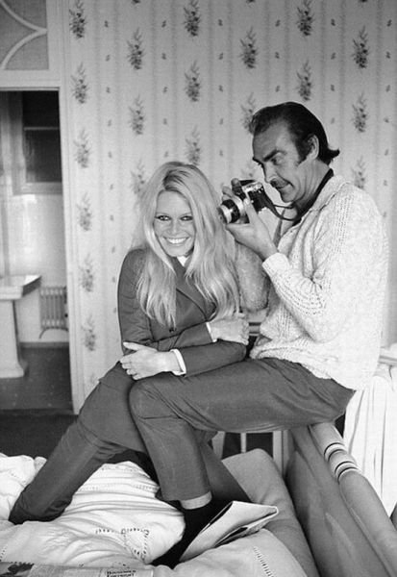
Then there was another idealogii, other values.

Slide 7
Thanks for your attention!

