Slide 1
Albert Einstein

Slide 2
Any list of the greatest thinkers in history will contain the name of the brilliant physicist Albert Einstein.

Slide 3
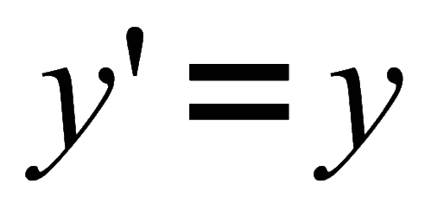
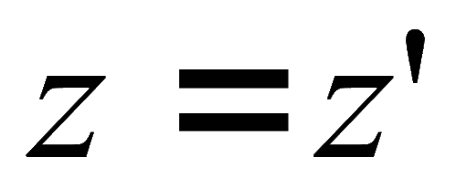
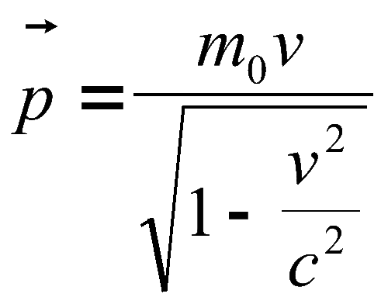
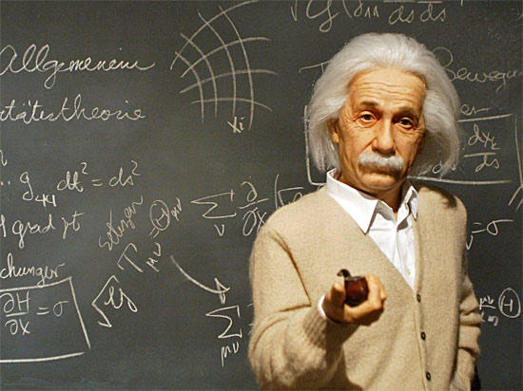
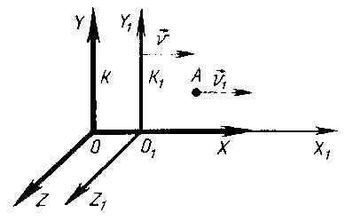
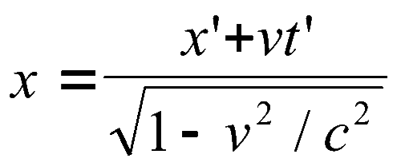
His theories of relativity led to entirely new ways of thinking about time, space, matter, energy, and gravity.
Einstein`s work led to such scientific advances as the control of atomic energy and to some of the investigations of space.

Slide 4
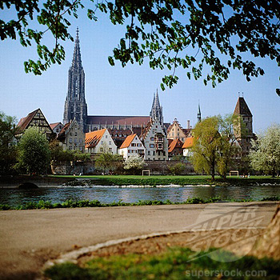
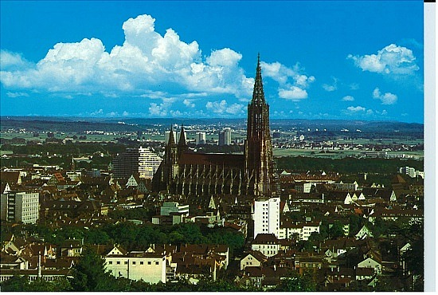
Einstein was born in Ulm, Germany, on March 14, 1879, of Jewish parents.
He was shy and curious child.
Ulm, Germany

Slide 5
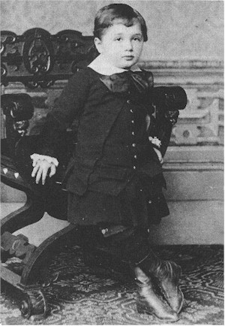
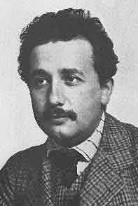
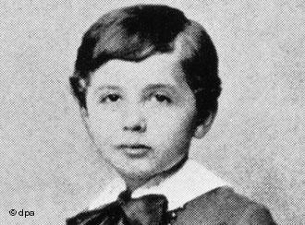
He attended a Munich elementary school where he showed an interest in science and mathematics but did poorly in other areas of study.
He finished high school and Technical College in Switzerland.

Slide 6
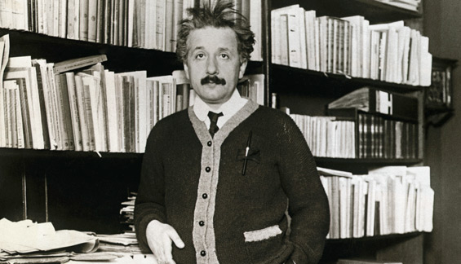
In 1905, at the age of 26, he published five major research papers in an important German physics journal.
He received doctorate for the first paper.

Slide 7
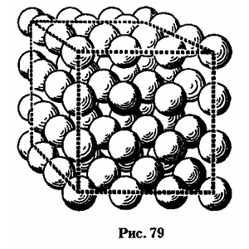
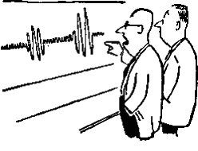
Publication of the next four papers forever changed mankind`s view of the universe.
One of his papers laid the foundation for the photon, or quantum, theory of light.
Hjgfj,gh,kg,

Slide 8
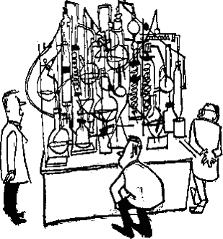
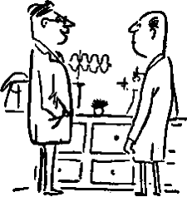
In his works Einstein showed that time and motion are relative to the observer, if the speed of light is constant and natural laws are the same everywhere in the universe.

Slide 9
Television and other inventions are practical applications of Einstein`s discoveries.

Slide 10
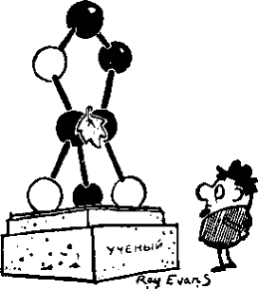
His fourth paper was a mathematical addition to the special theory of relativity.
In 1916 Einstein published his general theory of relativity.
fjyf
Fjhf,kjkgj

Slide 11
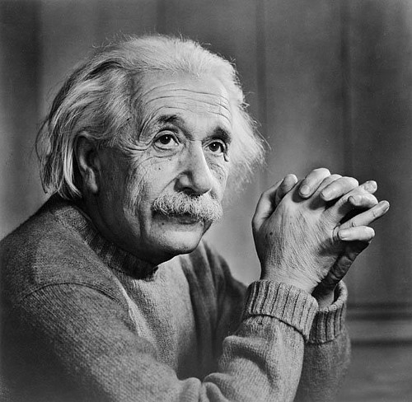
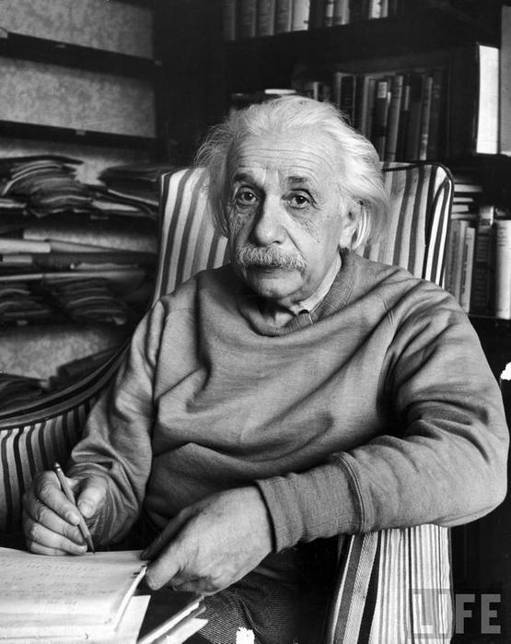
World-wide fame came to him in 1919 when the Royal Society of London announced that his general theory of relativity had been confirmed.

Slide 12
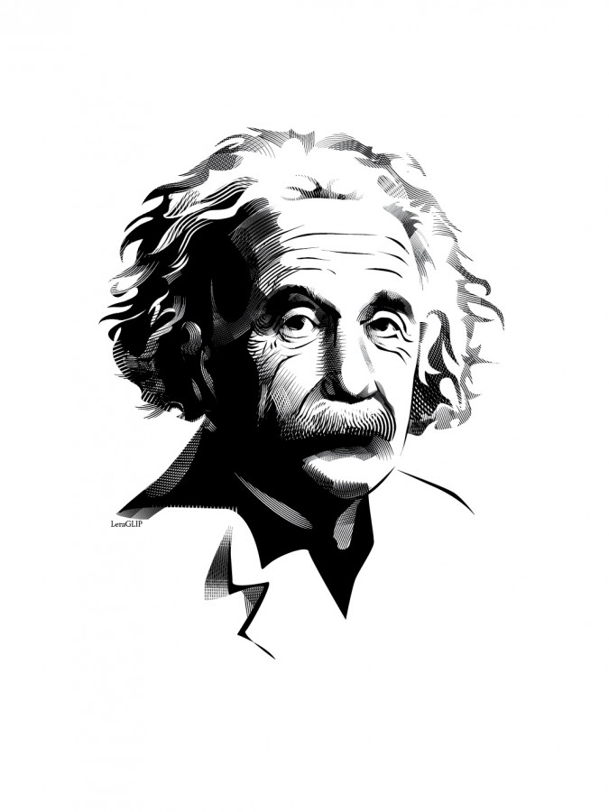
Einstein died in Princeton, on April 18, 1955.

