Slide 1
Hurdy gurdy
Tsabevskaya, 10-c

Slide 2
Description
The hurdy gurdy is a stringed musical instrument that produces sound by a crank-turned wheel rubbing against the strings. Melodies are played on a keyboard that presses small buttons (typically made of wood) against one or more of the strings to change their pitch. Like most other acoustic stringed instruments, it has a sound board to make the vibration of the strings audible.

Slide 3
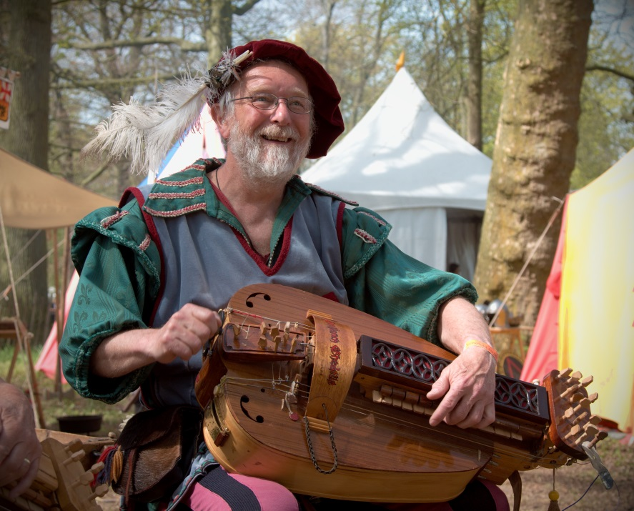
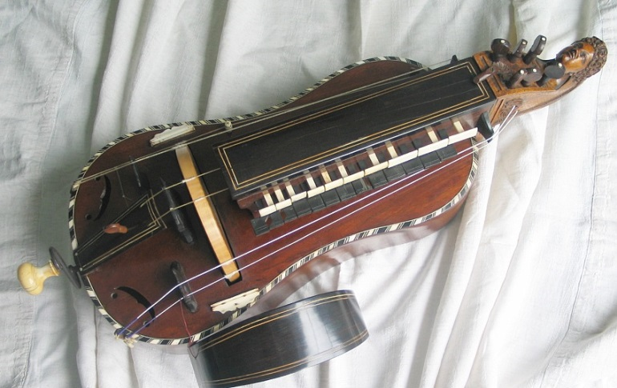
The Photos of hurdy gurdy

Slide 4
The places of hurdy gurdy
The hurdy-gurdy has a well-developed tradition in Eastern Europe, in particular in Hungary, Poland, Belarus and Ukraine. In Ukraine it is known as the lira or relia. It was and still is played by professional, often blind musicians known as lirnyky. Their repertoire is primarily para-religious in theme, most of which can trace its origins to works composed in the Baroque period. In Eastern Ukraine the repertoire includes unique historic epics known as dumy and folk dances.

Slide 5
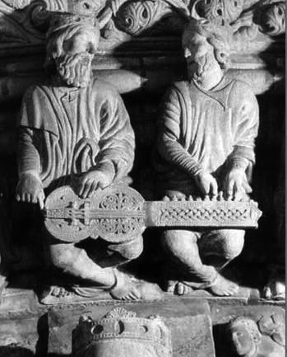

The sound of hurdy gurdy

Slide 6


