Slide 1
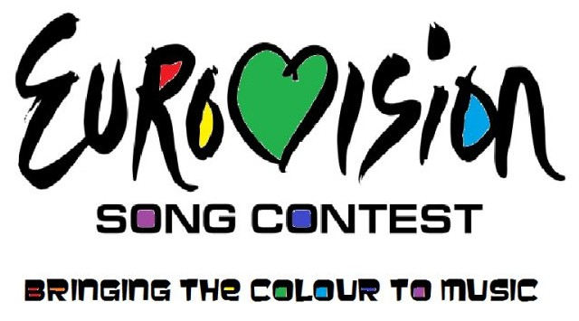
Eurovision Song Contest
IRELAND

Slide 2
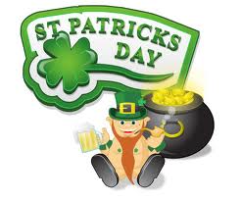
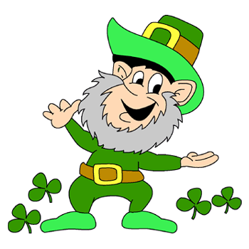
Something which
is familiar to Everybody
1. Capital –Dublin;
2. Square – 70200 sq. km.;
3. Population – 4 487 000;
4. Official Languages – English and Irish.

Slide 3
?

Slide 4
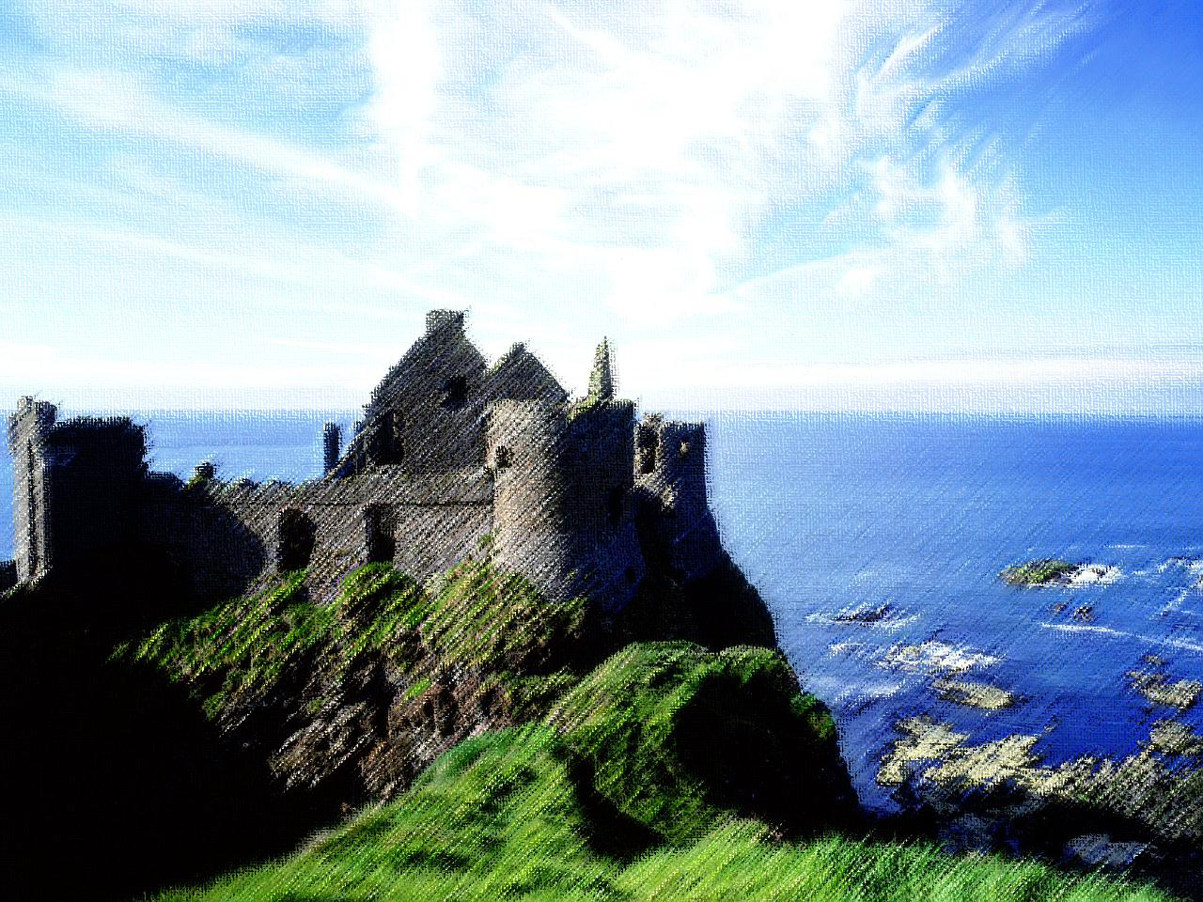
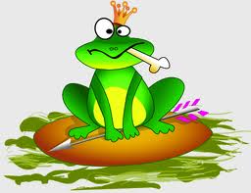
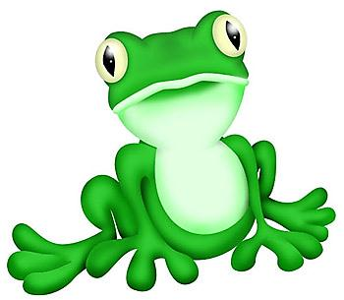
1.
The other side of Ireland
An old Irish remedy for stomach ache - to swallow a live frog.

Slide 5
2.
Tа cion
agam ort!!!

Slide 6
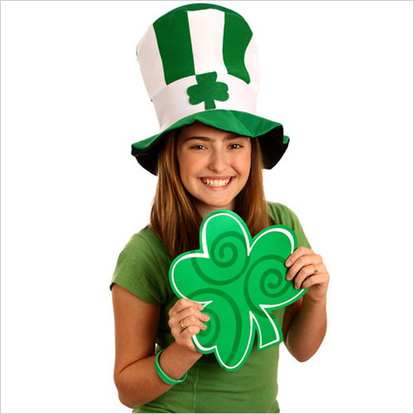
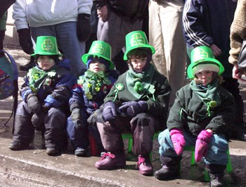
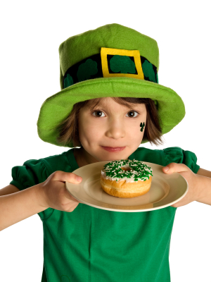
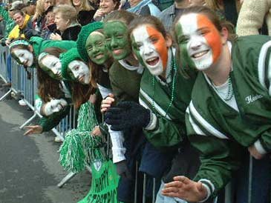
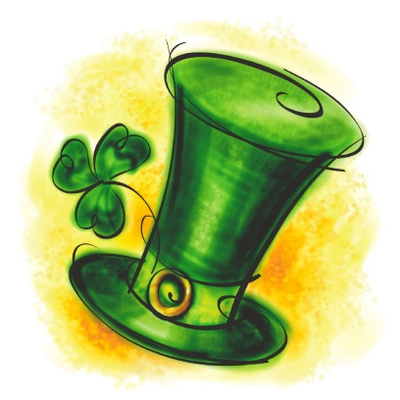
ST. PATRICK’S DAY
3.

Slide 7
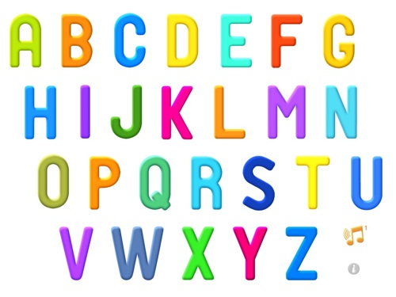
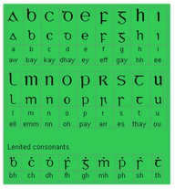
4.
J, K, Q, V
W, X, Y, Z

Slide 8
IRELAND
DESTINATION CALABRIA
LILIYA KOROTKOVA
EKATERINA BORODINA

