Slide 1
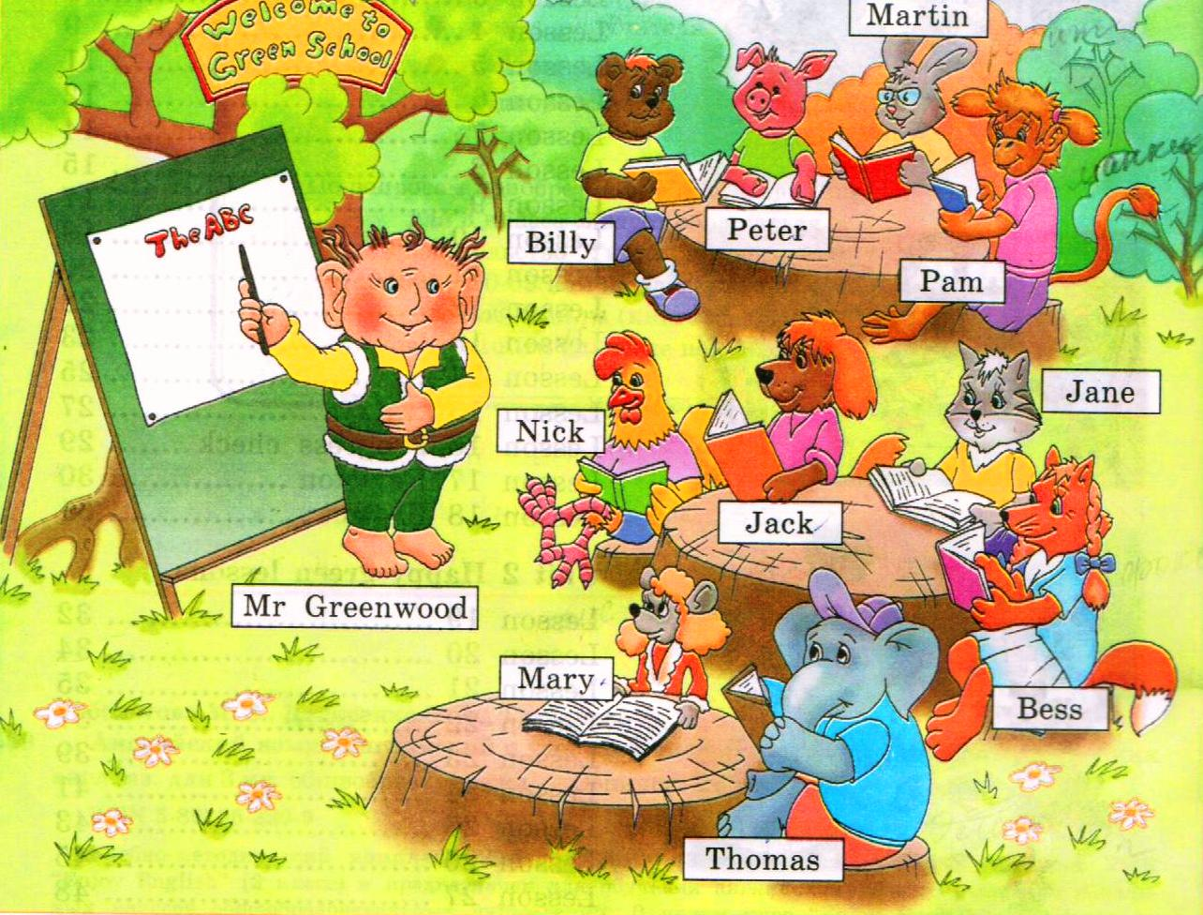
Welcome to Green School
Пантелеева Ольга Юрьевна
учитель английского языка
ГБОУ СОШ «Школа здоровья» № 404

Slide 2
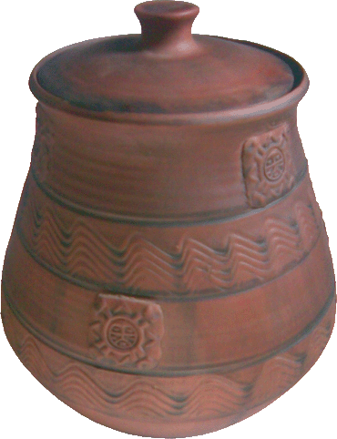
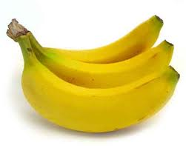
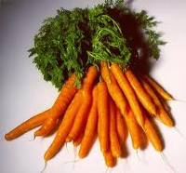
What do our pupils like to eat at breakfast ?
Billy likes
Pam likes
Martin likes

Slide 3
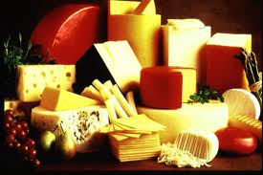
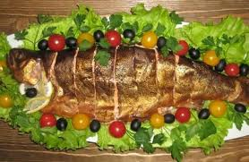
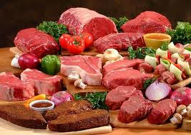
What do our pupils like to eat at breakfast ?
Mary likes
Jane likes
Jack likes

Slide 4
Let’s have a rest!
We are pupils of Green school!
We can jump!
We can run!
We can swim in the pool!

Slide 5
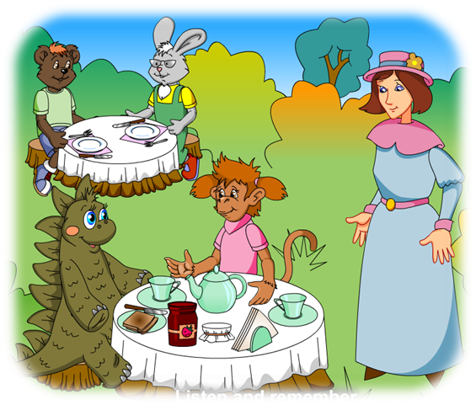
Make a dialogue, please!
-Would you like some..?
-Yes, please/ No, thank you.
-Here you are.
-Thank you.
-May I have some …, please?
- Help yourself!
- Thank you.
- You are welcome.

Slide 6
Sing a song
I will eat all my vegetables...Yum, yum yum I will eat all my vegetables...Yum, yum yum I will eat all my vegetables...Yum, yum yum Vegetables are good for me!
Carrots, celery, cauliflower, Vegetables give my body power.

