Slide 1
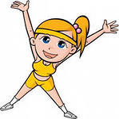
Sport in Our Life
A sound mind in a sound body.

Slide 2
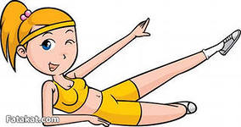
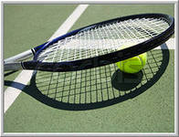
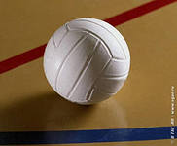
I think that sport is the key to health.

Slide 3
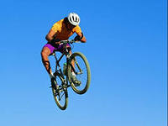
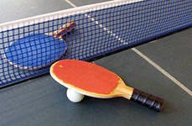
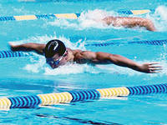
People all over the world are fond of sports and games. Sport makes people healthy, keeps them fit, more organized and better disciplined. It unites people of different classes and nationalities. Many people do sports on their personal initiative. They go in for skiing, skating, table tennis, swimming, volley-ball, football, body-building, etc.

Slide 4
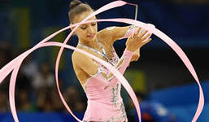
Practically all kinds of sports are popular in our country, but football, gymnastics and tennis enjoy the greatest popularity.

Slide 5
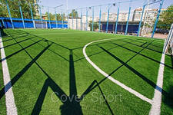
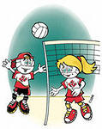
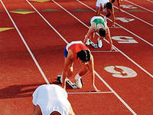
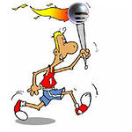
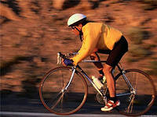
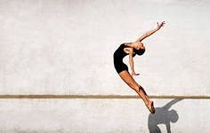
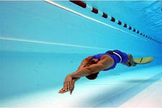

Slide 6
Exercise and be happy!

