Slide 2
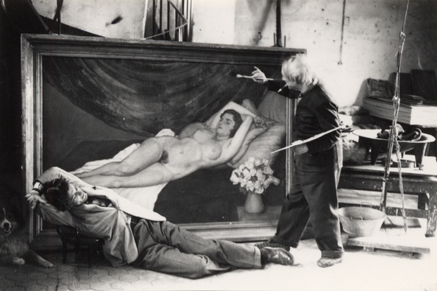
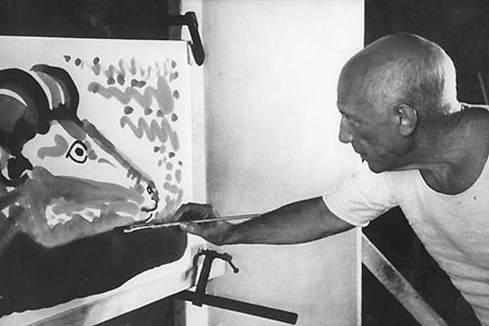
Pablo Picasso was born on October 25th, 1881. He was a Spanish painter, craftsman, and sculptor.

Slide 3
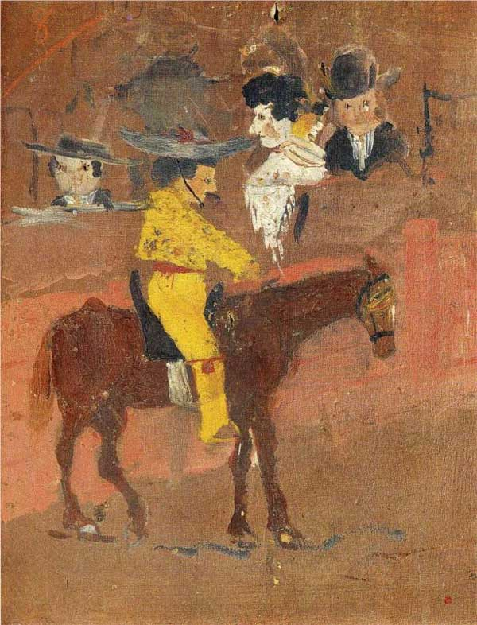
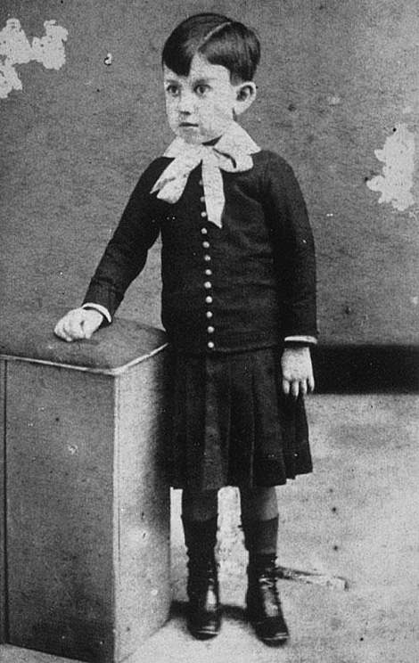
Picasso showed his truly exceptional talent from a very young age. His first word was lapiz(Spanish for pencil) and there was no stopping him. He learned to draw before he could talk.
The yellow picador. 1889

Slide 4
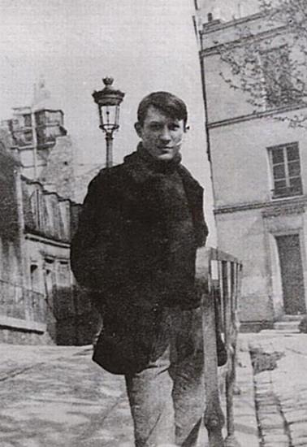
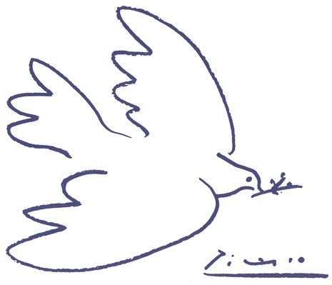
His father was an amateur artist. When he saw how beautifully Pablo completed a picture of their pigeons, he learned to draw.

Slide 5
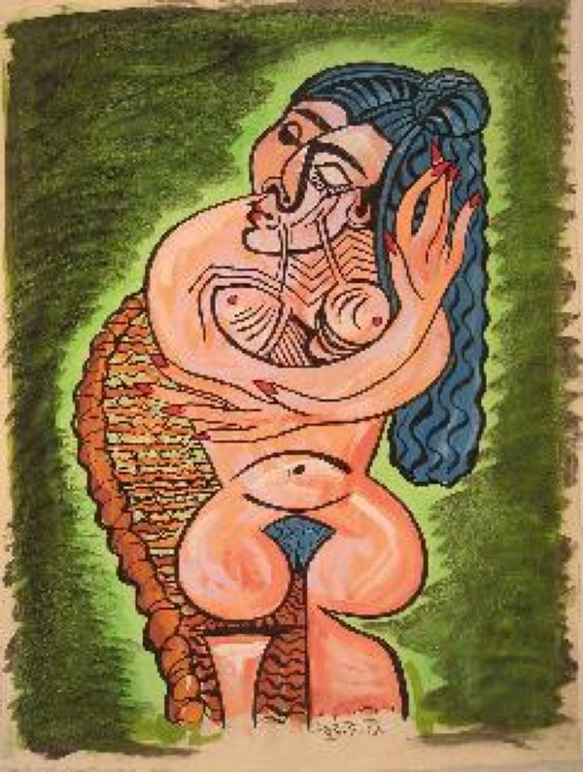
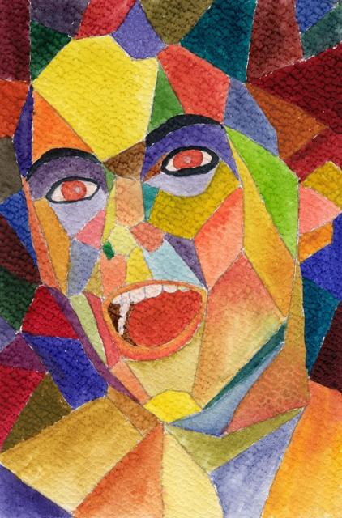
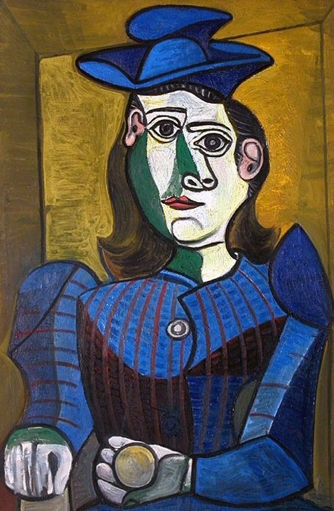
Picasso demonstrated the uncanny artistic talent in his early years, painting in a realistic manner through his childhood adolescence. During the first decade of the twentieth century his style changed as he experimented with different theories, techniques, and ideas.

Slide 6
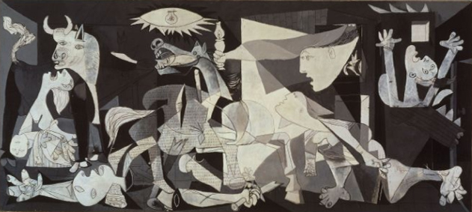
He is best known for his Cubist pictures which used only simple geometric shapes. Guernica painted 1937 is undisputedly one of the masterpieces of modern painting. It records the German bombing of Guernica during the Spanish Civil War. Picasso creates over 6,000 paintings, drawings and sculptures. Today a "Picasso" costs several million pounds.

Slide 7
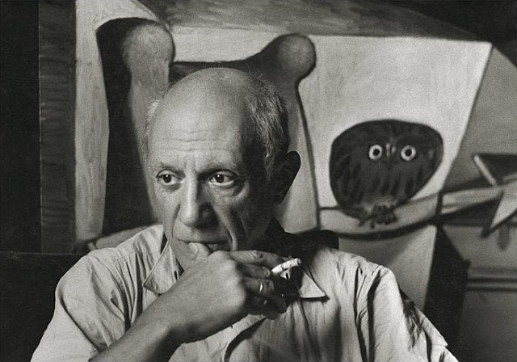
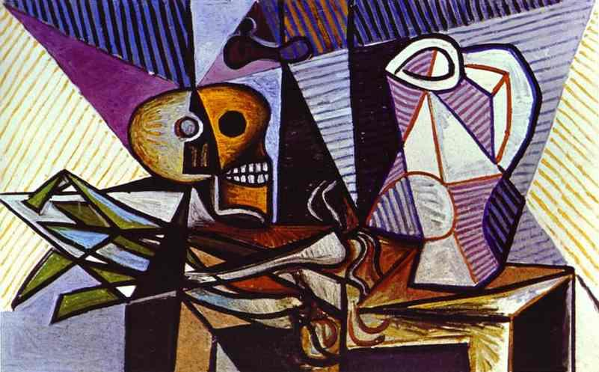
Pablo Picasso died of a heart failure on April 8^{th,} 1973 in France.

