Slide 1
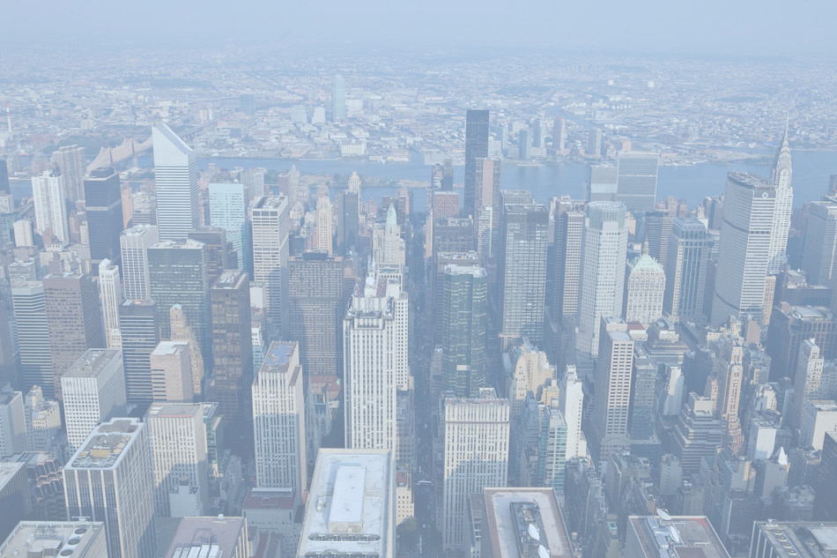
New York City

Slide 2
New York City
is the most populous city in the United States and the center of the New York Metropolitan Area, one of the most populous metropolitan areas in the world.

Slide 3
The five boroughs— The Bronx, Brooklyn, Manhattan, Queens, and Staten Island —were consolidated into a single city in 1898.

Slide 4
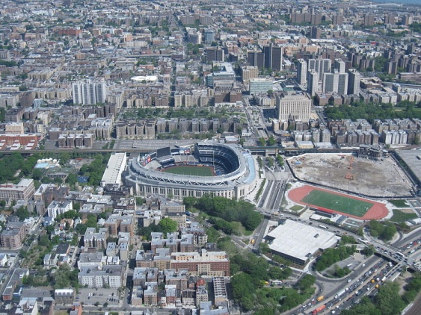
The five boroughs— The Bronx, Brooklyn, Manhattan, Queens, and Staten Island —were consolidated into a single city in 1898.

Slide 5
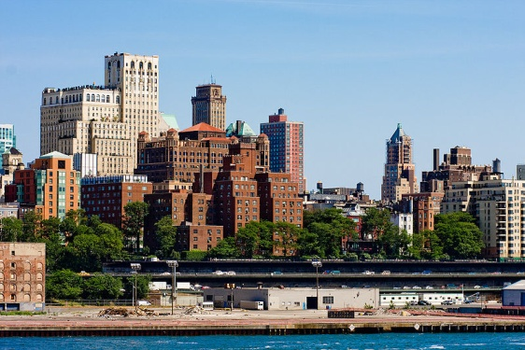
The five boroughs— The Bronx, Brooklyn, Manhattan, Queens, and Staten Island —were consolidated into a single city in 1898.

Slide 6
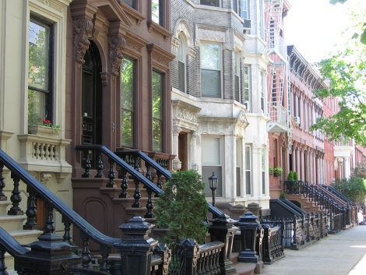
The five boroughs— The Bronx, Brooklyn, Manhattan, Queens, and Staten Island —were consolidated into a single city in 1898.

Slide 7
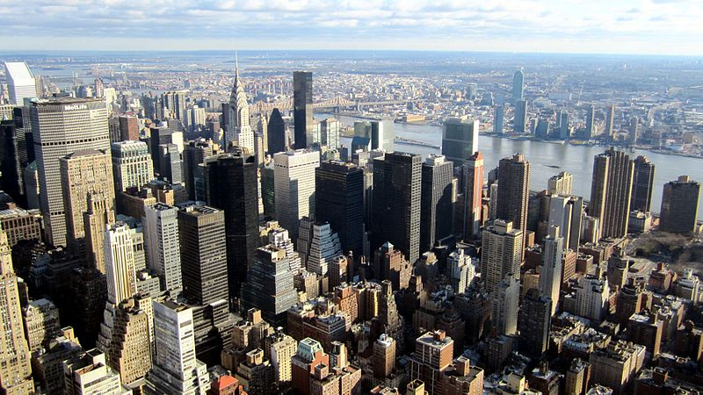
The five boroughs— The Bronx, Brooklyn, Manhattan, Queens, and Staten Island —were consolidated into a single city in 1898.

Slide 8
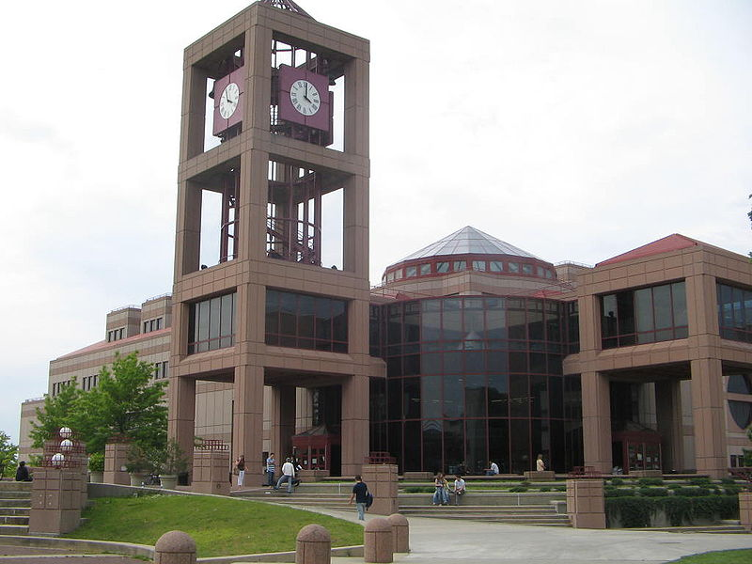
The five boroughs— The Bronx, Brooklyn, Manhattan, Queens, and Staten Island —were consolidated into a single city in 1898.

Slide 9
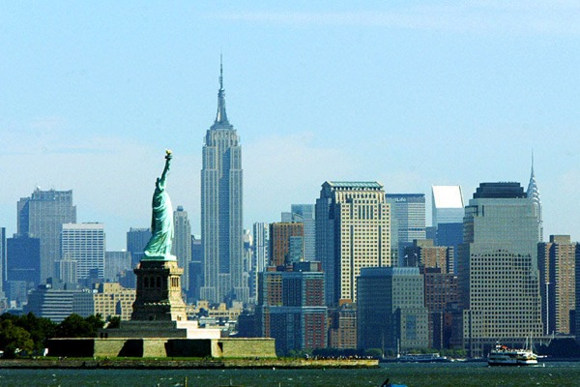
The five boroughs— The Bronx, Brooklyn, Manhattan, Queens, and Staten Island —were consolidated into a single city in 1898.

Slide 10
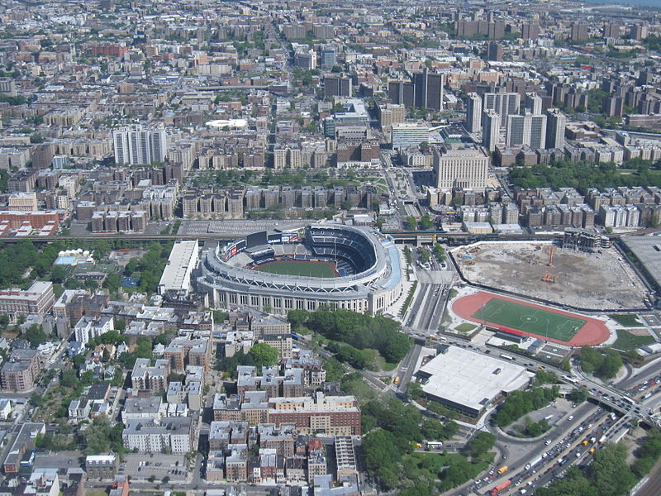
The Bronx

Slide 11
Brooklyn

Slide 12
Brooklyn

Slide 13
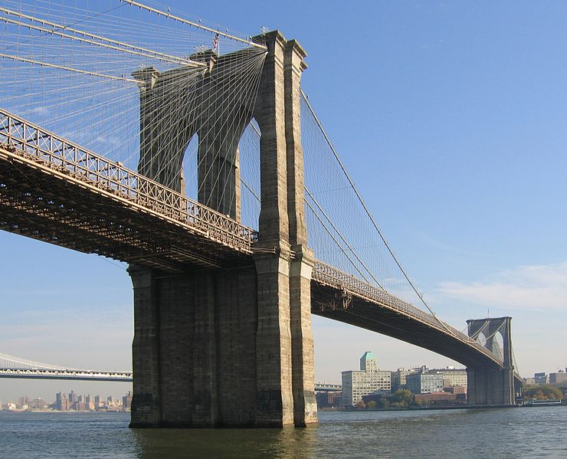

Slide 14
View of Brooklyn Bridge and Downtown Brooklyn

Slide 15
Manhattan

Slide 16
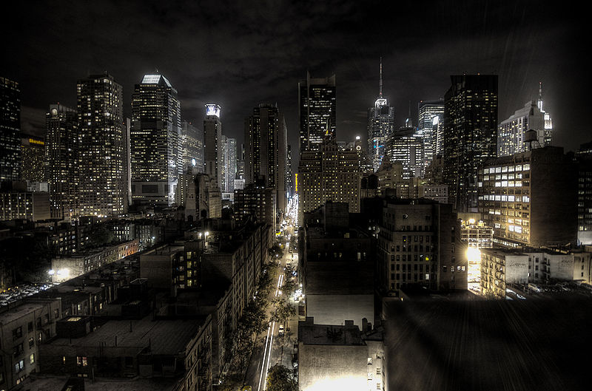
Night view of Manhattan

Slide 17
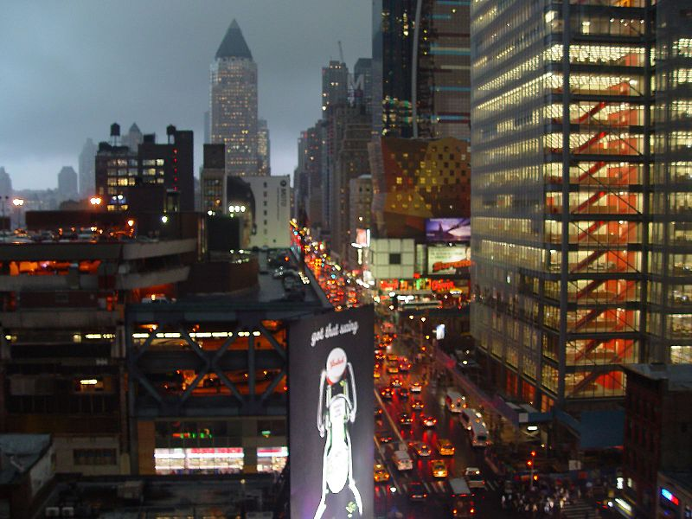
Rain in Midtown Manhattan

Slide 18
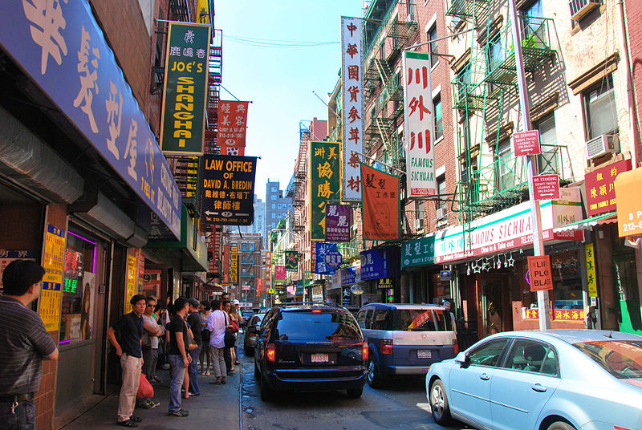
Chinatown,Manhattan

Slide 19
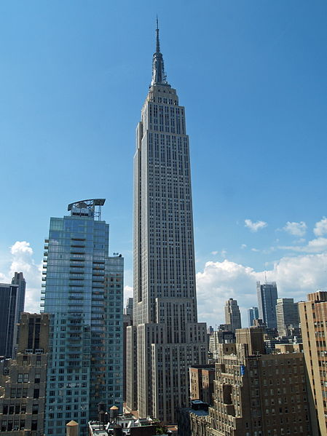

Slide 20
The Empire State Building was the world's tallest building from 1931 to 1972, and was once again the tallest building in the city, from September 11, 2001 until April 29, 2012

Slide 21
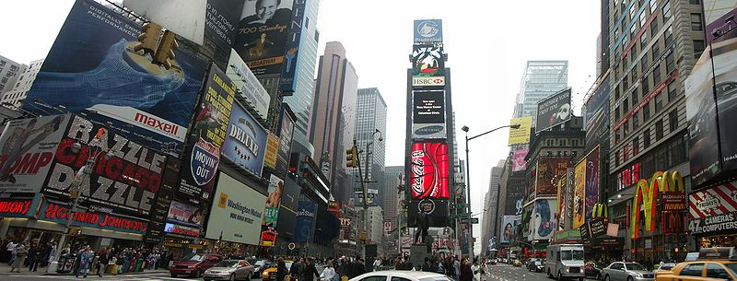
Times Square, a major cultural venue in the city

Slide 22
Times Square, a major cultural venue in the city

Slide 23
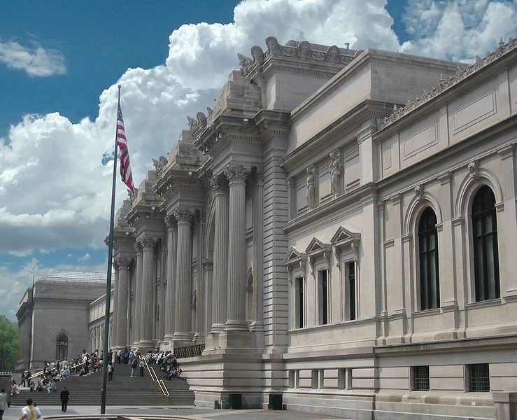
The Metropolitan Museum of Art

Slide 24
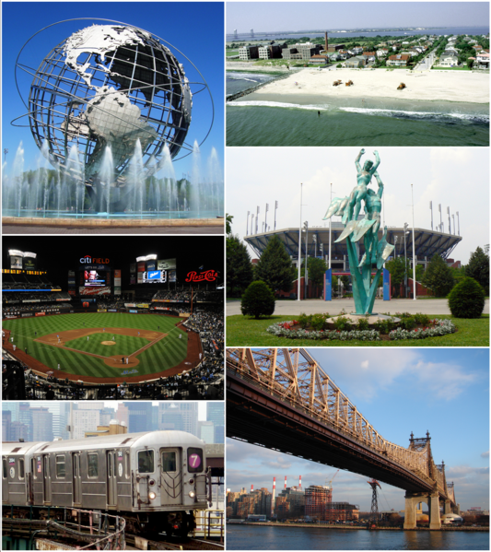
Queens

Slide 25
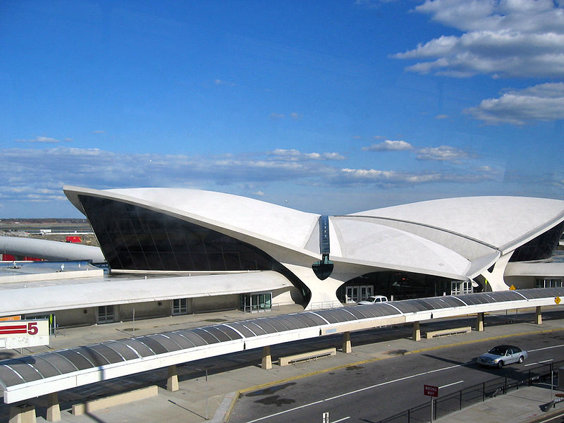
TWA Flight Center at John F. Kennedy International Airport

Slide 26
Queens College is part of the City University of New York.

Slide 27
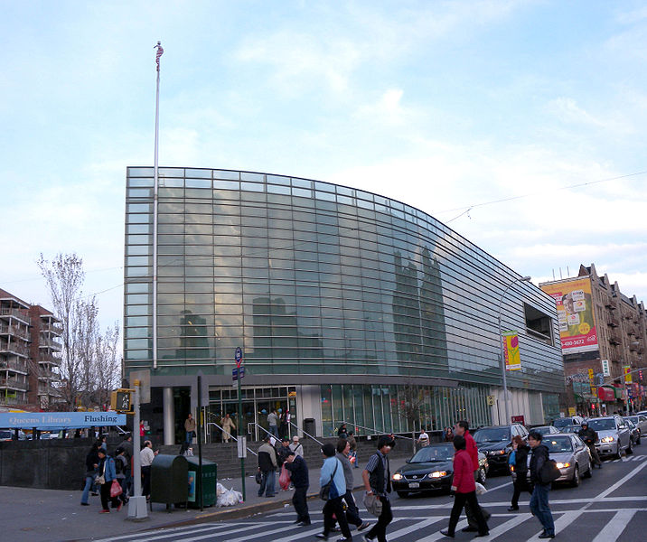
Queens Library in Flushing Chinatown

Slide 28
Staten Island

Slide 29
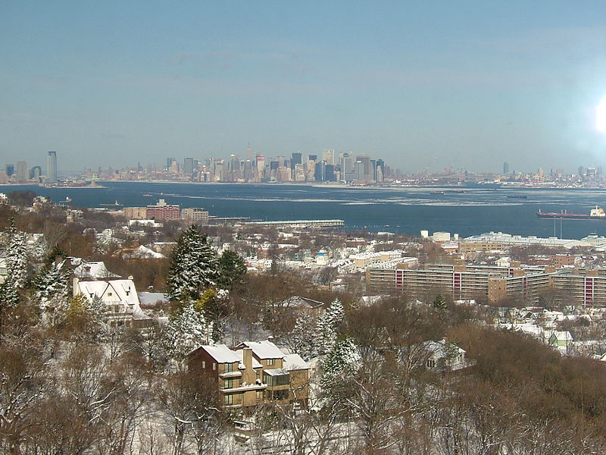
Jersey City, The Statue of Liberty, Lower Manhattan, and Downtown Brooklyn as seen from Northeast Staten Island.

Slide 30
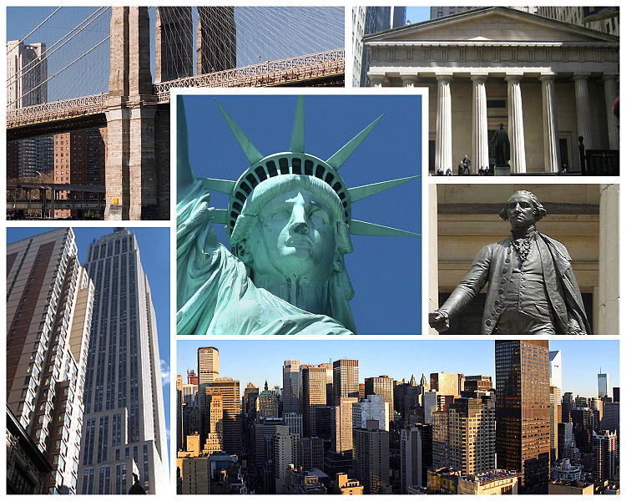
And a little bit about interesting places...

Slide 31
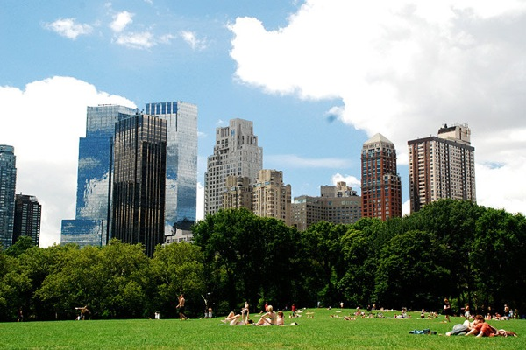
Summer in the city, Central Park

Slide 32
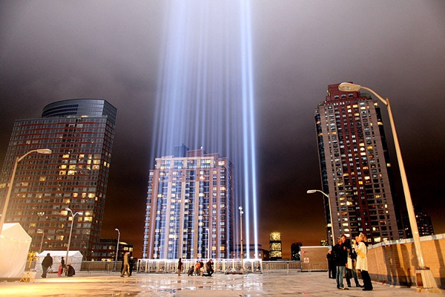
«Ground Zero»

Slide 33
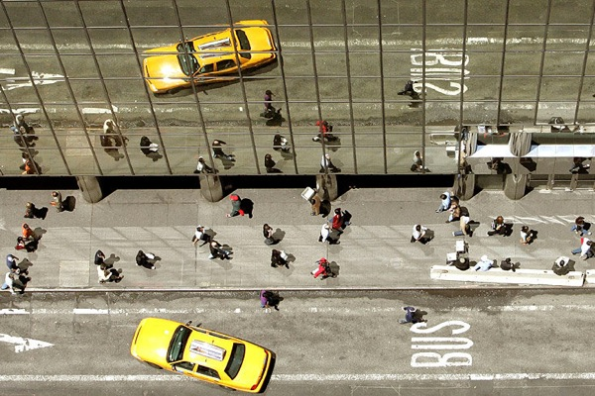
Yellow Cab

Slide 34
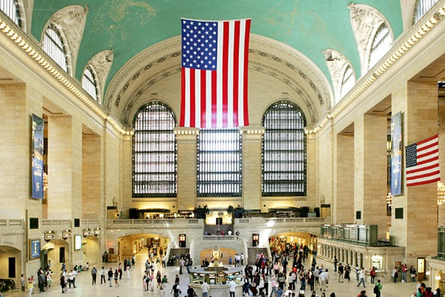
Grand Central Terminal

Slide 35
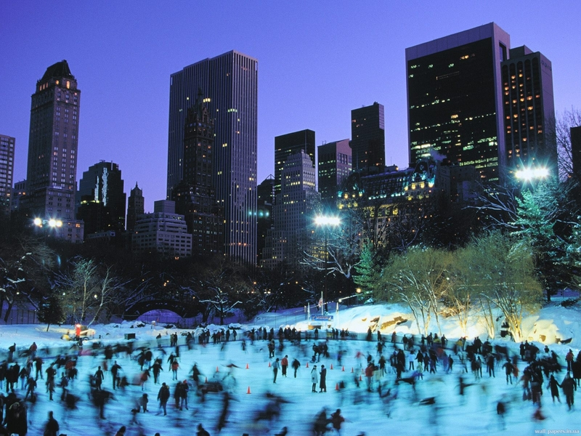
Skating Rink in Central Park

Slide 36
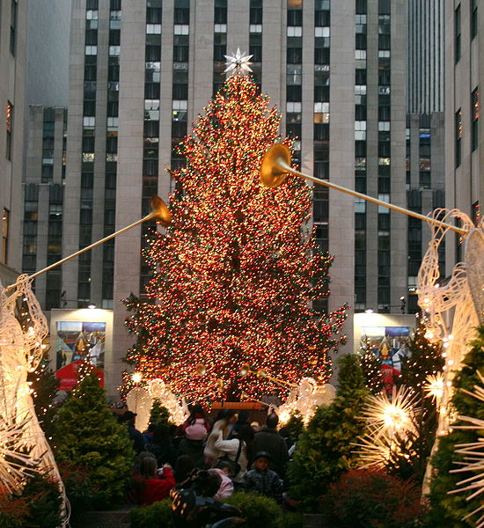
Christmas at Rockefeller Center

Slide 37
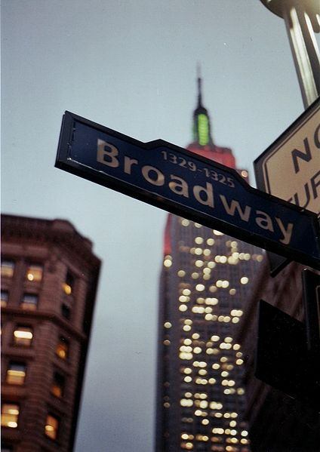
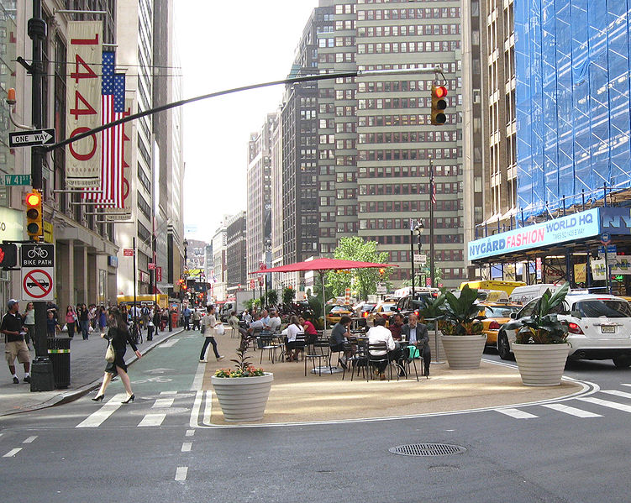
Broadway, a main street in New York City

Slide 38
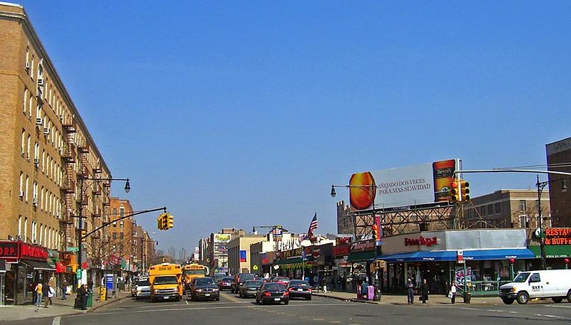
Broadway, a main street in New York City

Slide 39
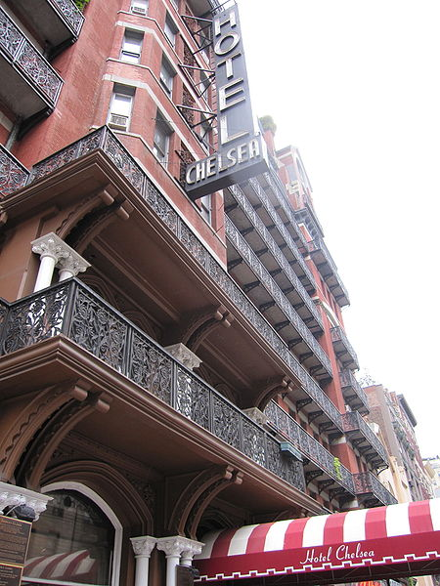
Hotel Chelsea

Slide 40
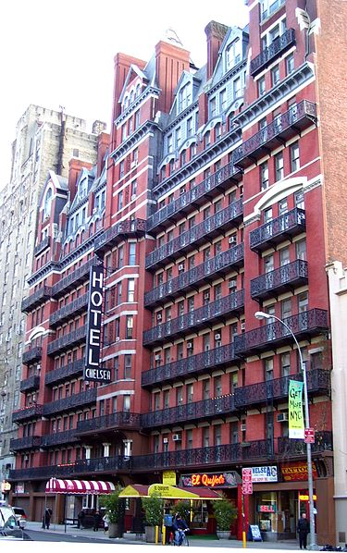
Hotel Chelsea

Slide 41
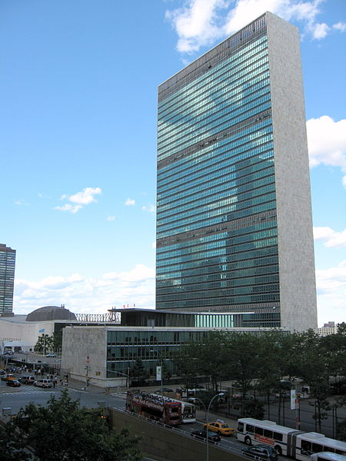
United Nations Headquarters

Slide 42
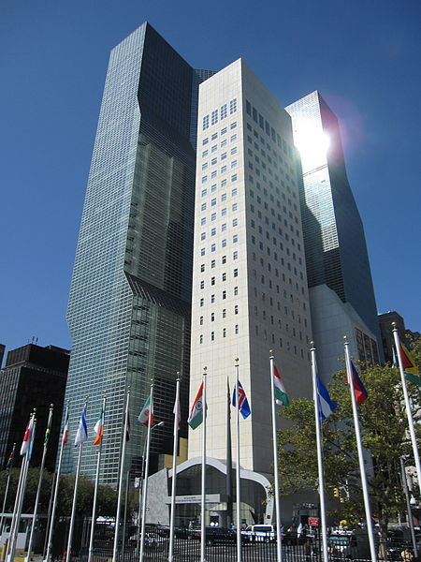
United Nations Headquarters

Slide 43
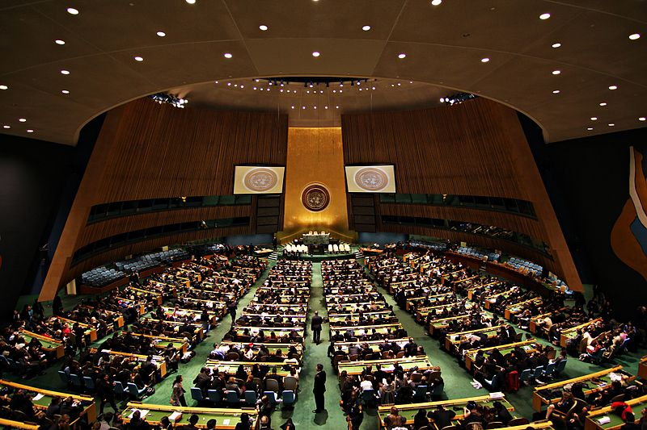
United Nations Headquarters

Slide 44
List of people from New York

Slide 45
List of people from New York
Scarlett Johansson
an American actress, model
and singer

Slide 46
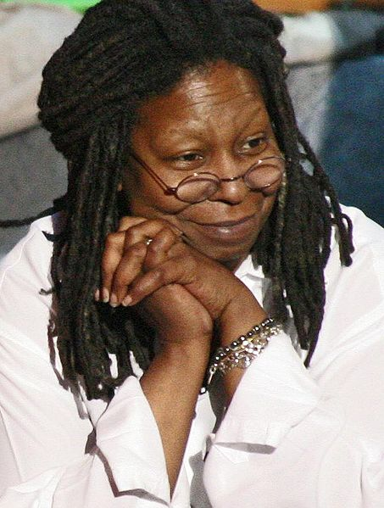
List of people from New York
Whoopi Goldberg
an American comedian, actress,
singer-songwriter, political
activist, author and talk show host

Slide 47
List of people from New York
Anne Hathaway
an American actress

Slide 48
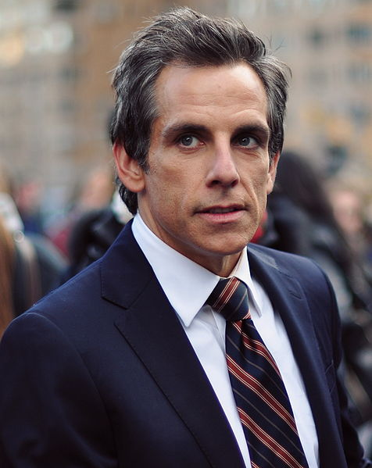
List of people from New York
Ben Stiller
an American comedian, actor, voice actor, screenwriter, film director, and producer

Slide 49
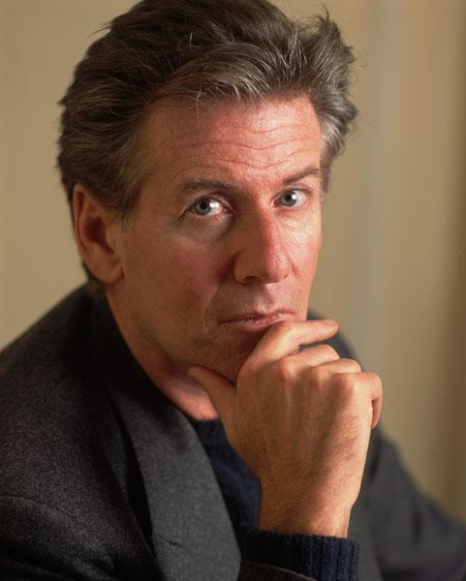
List of people from New York
Calvin Klein
an American fashion designer

Slide 50
Films about New York

Slide 51
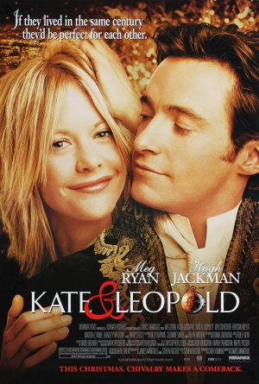
Films about New York

Slide 52
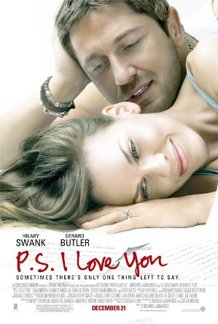
Films about New York

Slide 53
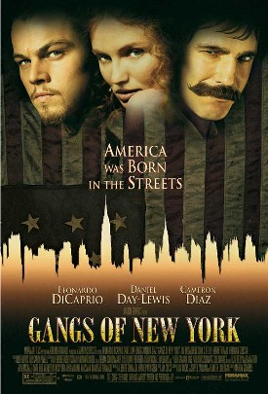
Films about New York

Slide 54
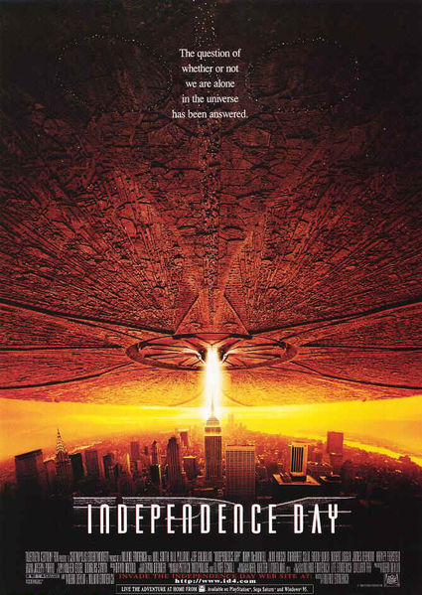
Films about New York

Slide 55
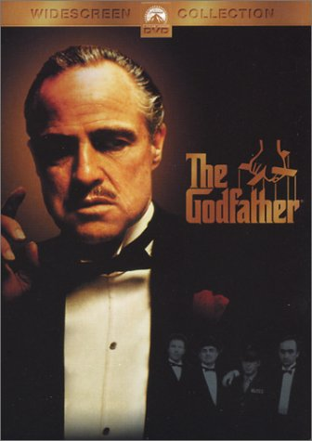
Films about New York

Slide 56
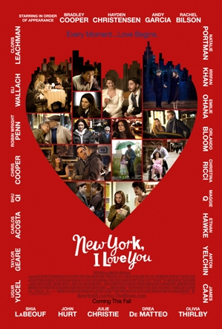
Films about New York

Slide 57
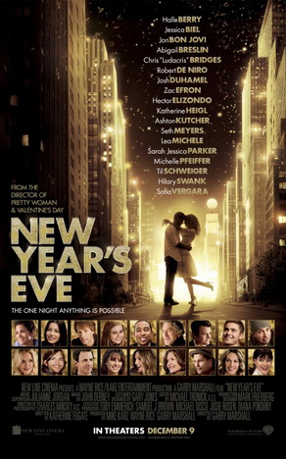
Films about New York

Slide 58
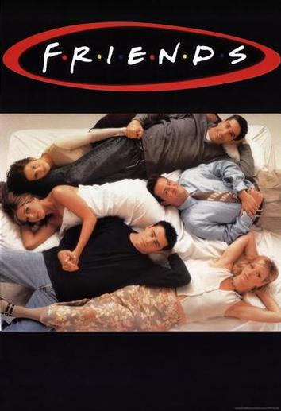
Films about New York

Slide 59
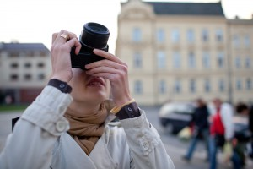
Hopefully, we can visit this vibrant city once.

