Slide 1
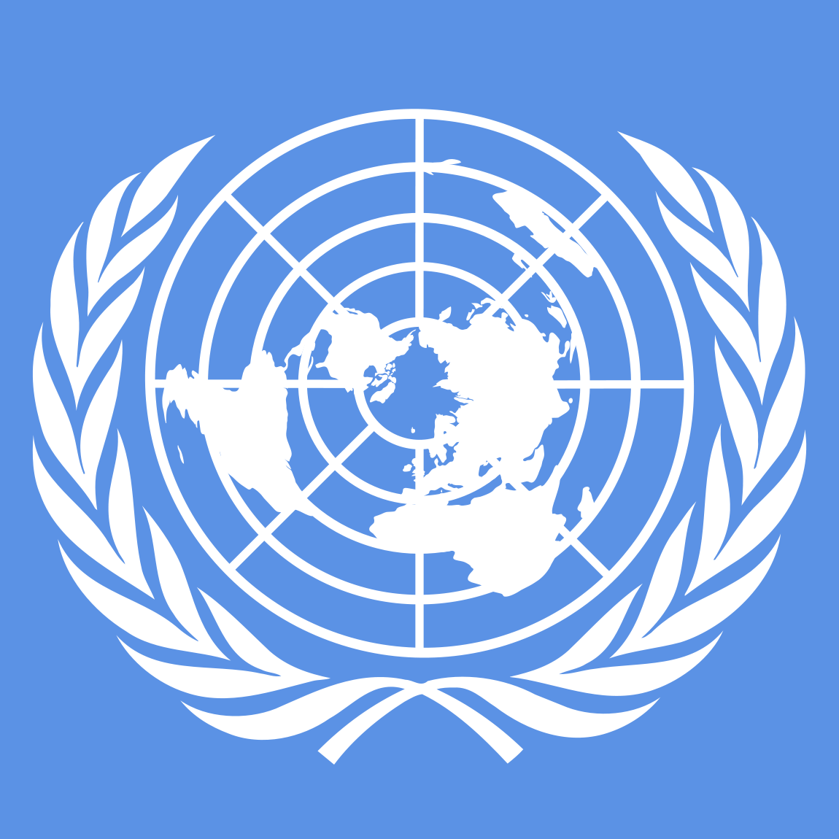
United Nations

Slide 2
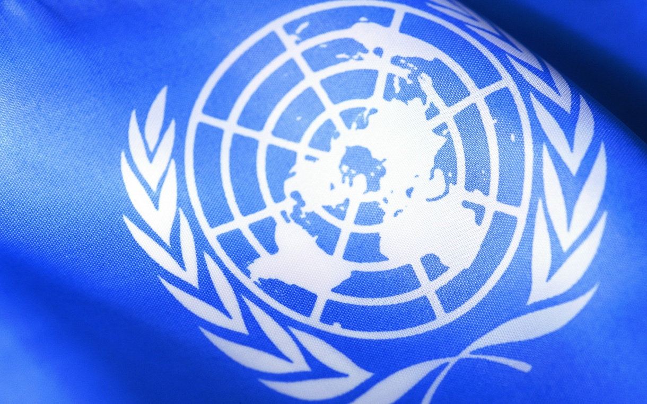
The United Nations is an international organization created to maintain and strengthen international peace and security, development of cooperation between states.
"The UN is the supporting structure of the international system of collective security, the main element of the modern diplomacy

Slide 3
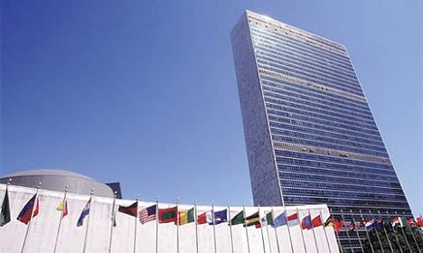
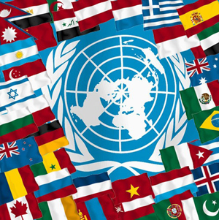
The name "United Nations" was first used in the UN Declaration, signed on January 1, 1942.
The UN Charter was approved by the San Francisco Conference, held from April to June 1945, and signed on 26 June 1945 by the representatives of 50 states.
The date of entry into force of the Charter (24 October) is celebrated as UNs Day.

Slide 4
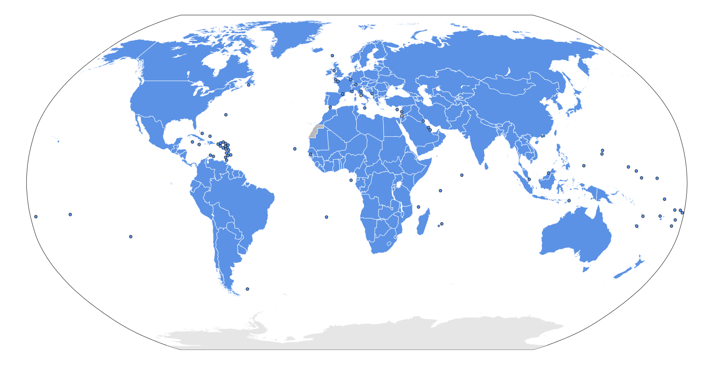
The members of UN

Slide 5
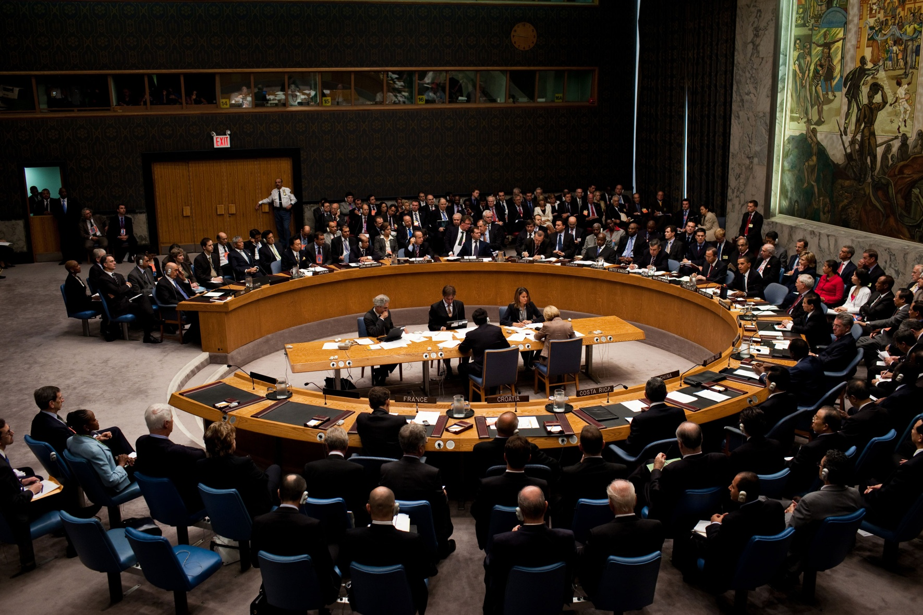
UN got the Nobel Peace Prize (2001), the award was "For contribution to creating a more organized world and peace throughout the world".

Slide 6
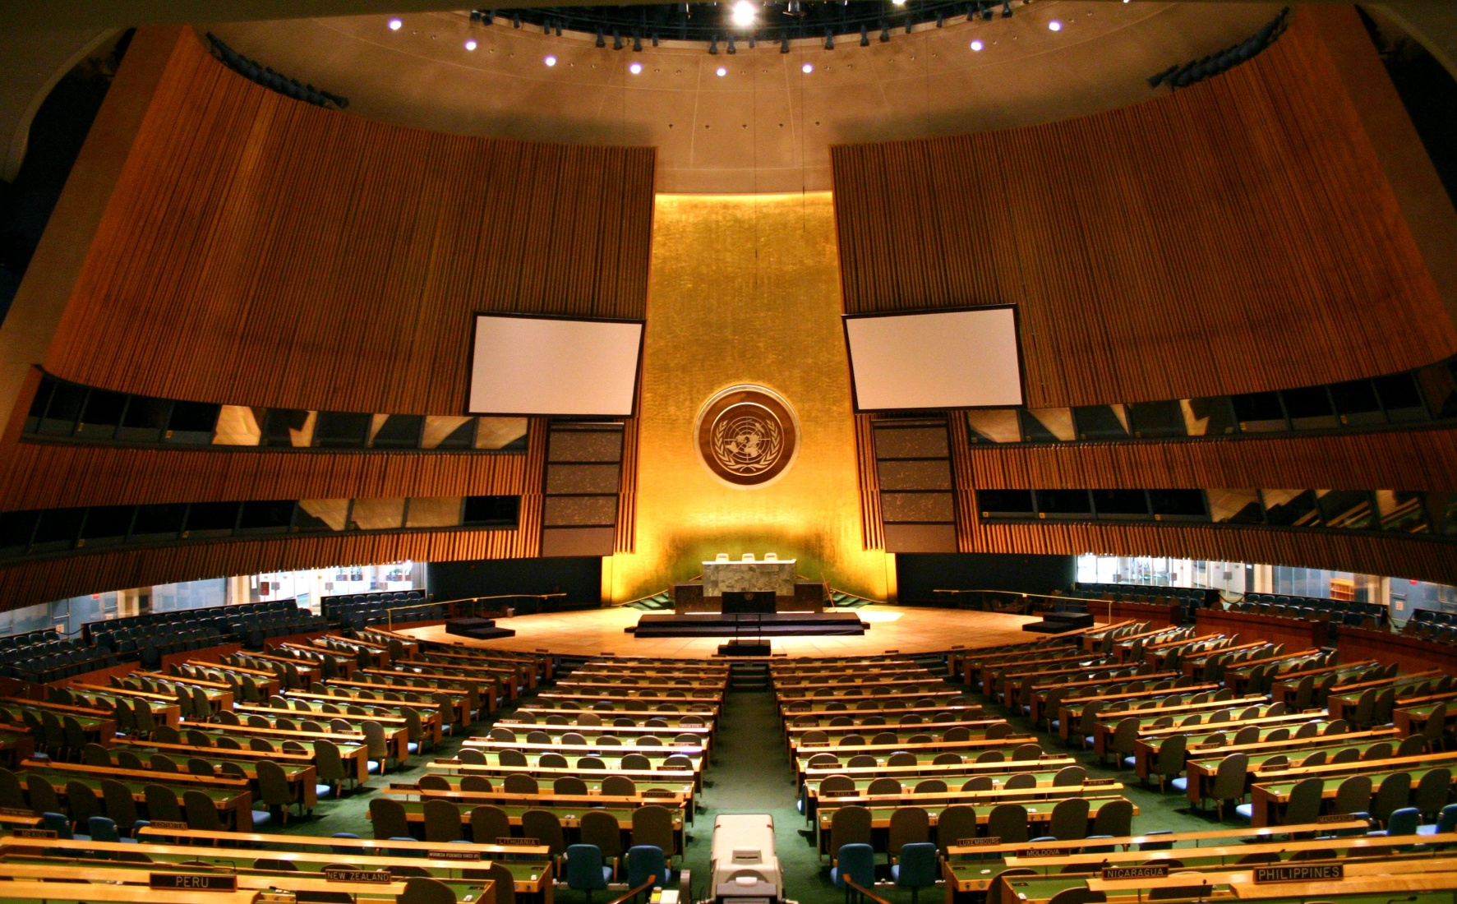
General Assembly considers the principles of cooperation in the field of international peace; elects the members of the UN Security Council, coordinates international cooperation in the social, cultural and humanitarian spheres.

Slide 7
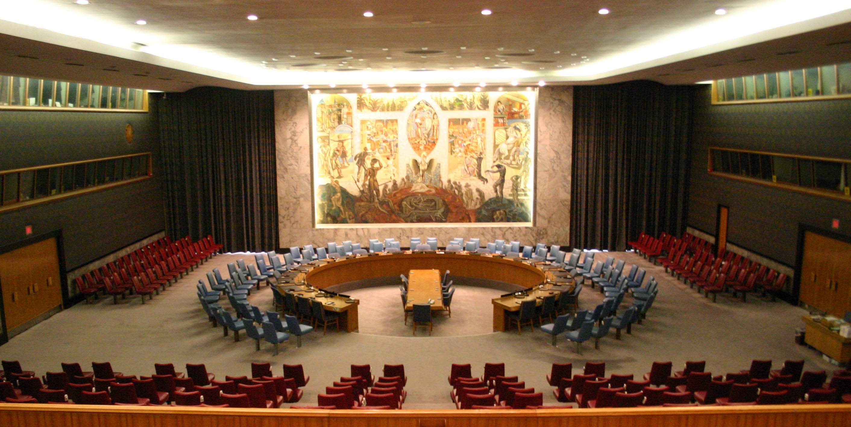
The Security Council has the primary responsibility for maintaining international peace and security. The five permanent members of the Security Council (Russia, USA, UK, France, China) have veto power .

Slide 8
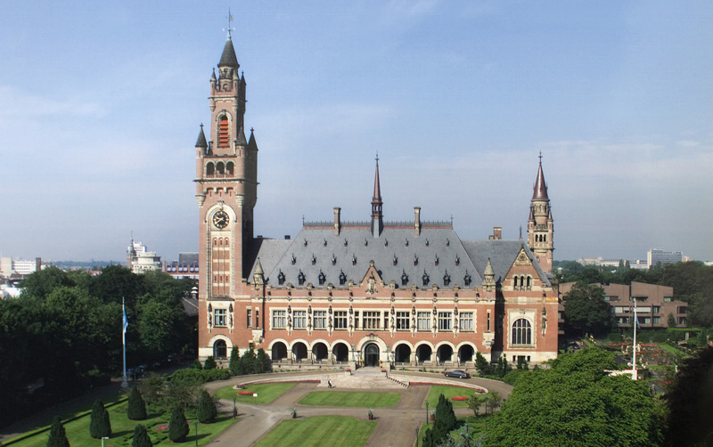
The principal judicial organ of the UN is the International Court of Justice. The Court is composed of 15 independent judges acting not as representatives of the state. They can not engage in any other occupation of a professional nature.

