Slide 1
Why go to school ?

Slide 2
Education
Education in its general sense is a form of learning in which knowledge, skills, and habits of a group of people are transferred from one generation to the next through teaching, training, research, or simply through autodidacticism.

Slide 3
Children are educated in schools.

Slide 4
School
A school is an institution designed for the teaching of students (or "pupils") under the direction of teachers .

Slide 5
What makes a school?
teaches us
educates us

Slide 6
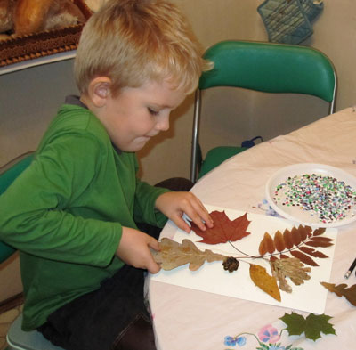
develops the ability to
reveals the talents

Slide 7
Why I Go to School?
Students share why they go to school as part of the American Graduate project focusing on the high school dropout crisis.
This collage represents why I go to school. I want to be able to afford these things. If I go to college to further my education, then I can afford the things that are in my collage. I love fashion. It's going to be my major in college and my collage represents that. Also, if I finish high school and college my mom will be very proud of me. If I finish high school and college I can prove that I can make it to those who said that I couldn’t. - Deasia, 11th grader via CET Learning Services
I go to school because my mom and dad left their wonderful lives in Haiti for me and my sister. I want to give back to them and say thank you for everything. Every day my dad and I talk about which college I will go to. I really want to be a pediatrician because I love taking care of kids. But if I am not able to do that, I have two other dreams I can follow. I want be a veterinarian or a track star. - Lynda, 8th grader
I go to school to see my friends and interact with people. I also go to school to increase my knowledge about life. Also when I graduate I want to go to the Marines and you have to graduate high school to be in the Marines. I think that the Marines would be a good way to pay for college. - Dallas, 9th grader

